Slide 1
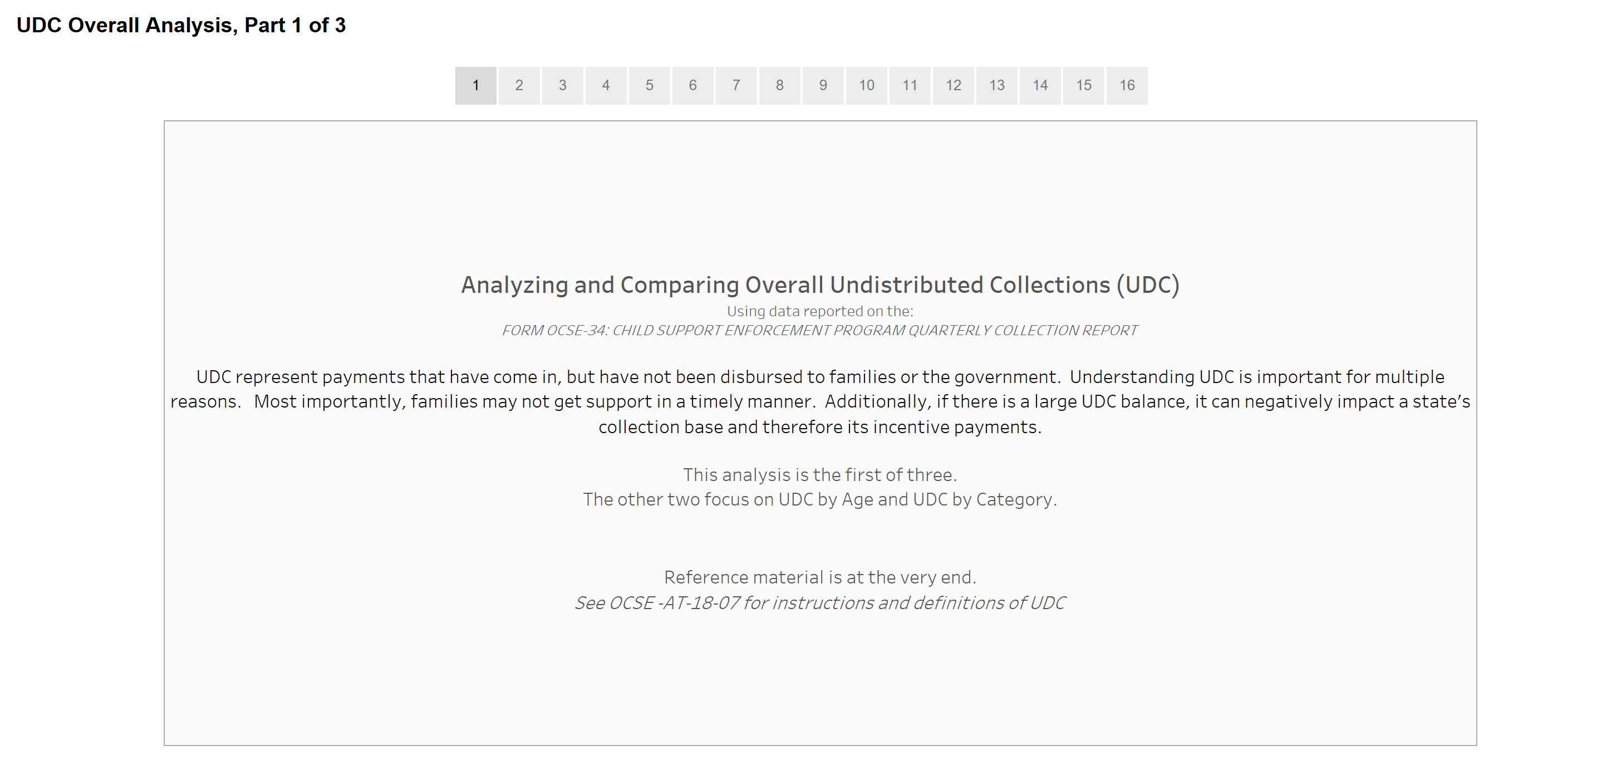
Review of Vermont’s Undistributed Child Support Collections (UDC) and relationship to issues with ACCESS

Slide 2
Vermont’s Undistributed Collections (UDC) Story
This presentation discusses UDC analyzed in three different ways:
  Overall UDC Percentage of Collections, i.e. all monies that are undistributed compared to child support collections
  UDC By Age, i.e. how long money has been undistributed, and
  UDC By Category, i.e. the various types of UDC
It compares Vermont to the national average as well as states with similar child support caseloads.
This data is taken from nationally published data by the federal Office of Child Support Enforcement, in its Annual Reports.
Vermont’s child support system, ACCESS, makes it difficult for caseworkers to identify and efficiently process UDC, leading to families who do not receive their child support in a timely manner.

Slide 3
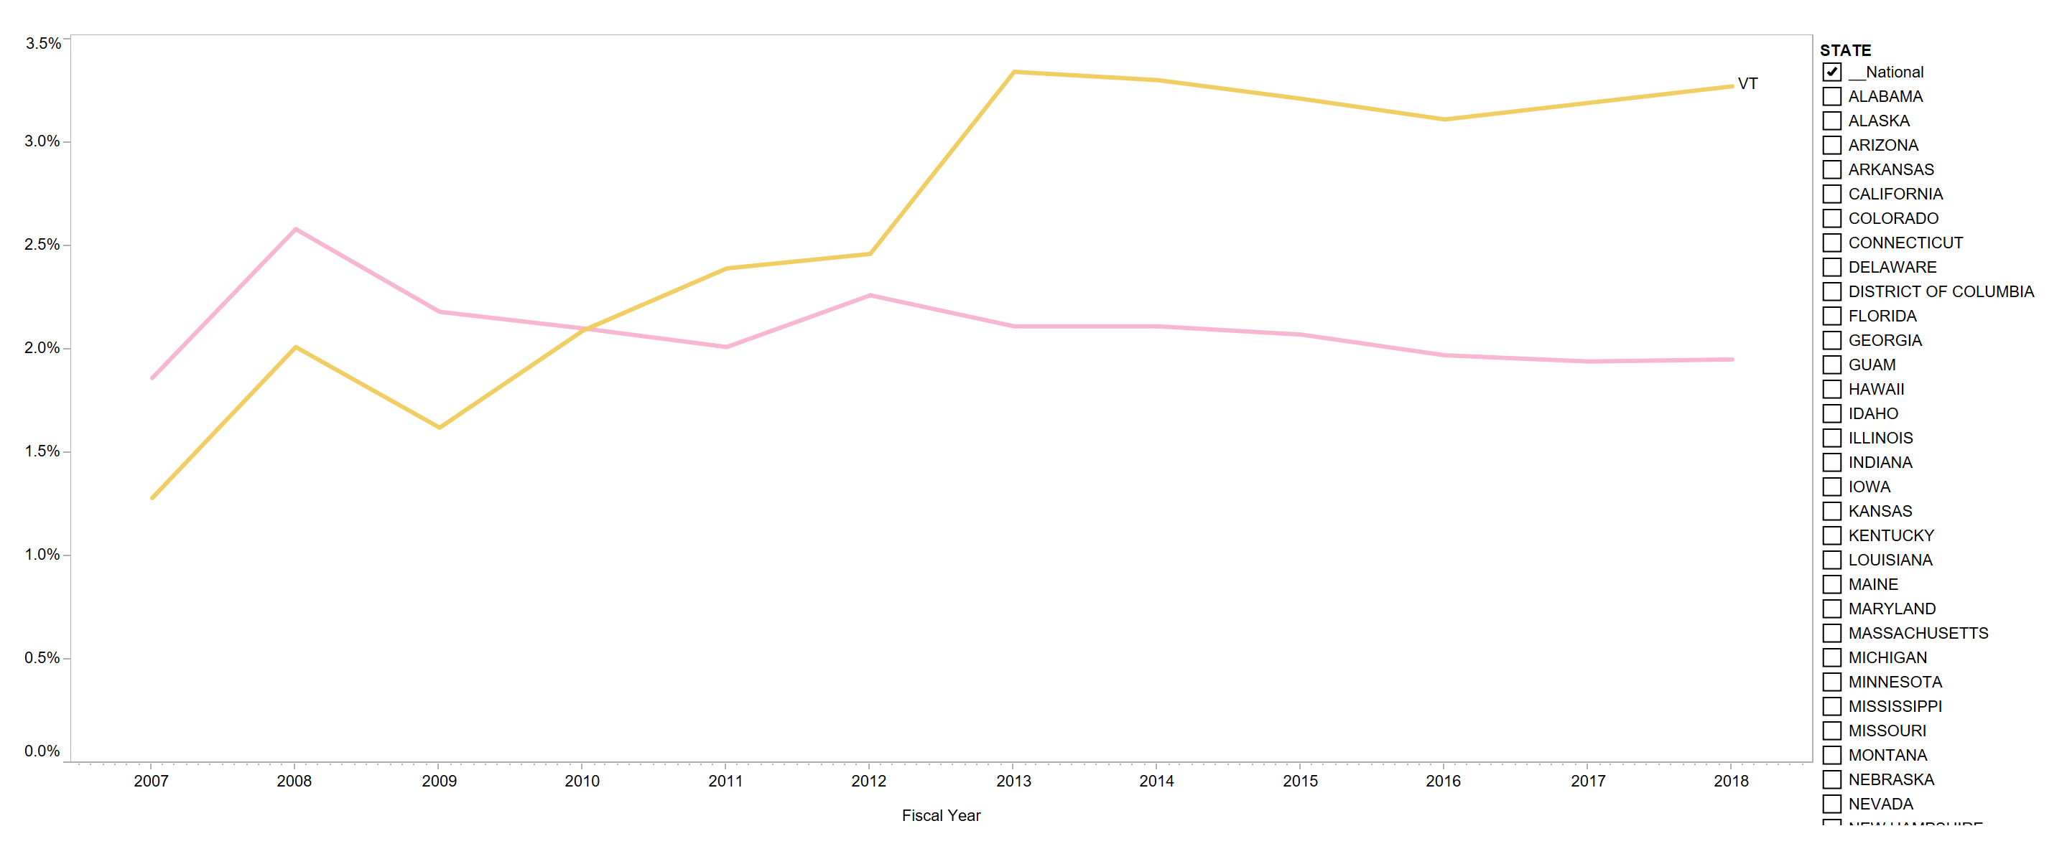
Vermont’s UDC Percentage of Collections* has been rising, compared to the national average.
Vermont’s UDC Percentage of Collections has risen from 1.3% in FFY2007 to 3.3% in FFY2018.
Nat’l
The National Average for UDC Percentage of Collections is relatively steady at 2% over time.
* “UDC Percentage of Collections” means the amount of undistributed collections in a state compared to their overall child support collections. Given the large variance in state child support caseloads and collections, this is the most meaningful way to compare states.

Slide 4
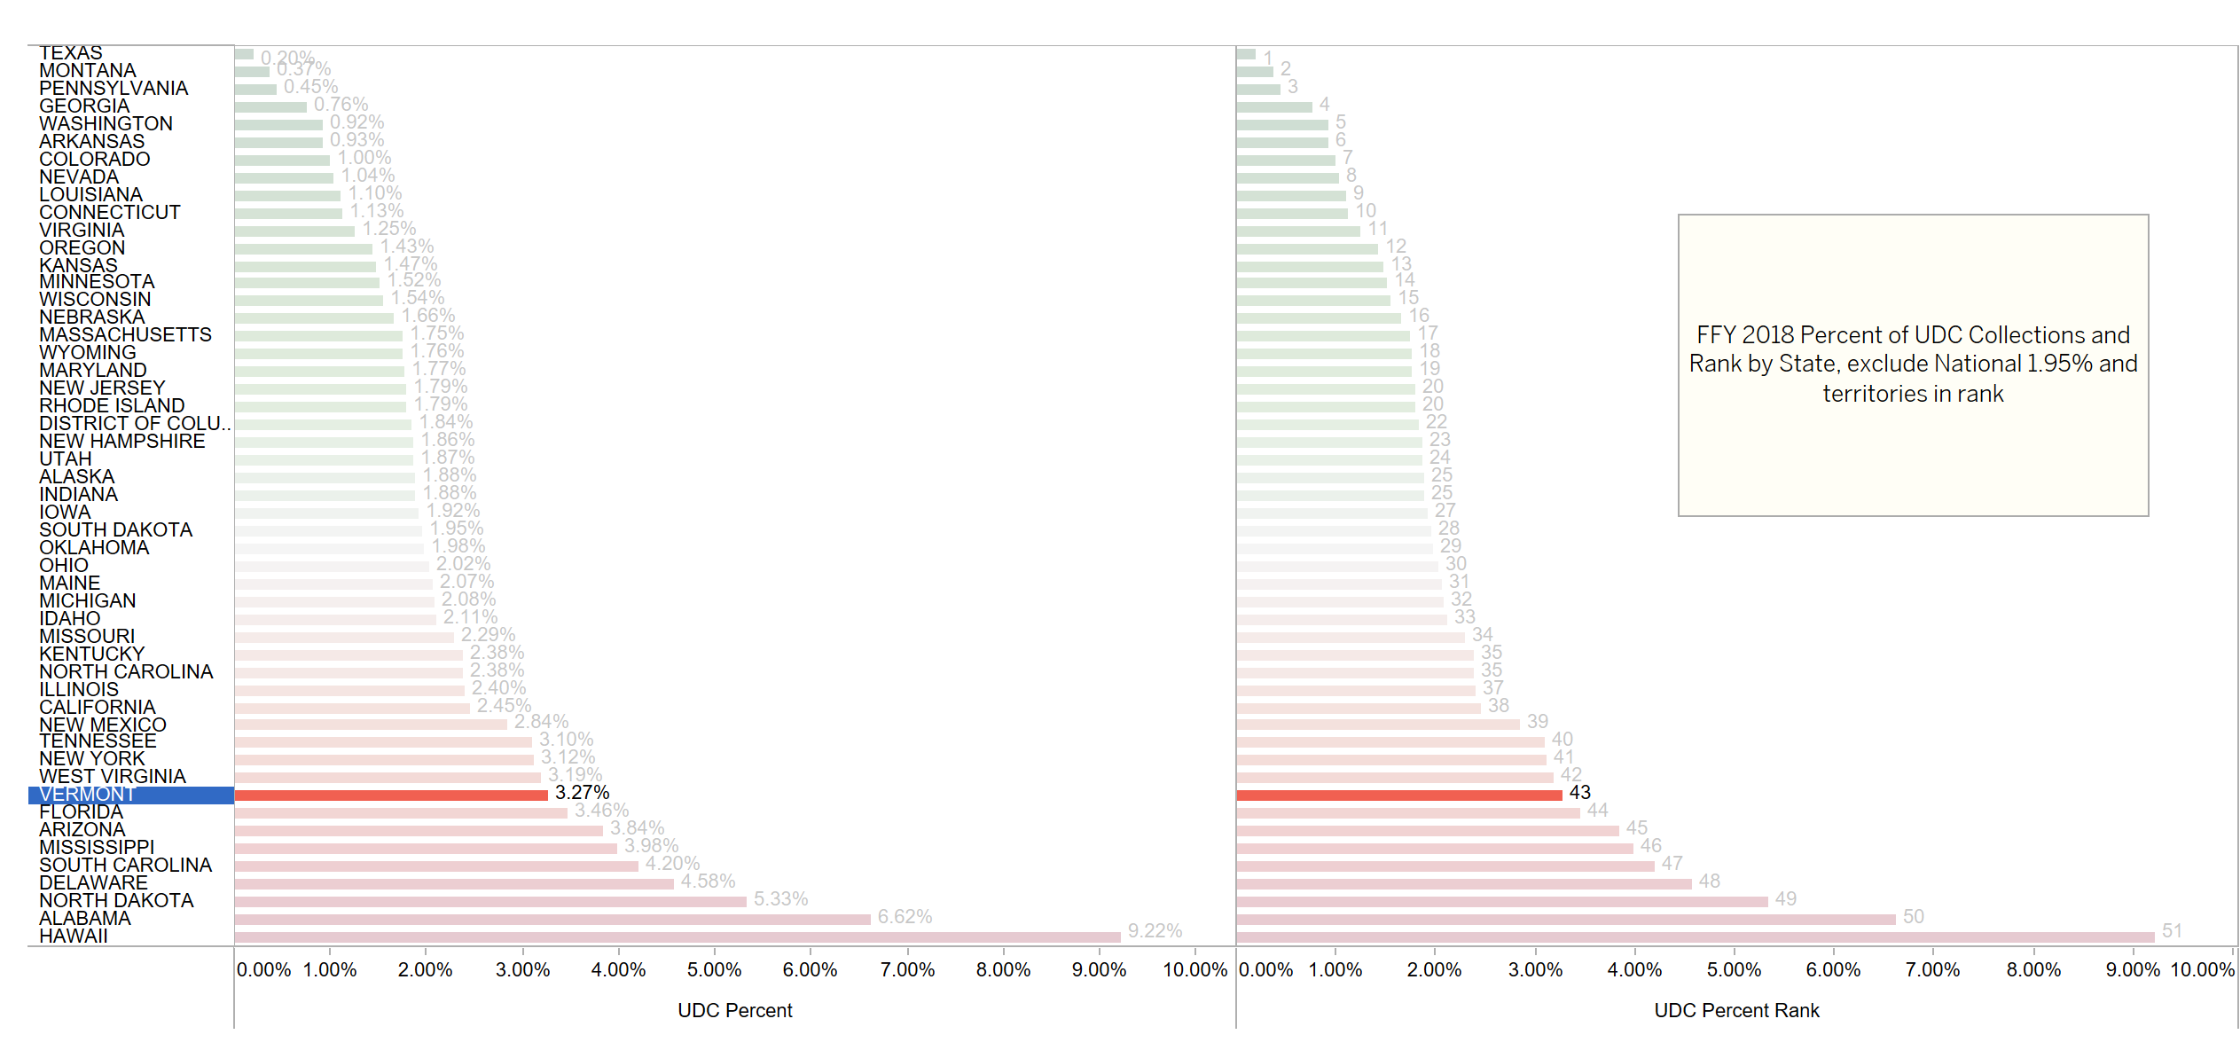
Vermont ranks 43rd nationally among the states in overall UDC % of Collections
3.27% or almost $1 million of Vermont’s child support collections are not able to be sent to families because of ACCESS.
3.27% = $971,118

Slide 5
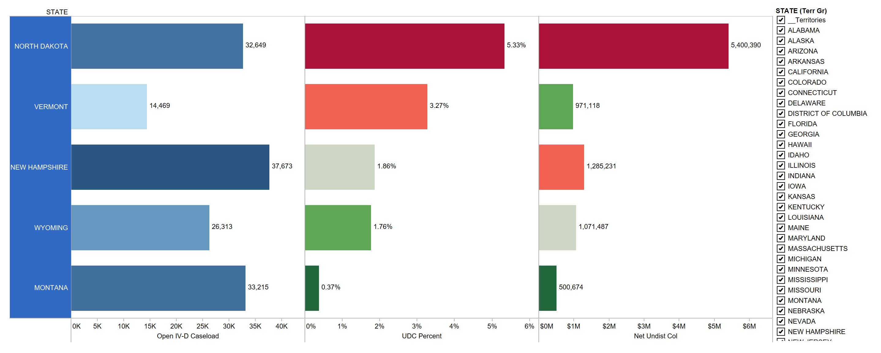
Compared to states with similar caseload sizes*, Vermont’s UDC Percent of Collections is second highest
* States with child support IV-D caseloads within approximately 25,000 cases

Slide 6
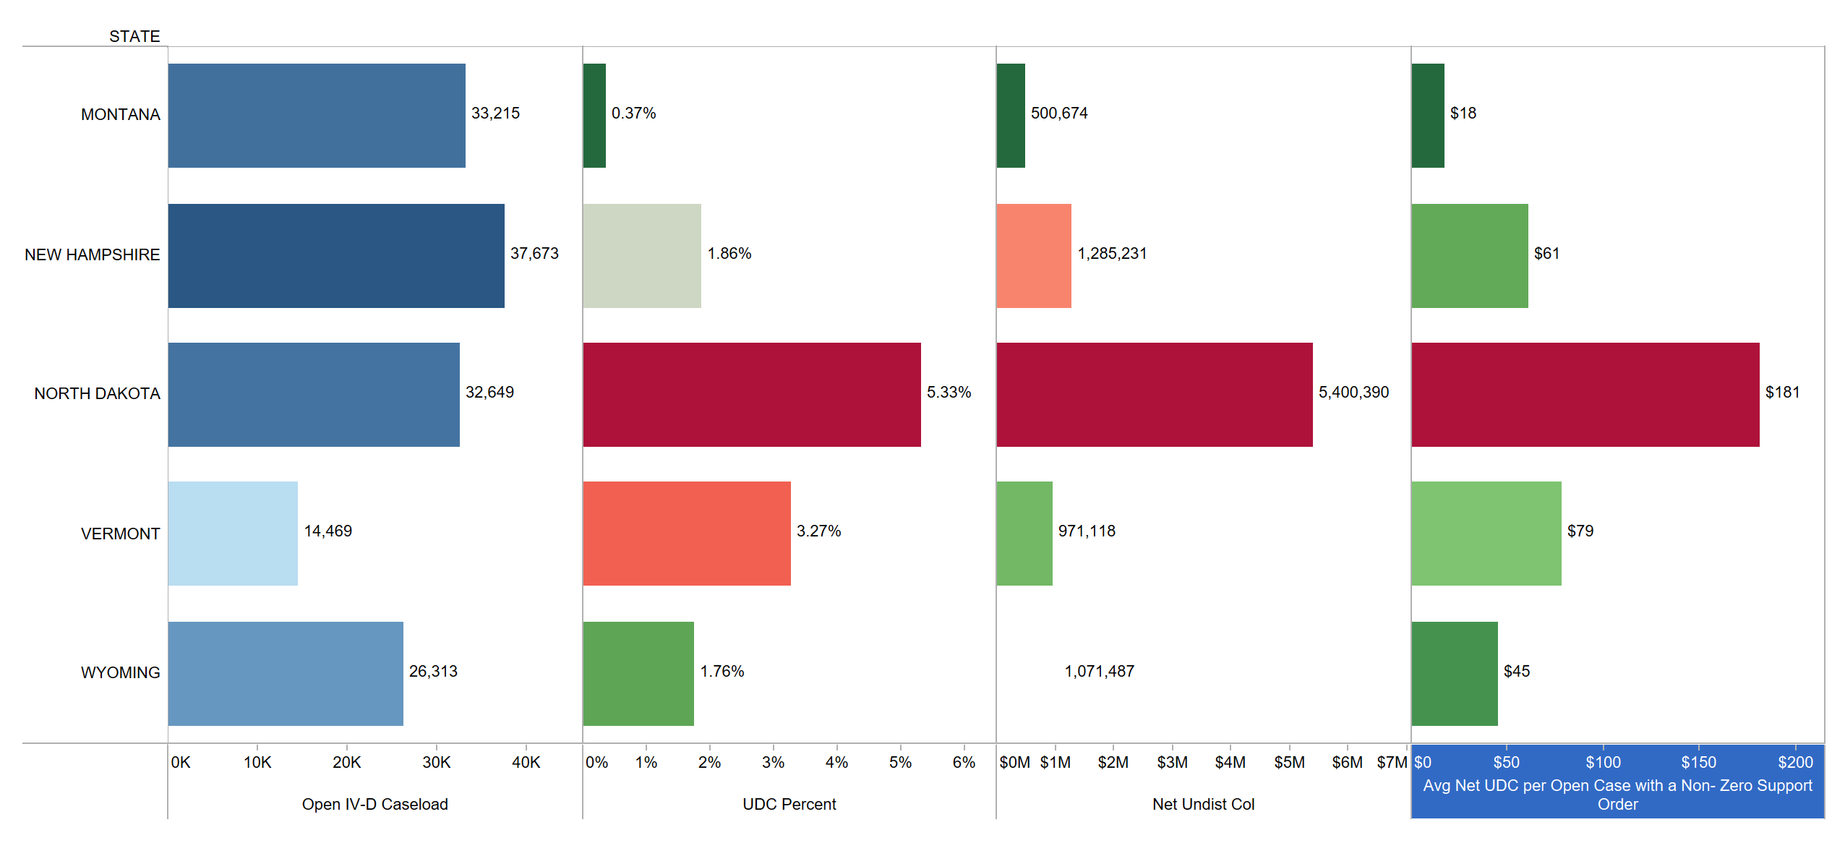
Vermont is also second highest in the average amount of UDC per “non-zero order” case*
*Amount of UDC per case where a payment is expected, i.e. open cases with “non-zero" support orders

Slide 7
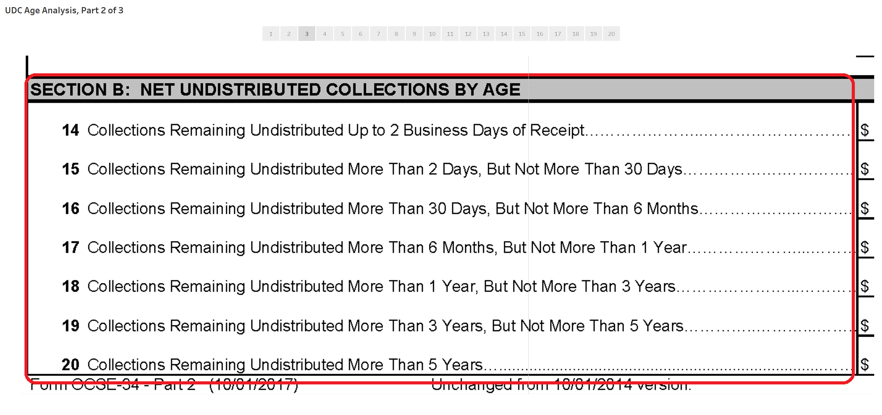
Now let’s turn to the “Age” of Vermont’s UDC
For this analysis, seven Ages of UDC are combined to four:
“New” UDC
> 2 days, < 1 year
“Middle Aged” UDC
> 1 year, < 3 years
“Old” UDC
> 3 years

Slide 8
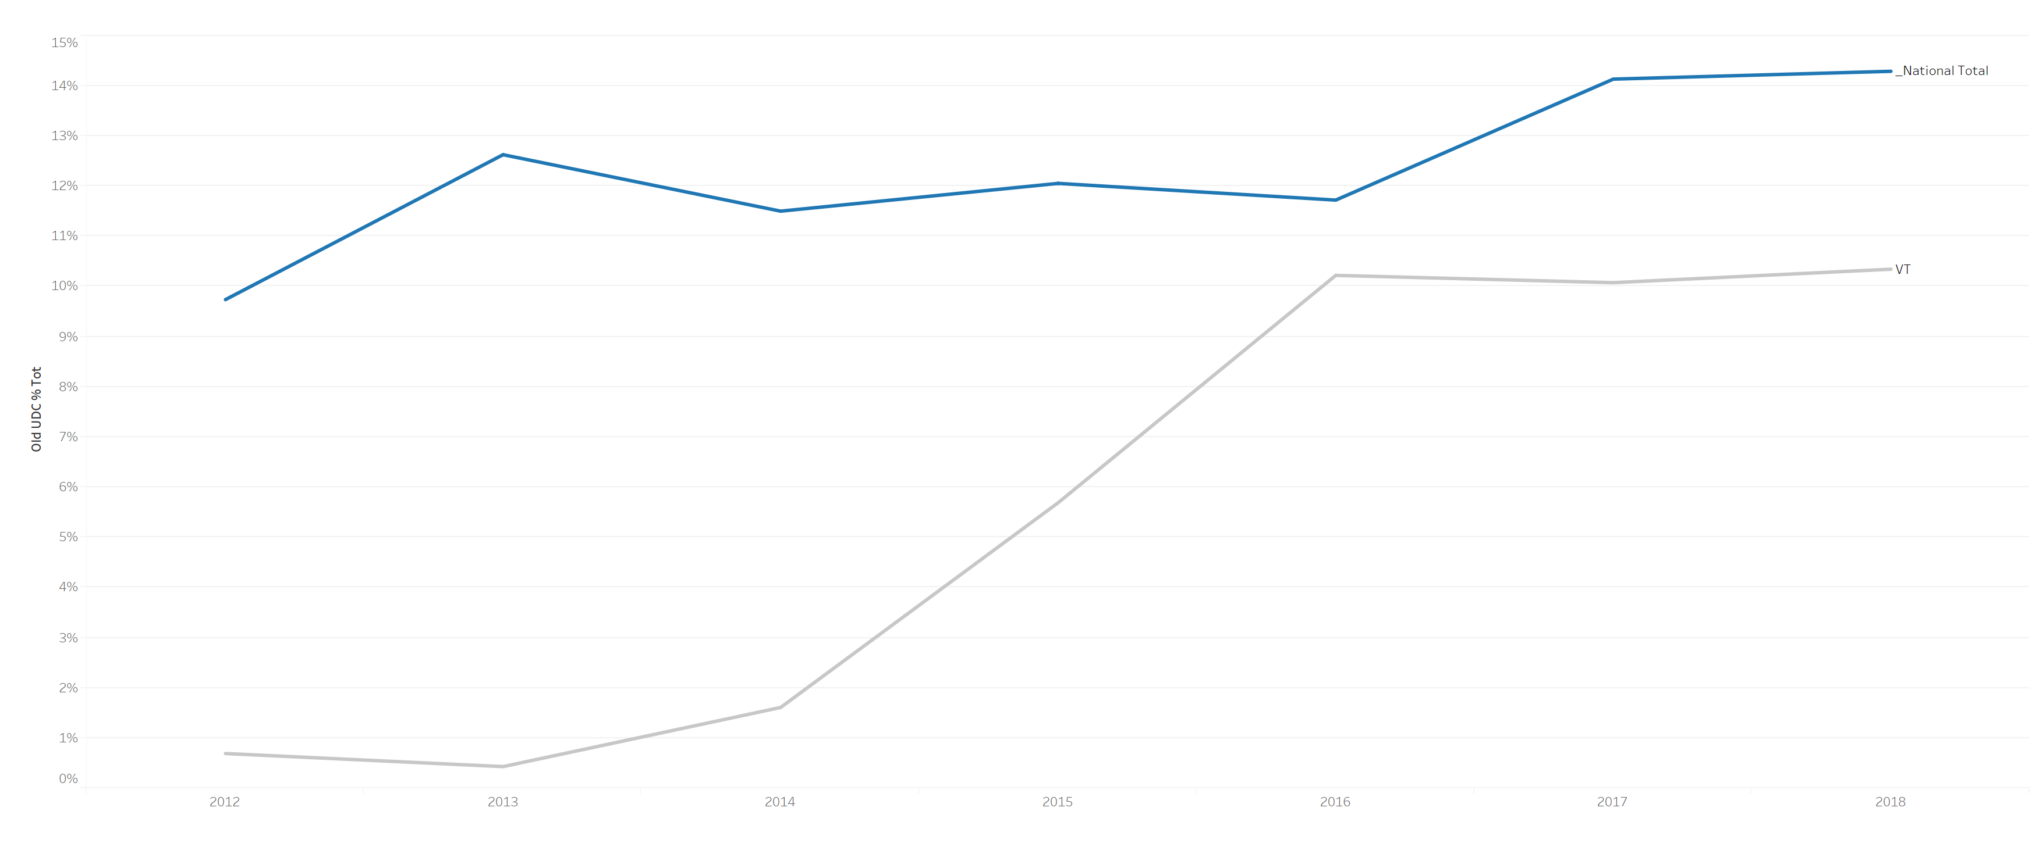

Vermont’s “Old” UDC* has risen steadily recently, compared to the National Average’s rate of increase
Vermont: 10.3% in FFY2018 vs. 0.7% in FFY2012
* Old UDC = Collections remaining undistributed more than three years

Slide 9
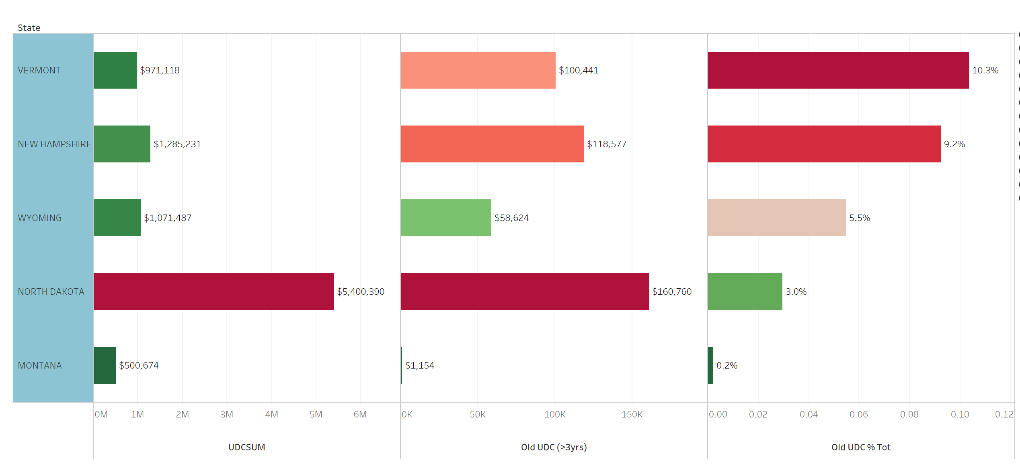
Compared to states with similar caseload sizes, Vermont has the highest percentage of “Old” UDC.
$100,441 is older than 3 years

Slide 10
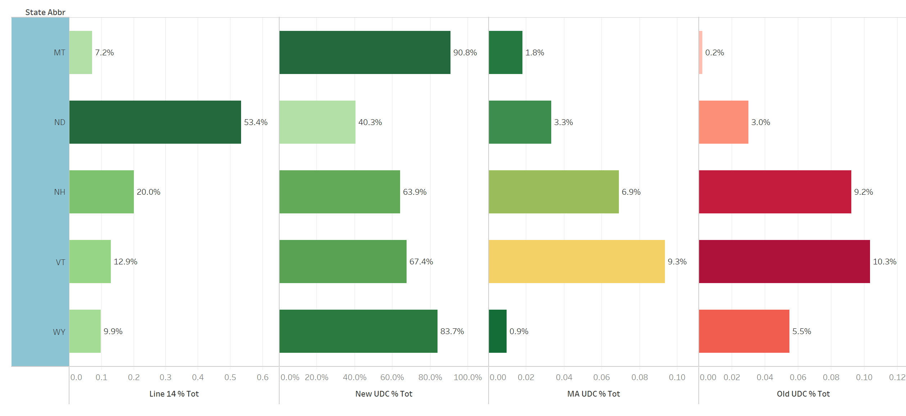
Vermont also has the highest percentage of “Middle Aged*” UDC.
$90,643
$100,441
* Middle Aged = more than 1 year but not more than 3 years

Slide 11
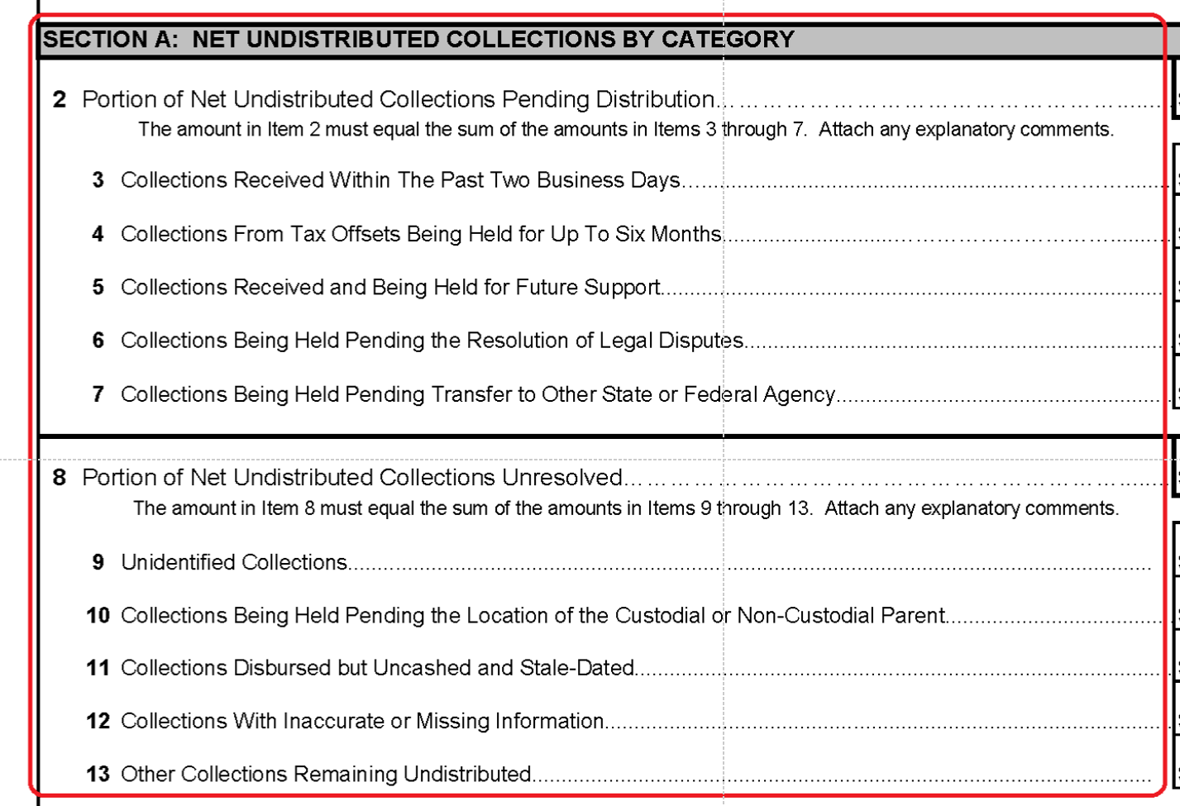
Now let’s look at the various “Categories” of UDC:
Lines 2-7 are called “Good UDC” since they typically distribute without worker intervention
Lines 8-13 are called “Bad UDC” since they typically need analysis and intervention
This is the most problematic category caused by ACCESS.

Slide 12
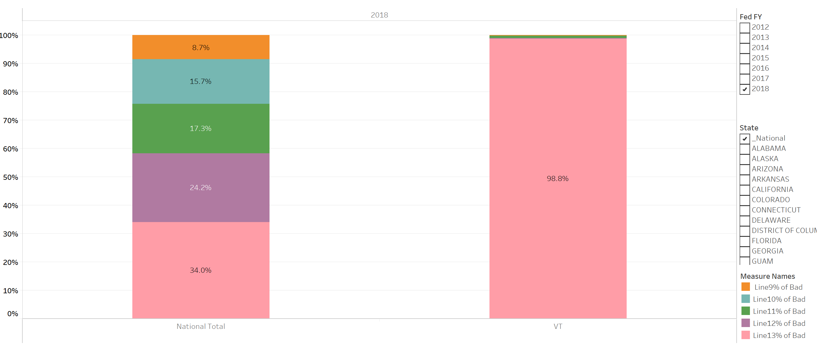
Because of Access, 98.8% of VT’s “Bad” UDC is uncategorized, making it inefficient to work.
98.8% or $227,138 out of $229,840 of VT’s Bad UDC is uncategorized, compared to only 34% nationally.

Slide 13
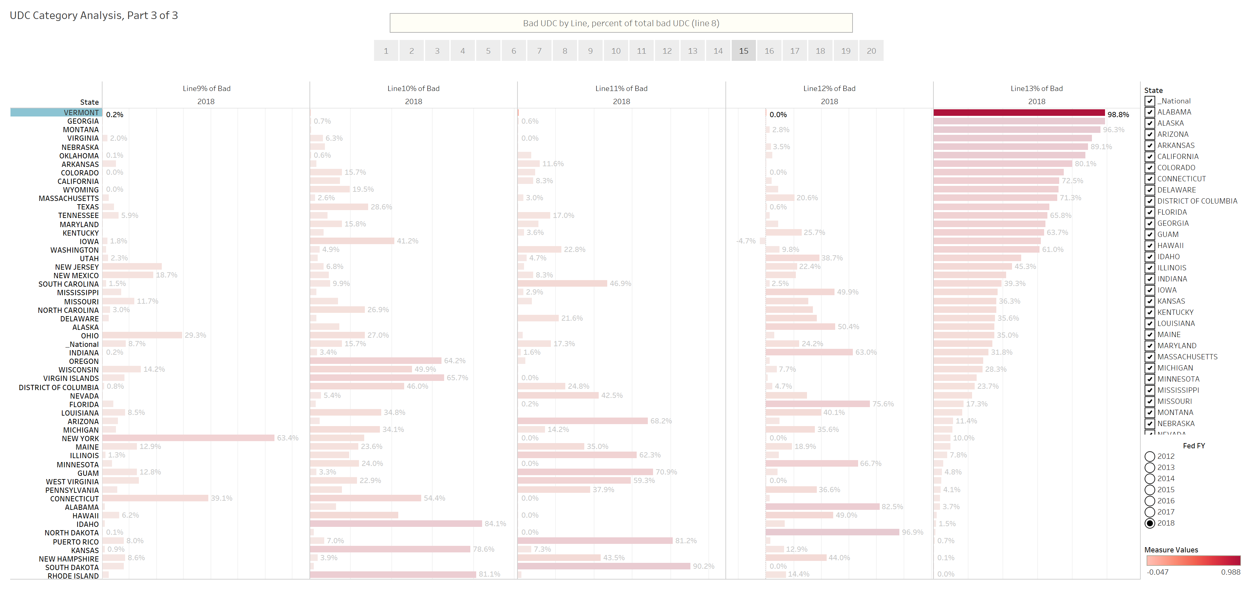
Vermont also has the highest % of uncategorized Bad UDC in the nation.

Slide 14
Summary
To reduce UDC and send more money to families, Vermont needs:
  In the short term, more resources for ACCESS program changes to better categorize undistributed collections;
  In the short term, more staffing resources to work UDC;
  Resources for a replacement system.

