Slide 1
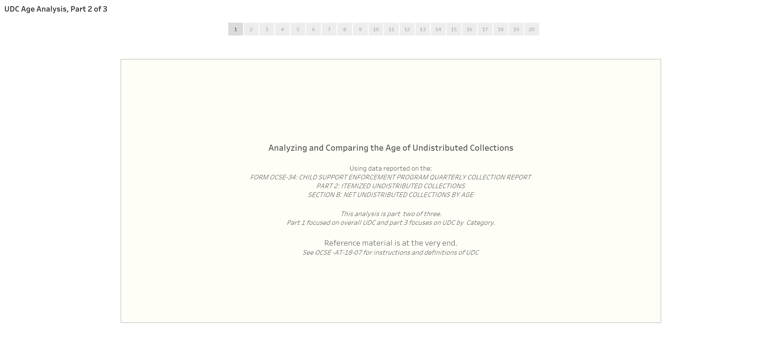
Undistributed Collections (UDC) by Age Comparisons for New York
Using the Federal OCSE 34 Report of Collections

Slide 2
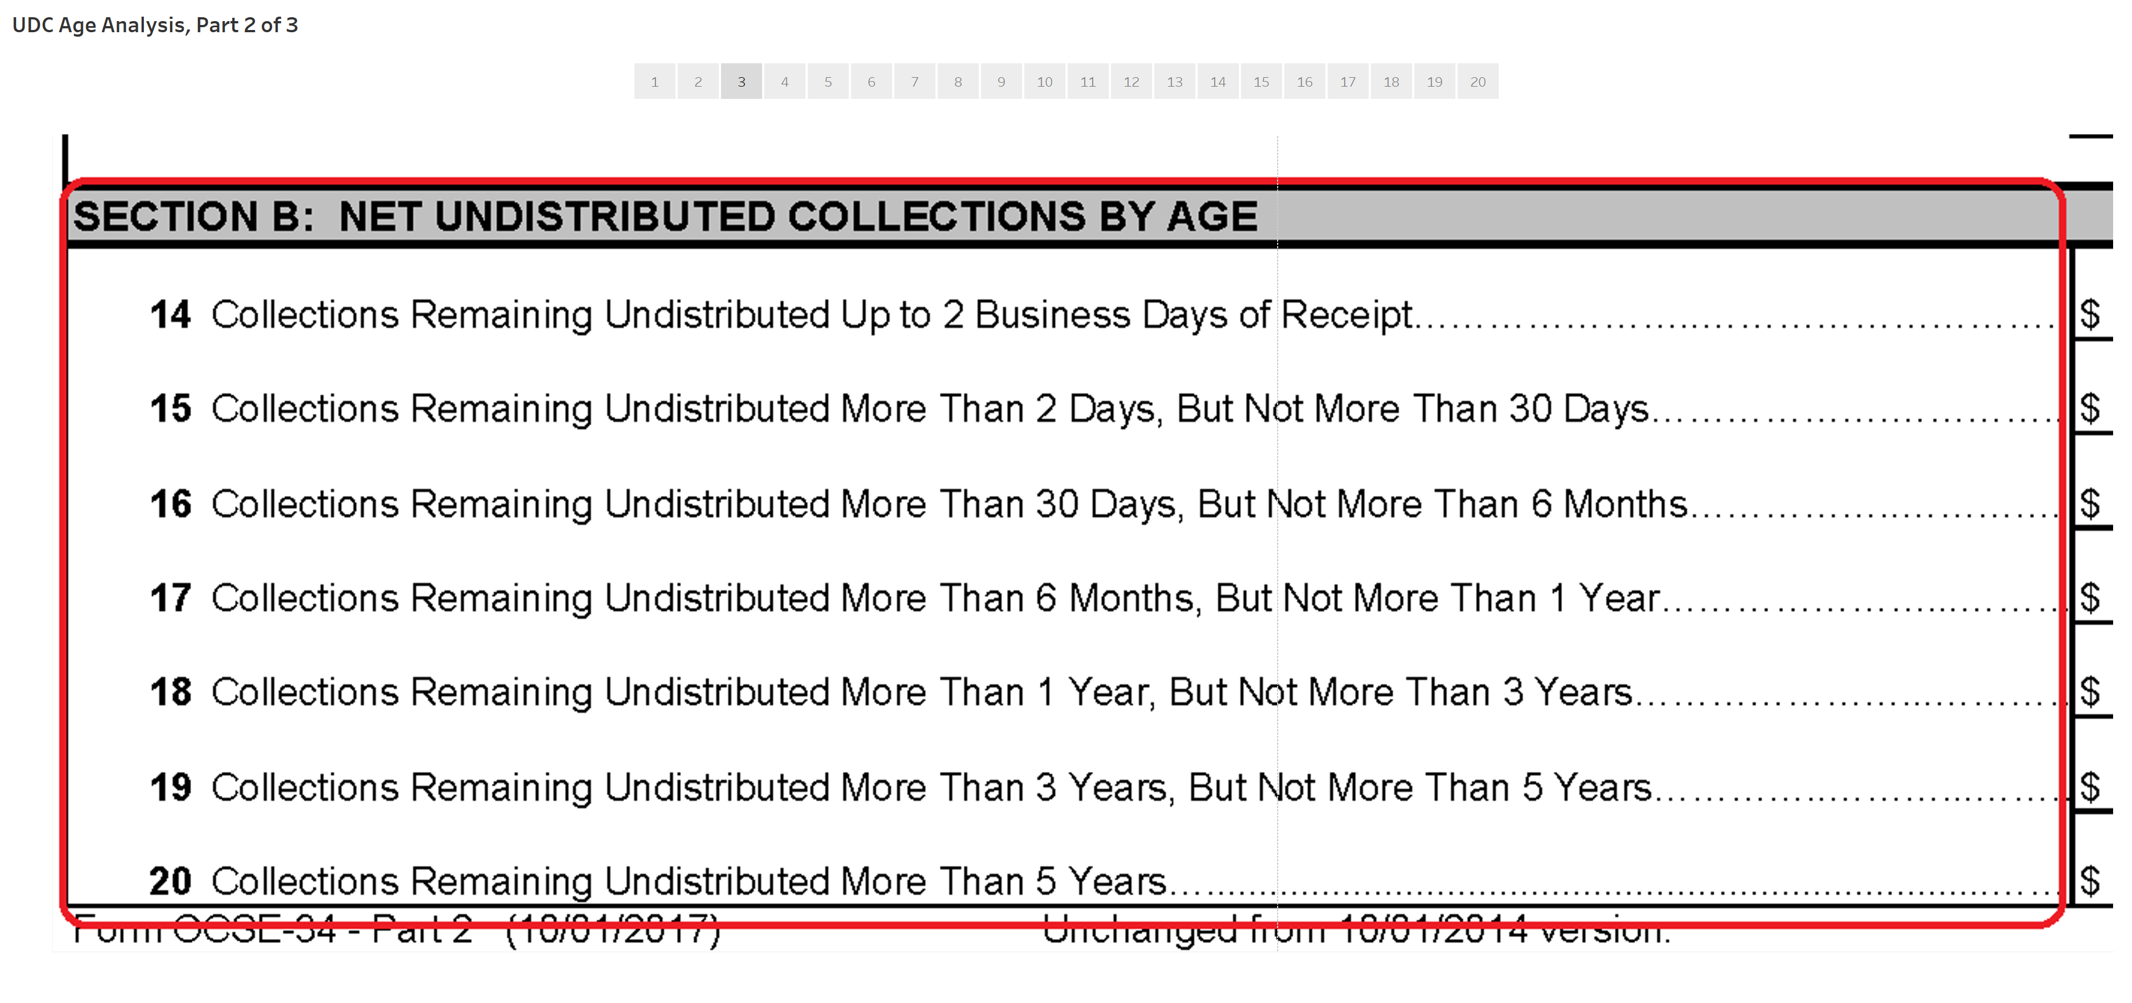
Seven Ages of UDC are combined to Four for Analysis
“New” UDC
“Middle Aged” UDC
“Old” UDC

Slide 3
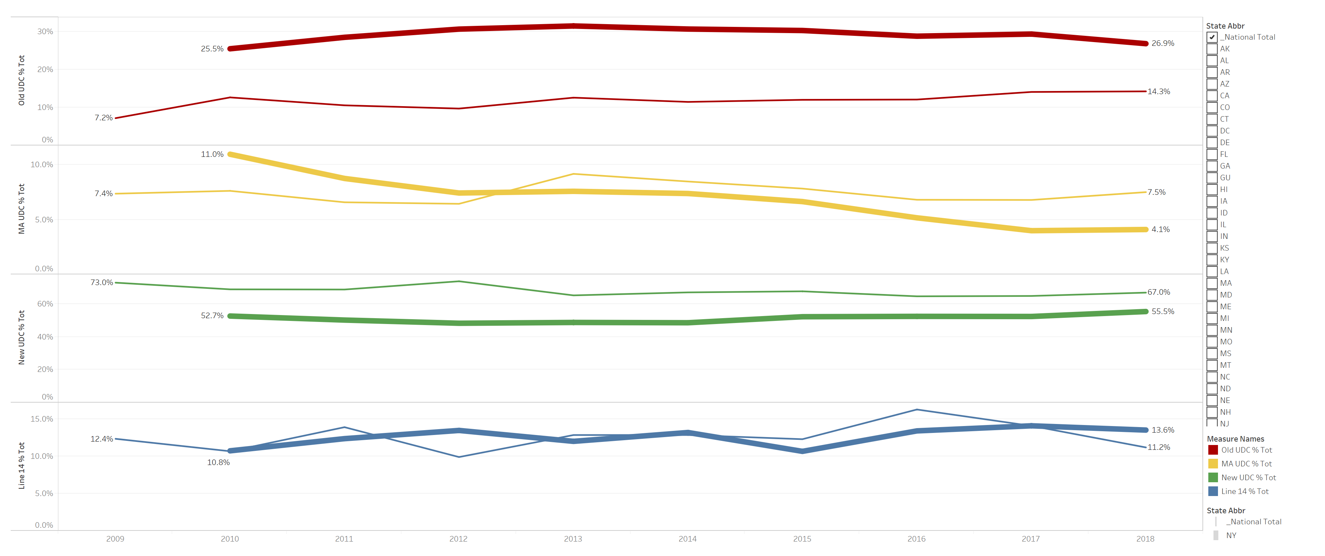
NY is at or below National Average in every category but “Old” UDC*
Four Categories over Time - NY (thick line) and Nat’l Average (thin line):
Old UDC: NY (26.9%) vs. Nat’l Average (14.3%) FFY2018
* For this analysis, “Old UDC” = collections undistributed for 3 or more years

Slide 4
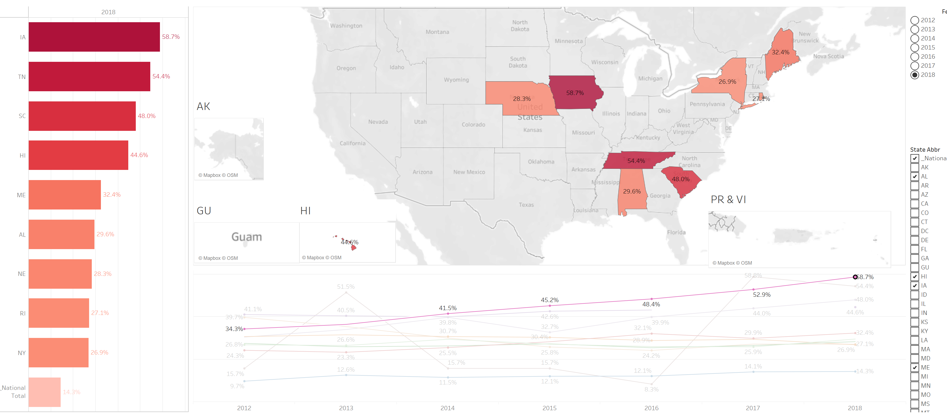

Other states have high “Old UDC” percentages, possibly because of similar statutory challenges.
(e.g. Iowa’s statute does not allow for escheatment and they have the highest percentage at 58.7%)

Slide 5
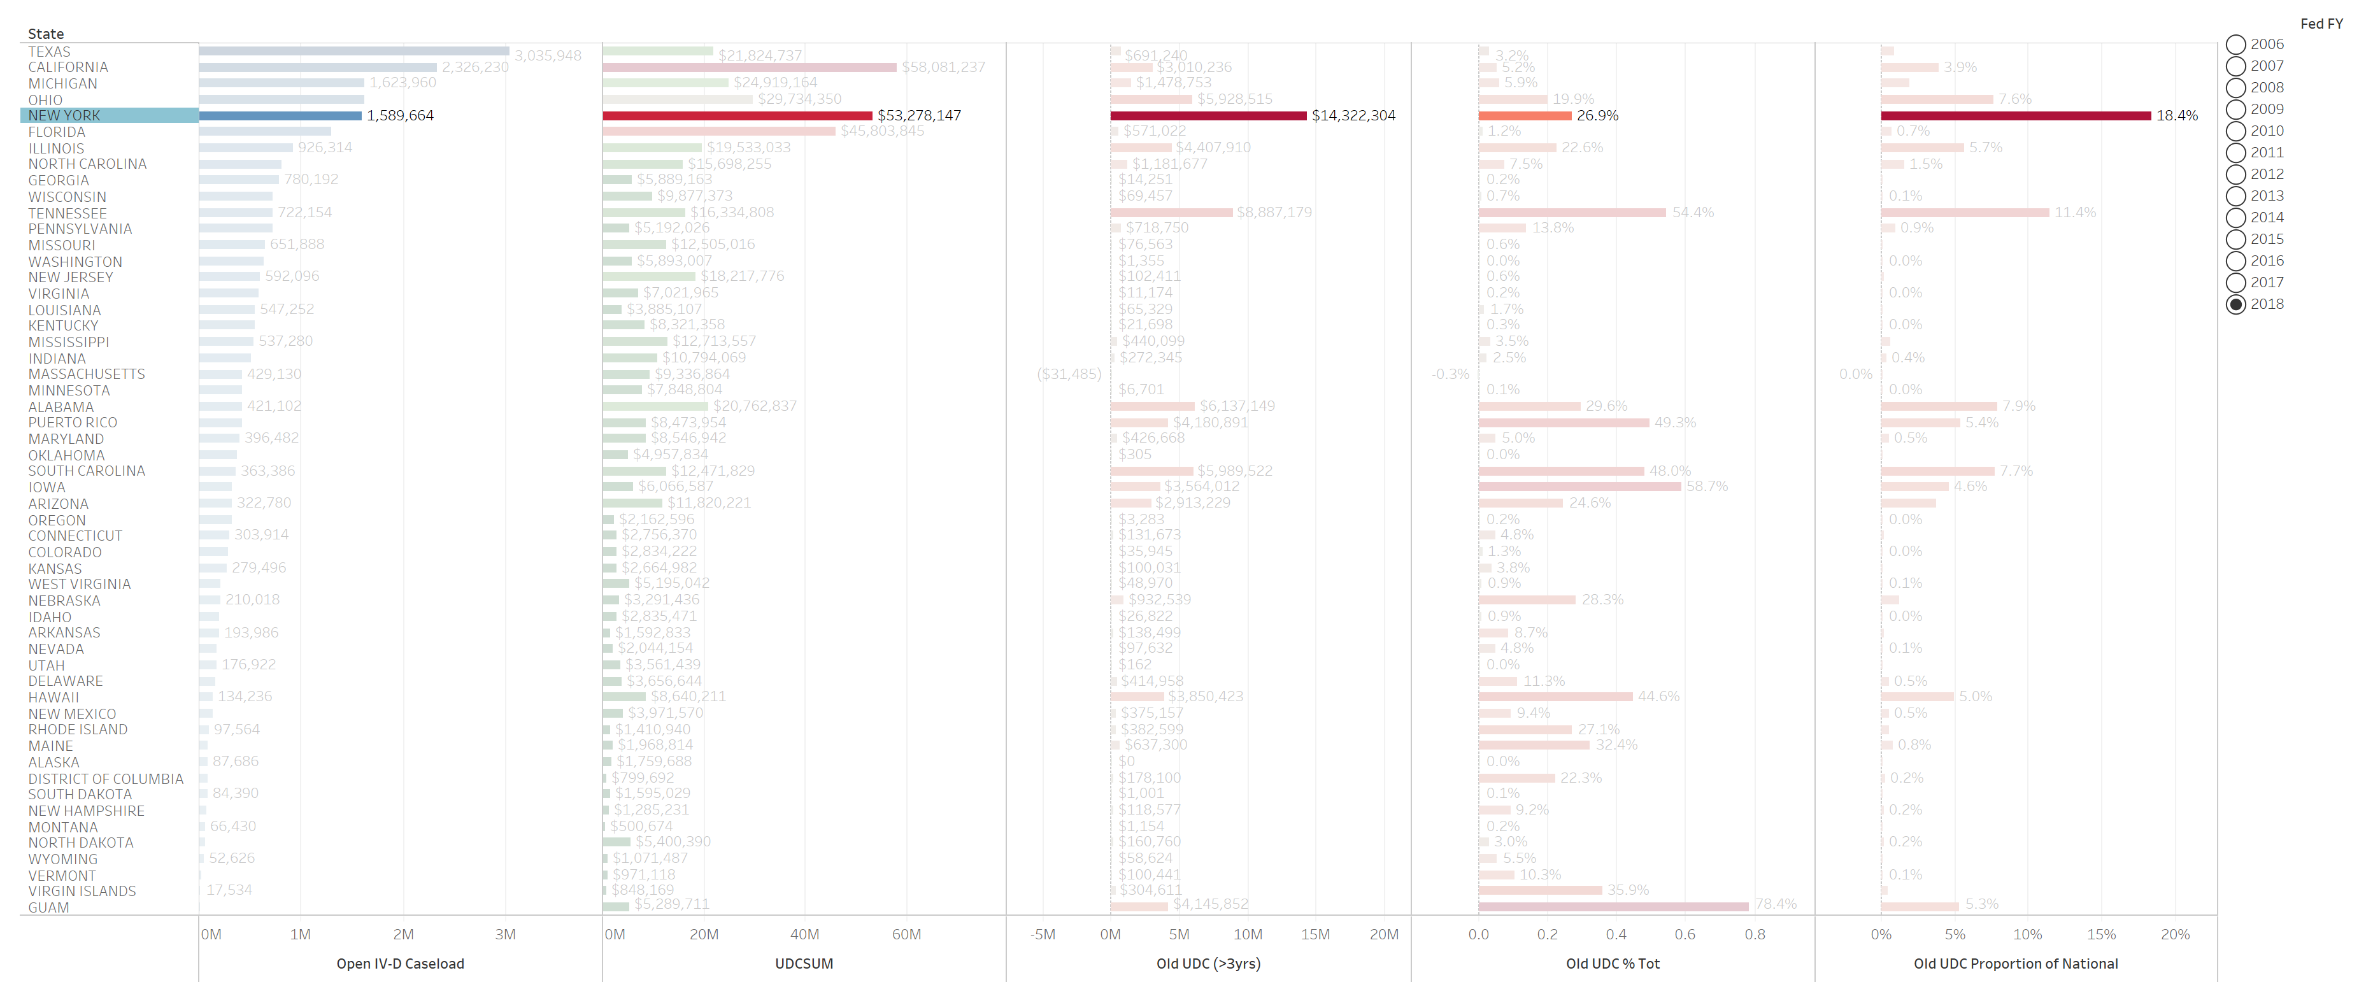
NY has the highest proportion of the National “Old” UDC – 18.4%

Slide 6
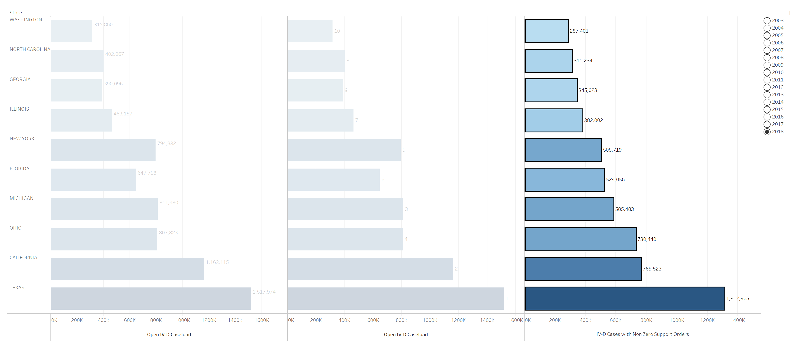
These are the 10 states with the highest “non-zero order”* caseload:
TX, CA, OH, MI, FL, NY, IL, GA, NC, WA
* Of the open IV-D cases, the number which have a support order that is greater than zero, i.e. those where child support collections are expected

Slide 7
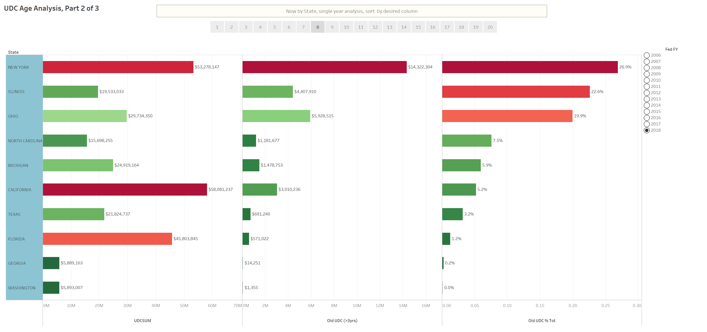
NY has the highest percentage of “Old UDC” of these ten states

