Slide 1
Undistributed Collections: New York’s Story
The following graphs give information about New York’s amount and percentage of Undistributed Collections (UDC). The data shows New York in comparison to other states, and in particular in comparison to states with large IV-D caseloads.

Slide 2
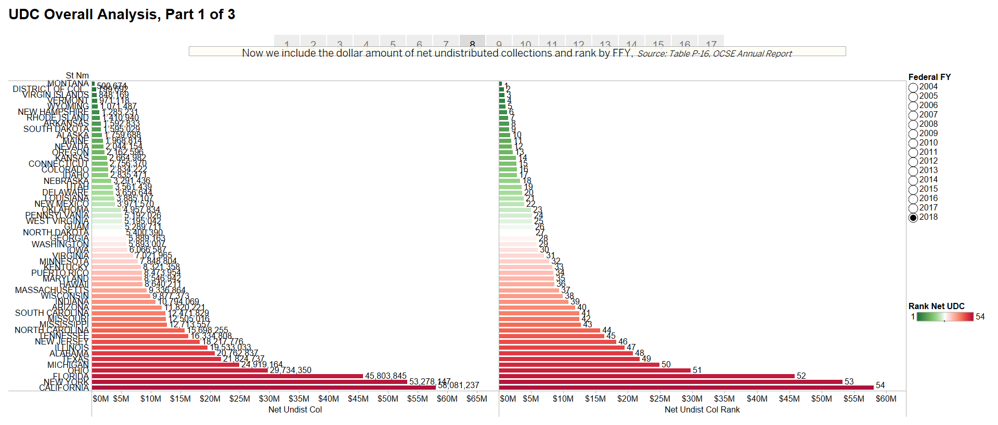
For Federal Fiscal Year 2018, only California had a higher amount of UDC. New York’s was $53.2 million, as shown in the left column at the bottom.

Slide 3
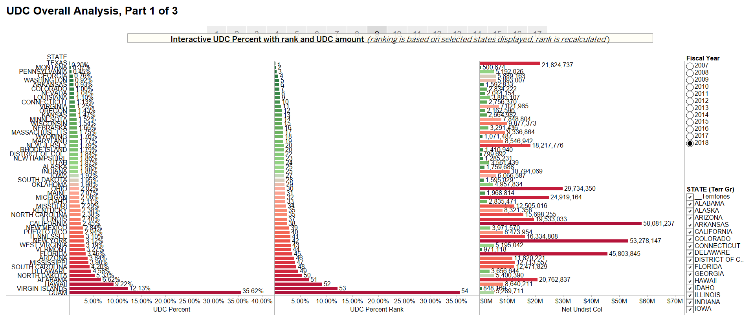
When looking at UDC compared to overall collections, New York’s percentage of UDC is 3.12%, compared to a national average of 1.95%.

Slide 4
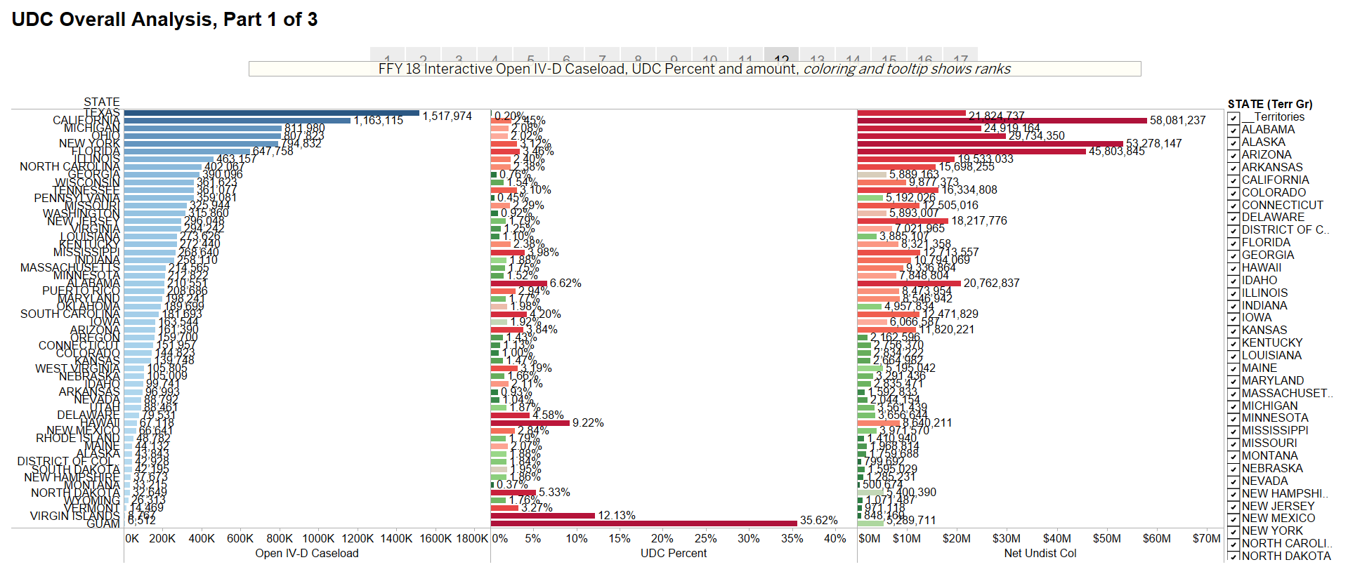
This slide focuses on the six states with the highest national caseloads (Texas, California, Michigan, Ohio, New York and Florida. New York has the 5th largest caseload in the nation. Compared to these six states, New York’s percentage at 3.12% is higher than any except Florida.

Slide 5
New York staff have been working hard to reduce UDC over time. This slide shows New York’s percentage change since 2007 compared to the national average.

Slide 6
This slide shows New York’s percentage change since 2007 compared to the other 5 states with large caseloads and the national average.

Slide 7
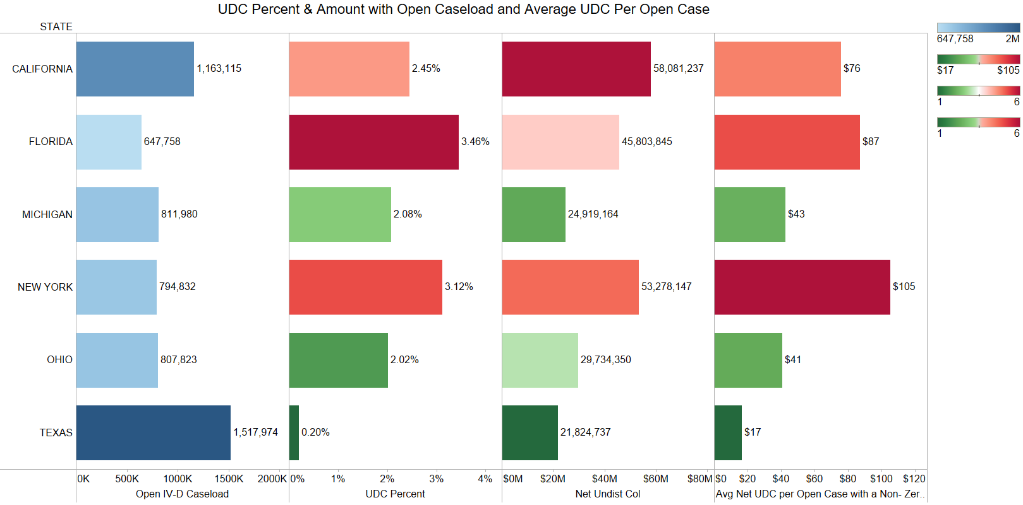
Importantly, when looking at the far right column which shows the average amount of UDC per case with support orders, New York is significantly higher (at $105 per case) than the other large states.
Texas = $17 per case; Ohio = $41; Michigan = $43; California = $76; Florida = $87; New York = $105

