Slide 1
Software Development Life Cycle (SDLC)

Slide 2
Choosing the right project management methodology for your team is the first step to success. But how can you know which project management methodology is best? And what makes one methodology better than another?

Slide 3
Methodologies
Waterfall and Agile are most popular methodologies
Most states used Waterfall
Agile becoming more popular
South Carolina, Maryland, and Oklahoma are latest states to use Agile:
Not committed to one vendor or fixed amount for the entire project
Can use array of vendors for each Sprint and potentially save money
Risks are easier to discover and resolve quicker, working in smaller pieces

Slide 4
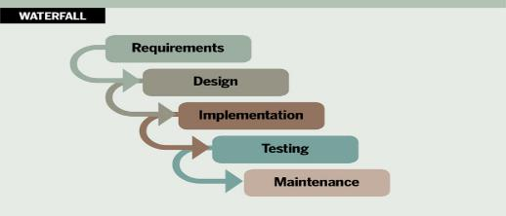
Waterfall Methodology
Has been a mainstay project management methodology for years
Most commonly used in software development
Every step preplanned and laid out in proper sequence
Each stage generally finishes before the next one begins
Simple to understand

Slide 5
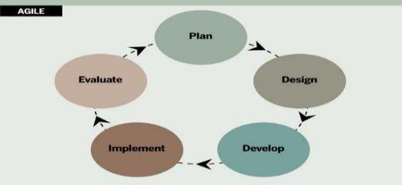
Agile Methodology
Takes significantly different approach to project management
Initially developed for projects that require flexibility and speed
Uses incremental iterative work cycles commonly known as “Sprints”
Best suited for projects requiring less control and real-time communication within self-motivated team settings

Slide 6
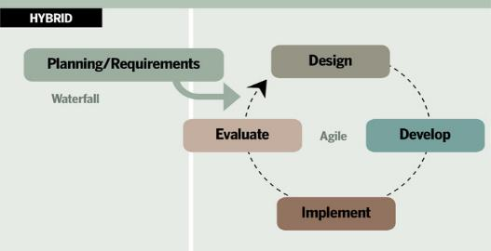
Hybrid Methodology
Hybrid project management methodology benefits from both Waterfall and Agile approaches
Planning and requirements phase uses Waterfall approach
Design, develop, implement, and evaluate phases follow Agile methodology

Slide 7
How Child Support Can Benefit From Using Agile
Cost, Quality, and Schedule:
Cost in smaller pieces
Releasing funds in increments, better inform investment decision-making, and potentially reduce overall spending
Team learns early, fails early, and can course-correct while budget still intact
High-quality software quickly
Reduce rework

Slide 8
How Child Support Can Benefit From Using Agile
(cont’d)
Flexible, fast, lean, responsive, and consistent
Focuses on people, more communication-oriented
Very flexible by adapting to change happening in the business
Regular inspection improves the leadership qualities to boost teamwork

Slide 9
Aligning Project Traits with Development Methodologies
Project Trait/Factor | Agile | Plan-Driven Waterfall | Comments
Customer Availability | Prefers customer available throughout project | Requires customer involvement only at milestones | States involvement reduces risk in either model
Scope/Features | Welcomes changes, but changes come at the expensive of Cost, Schedule, or other Features. Works well when scope is not known in advance. | Works well when scope is known in advance, or when contract terms limit changes. | Change is a reality so we should prepare adaptability where possible. Contract terms sometimes restrict it.
Feature Prioritization | Prioritization by Value ensures the most valuable features are implemented first, thus reducing risk of having an unusable product once funding runs out. Funding efficiency is maximized. Decreased risk of complete failure by allowing “Partial” success. | ”Do everything we agree on” approach ensures the customer gets everything they asked for; “All or nothing” approach increases risk of failure. | Contract term may not permit success and may require “do everything”.

Slide 10
Aligning Project Traits with Development Methodologies
Project Trait/Factor | Agile | Plan-Driven Waterfall | Comments
Team | Prefers smaller, dedicated teams with a high degree of condition and synchronization. | Team coordination/synchronization is limited to handoff points. | Team that works together works better, but when contracts are issued to different vendors for different aspects of the project, high degrees of synchronization may not work.
Funding | Works extremely well with Time & Materials or other non-fixed funding, may increase stress in fixed-price scenarios. | Reduces risk in Firm Fixed Price contracts by getting agreement up-front. | Fixed price is tough when scope is not known in advance, but many government contracts require it.
Summary | Agile is better, where it is feasible. | Plan-Driven may reduce risk in the face of certain constraints in a contract between a vendor and external customer such as the government. | Through educating the states about strengths and weaknesses of each model, we hope to steer them toward a more Agile approach. This may require changes to how the states approach software development projects.

