Slide 1
U.S. Bank Government Prepaid Team
Fast, safe and efficient payments.
Presented by:
Gretchen Anderson, VP Sales Manager Diane Gard, VP Senior Relationship Manager

Slide 2
Agenda
U.S. Bank ReliaCard® Overview of Cardholder Features
Alerts
Bill Pay
Savings
Visual IVR
Responsive Website

Slide 3
ReliaCard

Slide 4
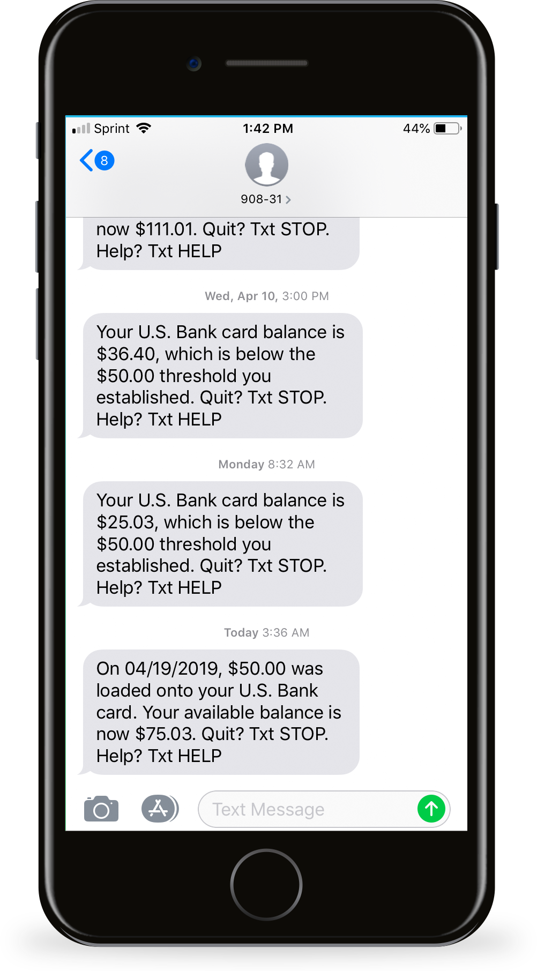
Text¹ and Email Alerts
 | Text | Email
Welcome Alert | P | P
Deposit Alert | P | P
Transaction Alert (any debit) | P | P
Low Balance | P | P
Purchase Alert | P | P
Purchase Decline | P | P
Pre-Authorized Transaction | P | P
Card Not Present Purchase | P | P
International Transaction | P | P
Card Shipped Alert | P | P
Informational Alerts | P | P
Two-Way Text Feature
Text BAL for balance
Text TRANS for recent transactions
Text HELP for customer service number
Text SAVE for savings balance
1. For text messages, standard messaging charges apply through your mobile carrier and message frequency depends on account settings.

Slide 5
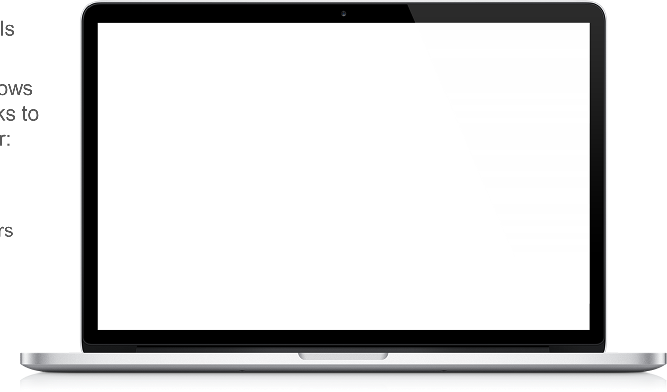
Paying Bills and Rent Online
Cardholders can pay bills online with their card
Pay Anyone features allows the cardholder to send checks to non-registered billers for:
Family
Personal Care Providers
Landlords

Slide 6
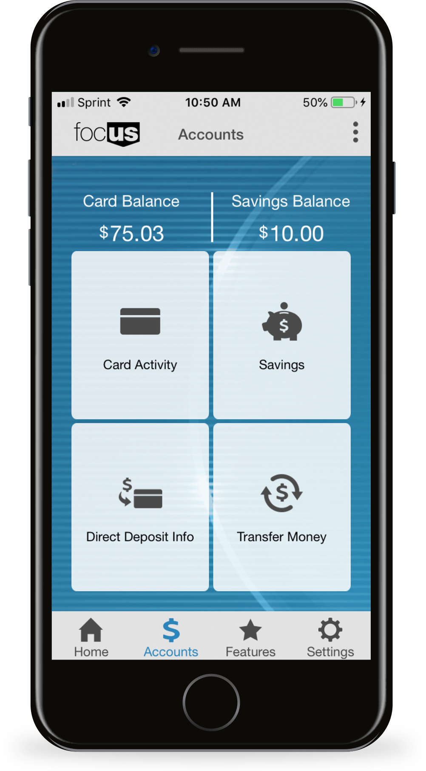
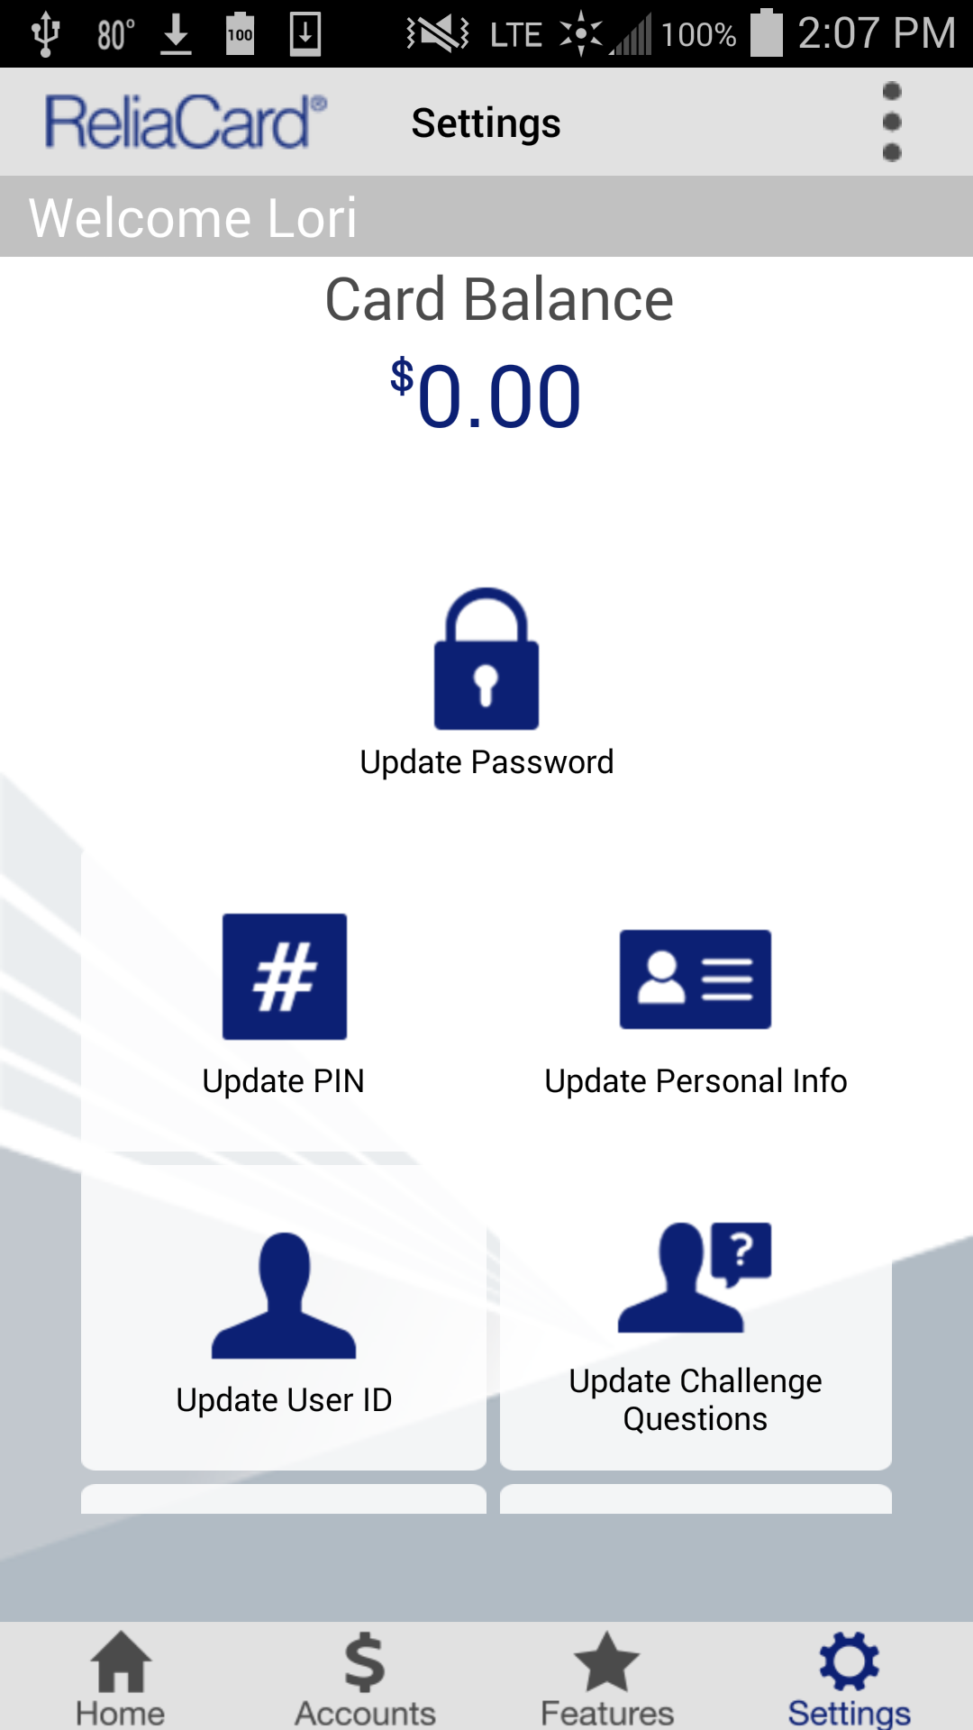
Savings Account Feature
Optional virtual account linked to primary pay card account
Manual, one-time transfers or automatic, recurring transfers
Save for future expenses, general savings, etc.
Account generates interest at standard bank rate
Cardholder is able to monitor balance from website or mobile app

Slide 7
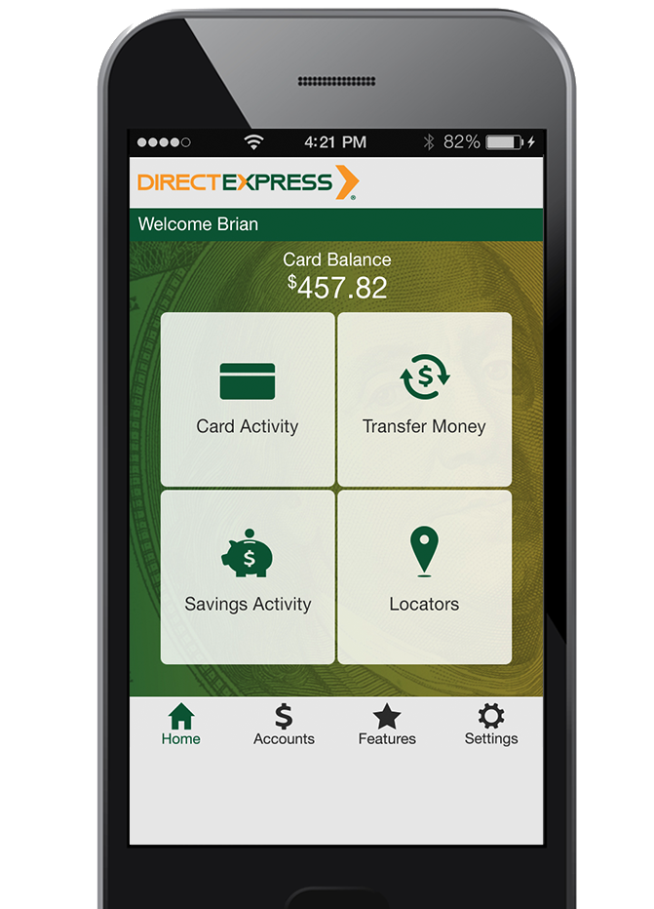
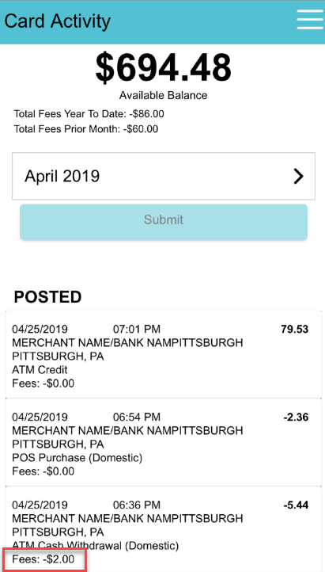
Visual IVR
Cardholder calls IVR and selects option to receive a one-time text message to their mobile phone
Cardholder receives text and clicks the link to view transaction history on their mobile phone
Cardholder can also press 1 to speak to an agent
Cardholder taps “details” to view information about the transaction
90831

Slide 8
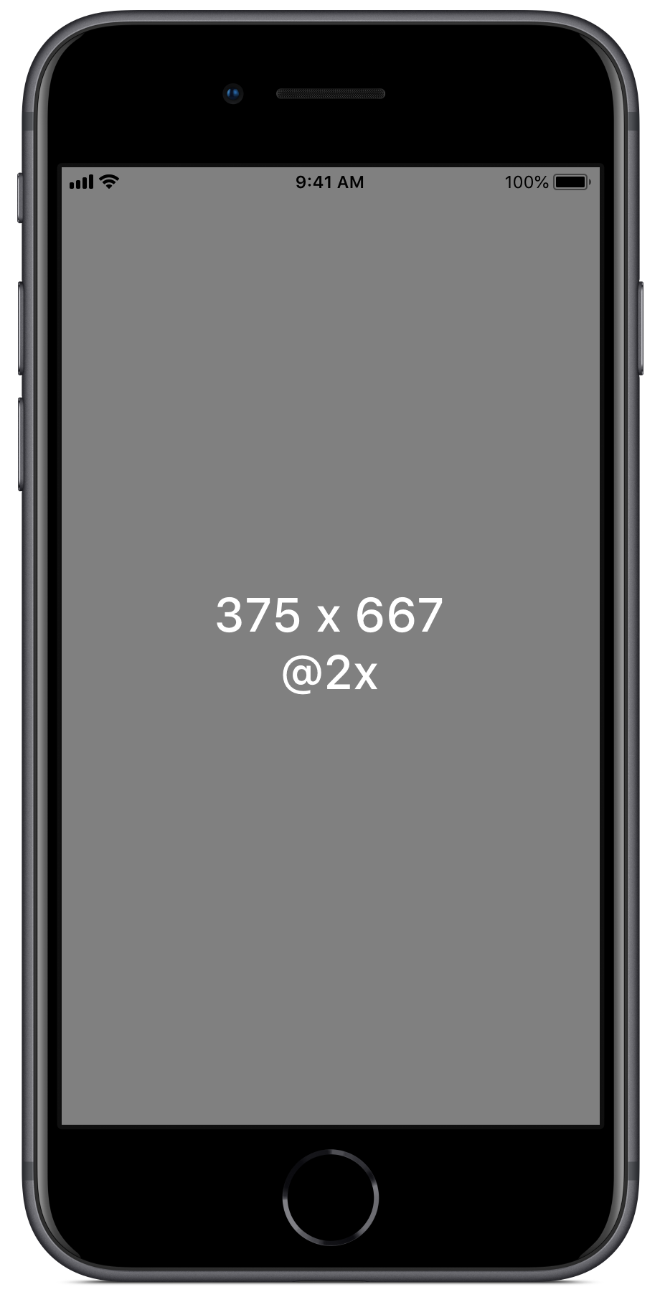
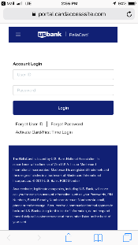
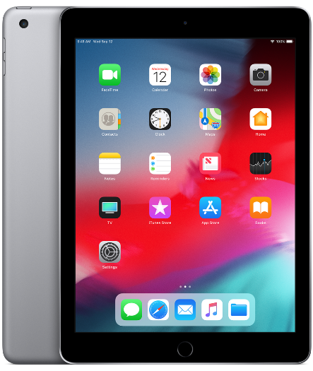
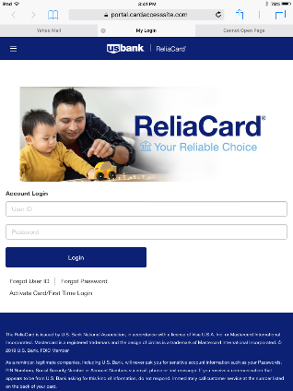
Responsive Website

Slide 9
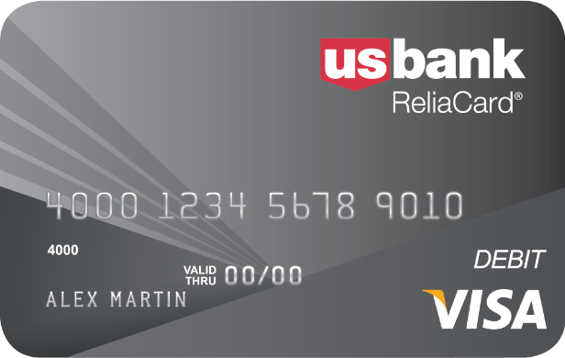
Thank you
The ReliaCard is issued by U.S. Bank National Association pursuant to a license from Visa U.S.A. Inc. © 2019 U.S. Bank. Member FDIC.

