Slide 1
Provides END-TO-END
Payment Solutions
ALL INCLUSIVE
COMPREHENSIVE
THOROUGH
A Total Payment Solution
ENTIRE
COMPLETE
We process Child Support in 16 States providing
FAST, SECURE, and CONVENIENT ways to make payments.

Slide 2
A Partnership Story Worth Telling

Slide 3
?
?
How Can We Make It Easier
To Increase Child Support Payments ?
?
?
?
?

Slide 4
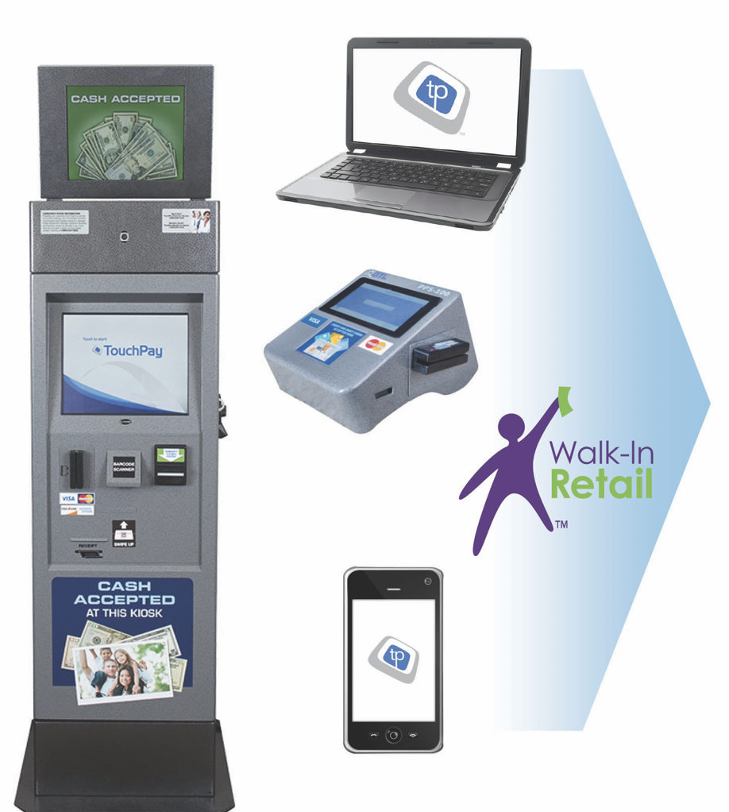
Kiosk
Countertop Terminals
Web Payments
IVR
PayPal
Walk-In-Retail
Mobile Payments

Slide 5
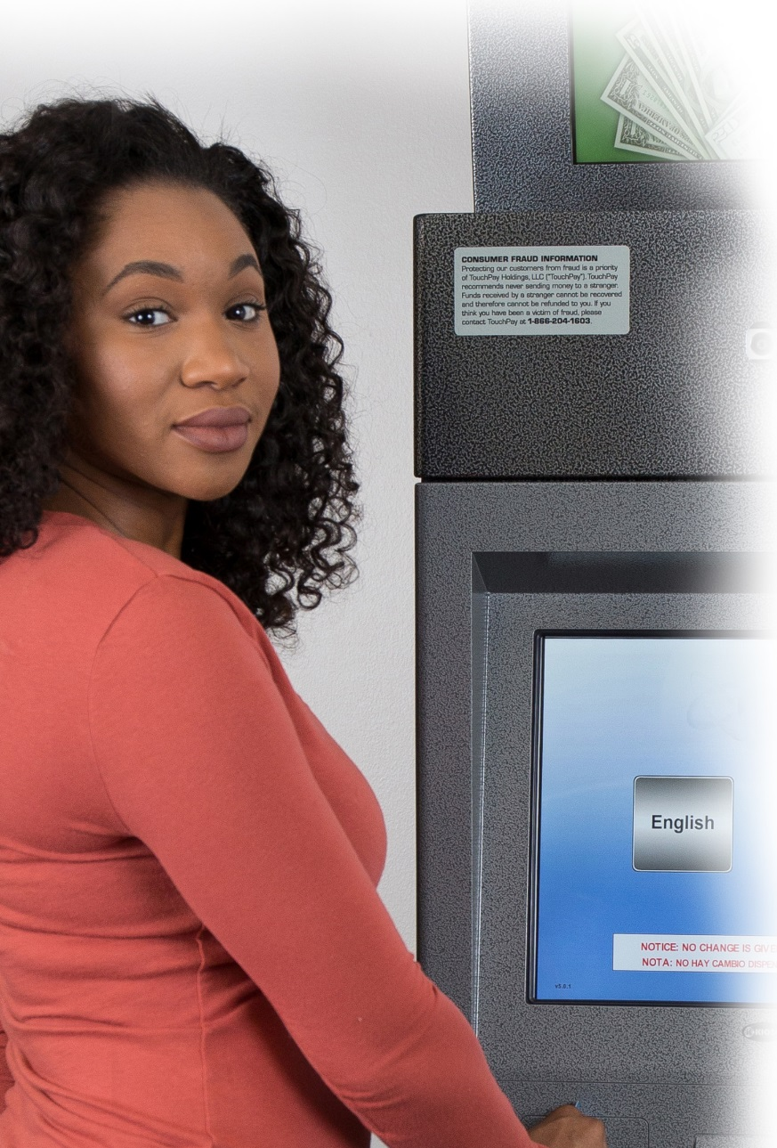
TouchPay’s Lobby Kiosk
Easy ATM-Type Navigation
(Transactions in Under 2 minutes)
Payment Solutions for Cash, Credit/Debit cards and E-checks
Increases the Number of Payments Made
Reduces Agency Cash Handling, Cash Management, and Liability
Provides 100% Funding Guarantee
Streamlines Payment Processing and Reporting
Increases the Efficiency of Back Office Accounting
Reduces Cash Shrinkage & Misappropriation

Slide 6
?
?
How Can We Make It Easier
To Increase Child Support Payments ?
?
?
?
?

Slide 7
Accepts Discover, Visa and MasterCard Credit/Debit Cards
Use Simplistic Touchscreen for Users
Real-time Account Validation
Real-Time Processing and Immediate Reporting
Instant Customer Receipts
Seamlessly Reconciles with all TouchPay Portals
TouchPay’s Countertop Terminal
Ideal for small offices, low traffic areas or to add efficiency to payment windows.

Slide 8
How has the Partnership done ?
WA
ME
MT
ND
VT
OR
MN
NH
WI
NY
MA
RI
ID
SD
MI
CT
WY
PA
NJ
NE
IA
MD
DE
IL
OH
DC
98 Million Dollars for Child Support Agencies
NV
UT
CO
WV
MO
VA
KS
MO
KY
CA
TN
NC
OK
AR
AZ
OK
SC
NM
MS
AL
GA
TX
LA
FL
S. TX
States currently using TouchPay
Notes:
8

Slide 9
?
?
How Can We Make It Easier
To Increase Child Support Payments ?
?
?
?
?

Slide 10
New ways to Pay

Slide 11
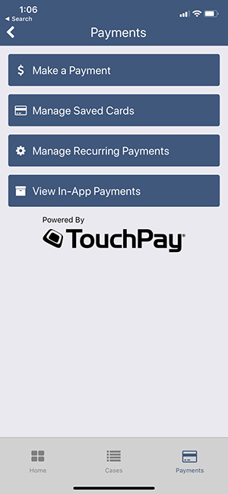
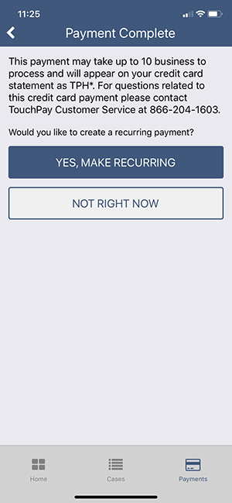
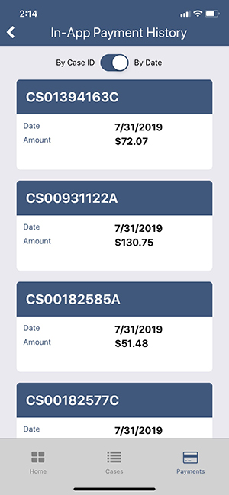
Mobile Payments

Slide 12
Reports
TouchPay provides online access to our Reporting Tools to authorized users
Reports are available 24/7 and include all transaction data from all TouchPay portals
Reports can be customized
Data on reports is available within seconds of “Real Time”
All Kiosk payments include the payer’s photograph
Reports are sortable, filterable, and exportable

Slide 13
Thank You
For Your Attention!
Keith Benton
Director, Government Payments
TouchPay Holdings, LLC
(903) 316-3506 (mobile)
Keith.Benton@gtl.net
Visit Us Online
www.TouchPayDirect.com

