Slide 1
National Council of
Child Support Directors Conference

Slide 2
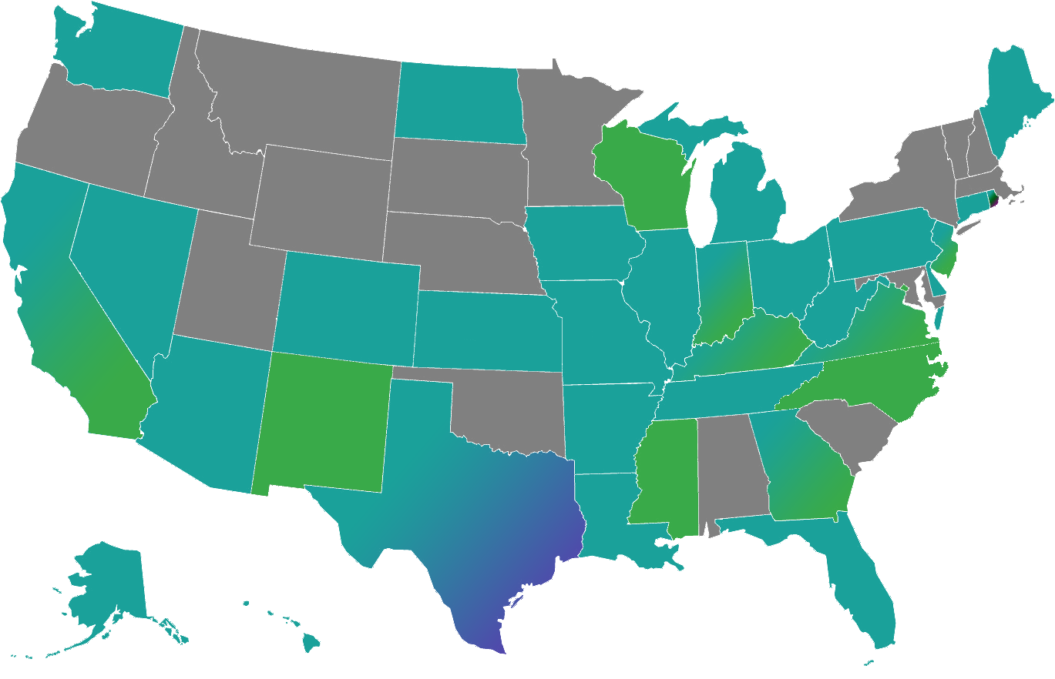
Stellarware Corporation – Visual Overview
Stellarware Corporation was founded in 1997 as a unique web design firm that focuses on improving business and government communications by employing the technological advantages of the Internet. Today, Stellarware is much more than just another web design firm. Stellarware has become a premier, web-based solutions company that serves government and private sector organizations by building web systems that modernize business
processes and
communications.
Child Support Lien Network (CSLN) | Medical Assistance Intercept System (MAIS) | New Hire Reporting

Slide 3

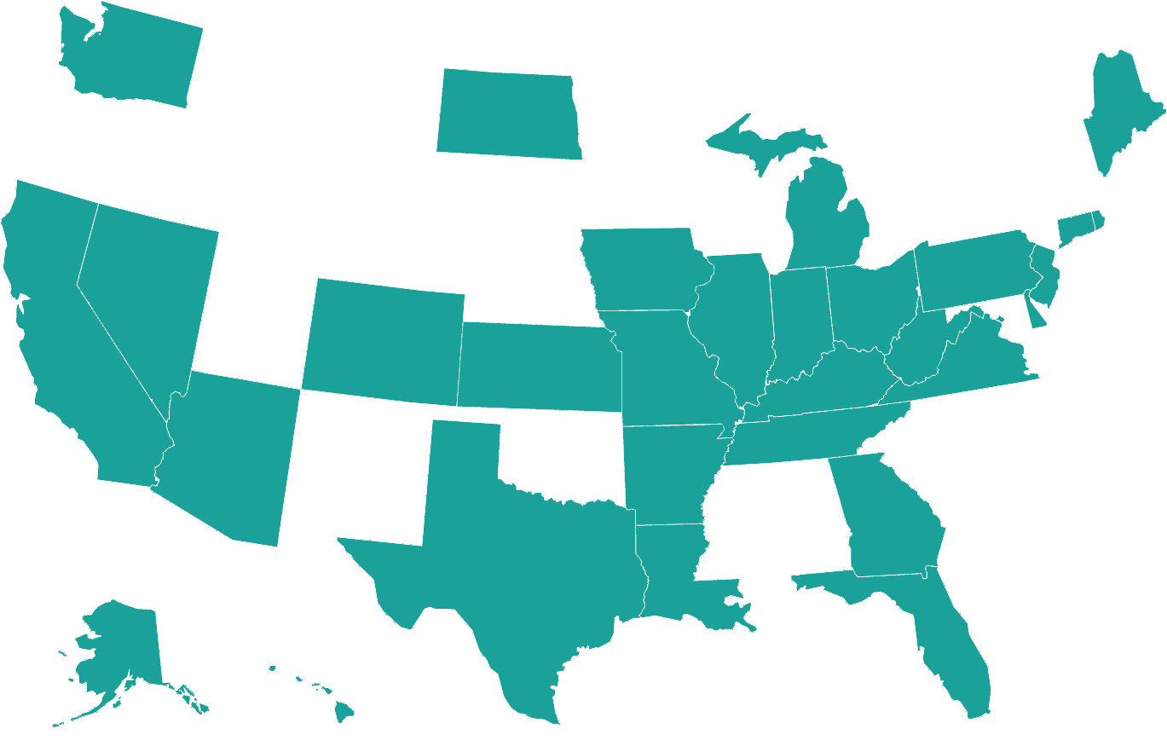
Child Support Lien Network (CSLN)
One of the largest consortiums in State government
Comprised of 31 U.S. child support agencies and over 1,800 insurance companies
Data Matching Services: Insurance Intercept (Property & Casualty, Life Insurance), FIDM, and Real Property
70% Electronic transmission rate
Cost benefit ratio of 30:1
Total collections amount of $1.8 B

Slide 4
New Hire Reporting
Managing projects in the District of Columbia, Georgia, Indiana, Kentucky, Mississippi, New Jersey, New Mexico, Rhode Island, Virginia and Wisconsin
Currently implementing new hire services for North Carolina as well as new hire compliance solutions for California
Services include employer database verification and maintenance, employer compliance and monitoring, IWO issuance, and follow-up
Innovative proprietary solutions: Employer Registry (Portal) and Outreach Module
91% average electronic reporting rate with peak periods as high as 97%
Average reporting growth of 28% across all projects

Slide 5

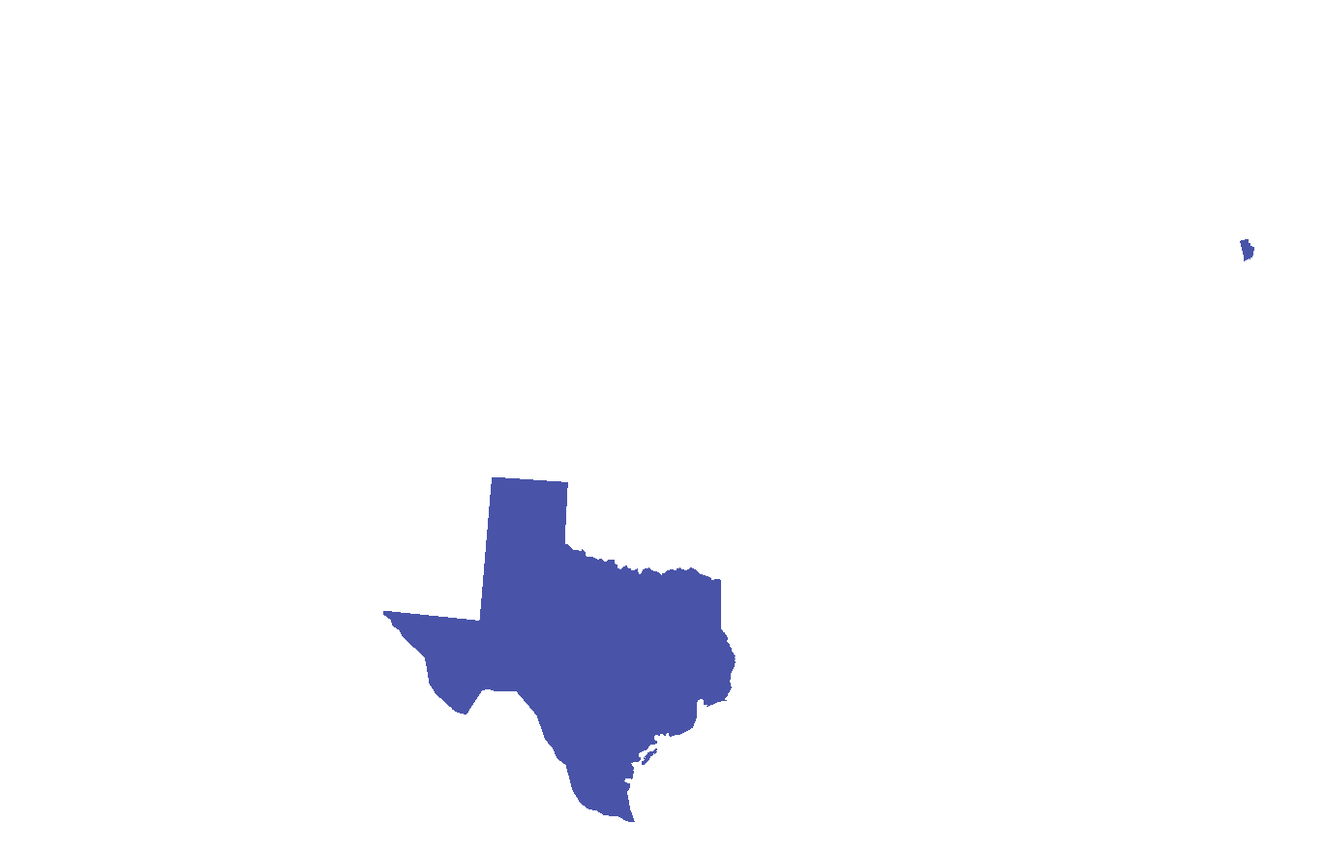
Medical Assistance Intercept System
Fully integrated and customizable online solution for Medicaid recoveries
Matches states’ Medicaid recipient records against personal injury and workers’ compensation claims
Invaluable solution for states to mitigate overall medical assistance claim costs
Since 2013, over $25 million in liens have been applied in the State of Rhode Island alone
Key features include online lookup functionality and quality assured claim verifications

Slide 6
Thank you.
Contact information:
George French, President
Stellarware Corporation
140 North Franklin Street, Suite 2-1
Holbrook, MA 02343
(781) 986-1400
gfrench@stellarware.com

