Slide 2


Systems and Methods Inc.
Family Owned and Operated
  Headquartered in Carrollton, GA
Providing services to Government Agencies since 1971:
  Child Support Payment Processing
  Document Imaging
  smiONE™ Visa® Prepaid Card
  Call Centers
  Financial Services
    Payroll
    Provider Payments
Prepaid Card Partnership with 10 States and 9 Tribes

Slide 3

Mission and Values
Notes:
At SMI we hold true to our mission of “going the extra mile with a passion to serve.” Every one of our partners is unique; no cookie cutter solutions – everything is customizable based on your unique requirements.
Our staff has extensive human service experience and specifically child support. We’re customer focused, plain and simple. As Joe would say, why do we do what we do? Simple: we have a passion to serve!

Slide 4
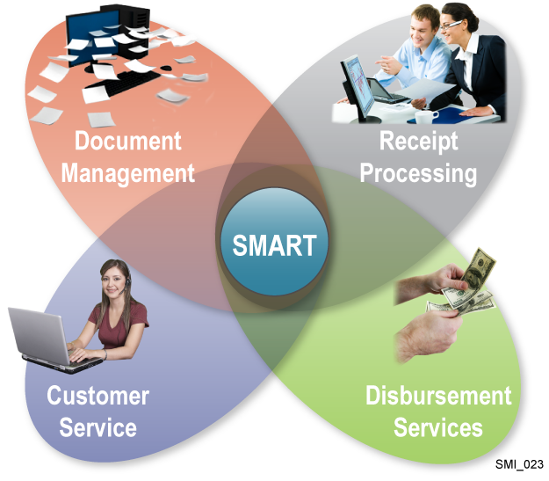
The SMI Child Support Solution
Process Payments
  SMART
    Over 67 million payments processed
    Totaling $12 billion processed
Issue Disbursements
  Checks
  ACH
  smiONE™ VISA® Prepaid Card
Notes:
Important to mention that we’re always working on the next level of technology. When we implement an enhancement in one state we’ll offer to all.
We’re also willing to work with any payment vendors.

Slide 5
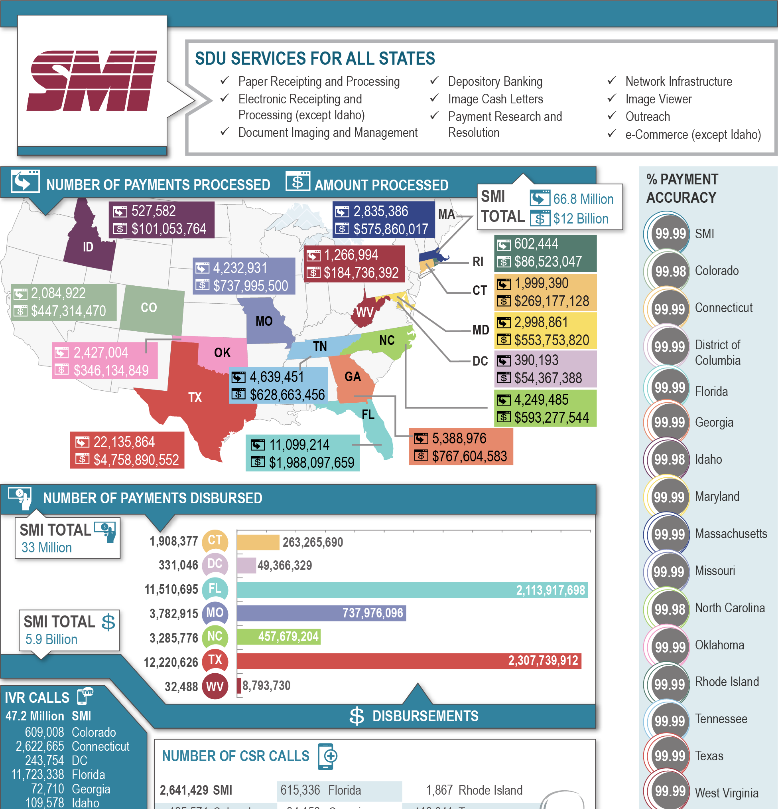
Current State Child Support Partners
Colorado
Connecticut
District of Columbia
Florida
Georgia
Idaho
Maryland
Massachusetts
Missouri
North Carolina
Ohio
Oklahoma
Rhode Island
Tennessee
Texas
West Virginia

Slide 6
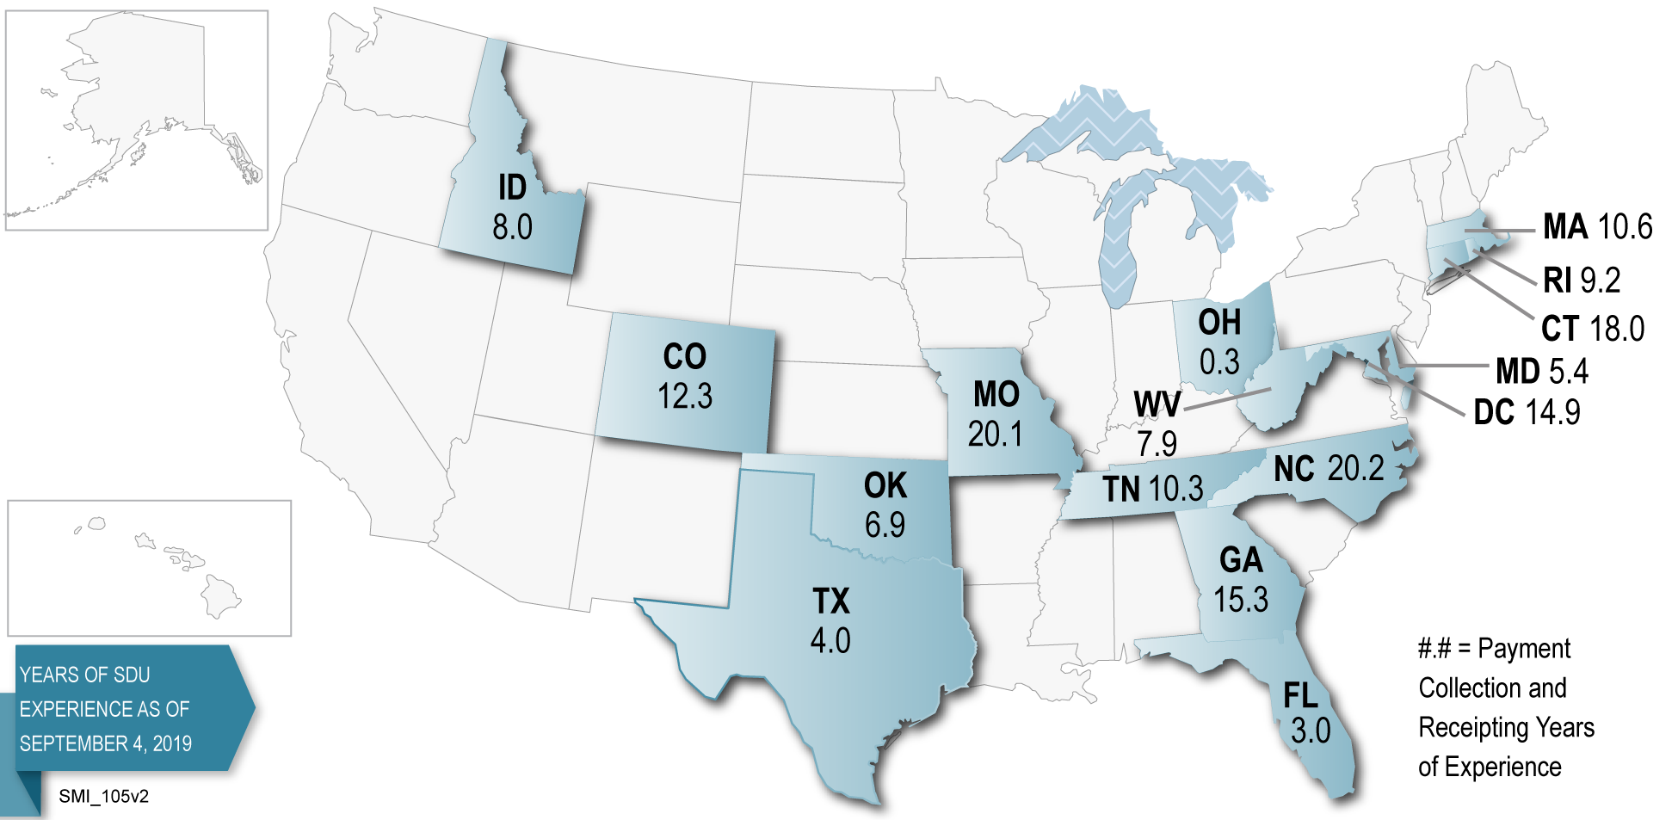

Slide 7

The SMI Difference: By The Numbers
Companywide payment processing accuracy rate of 99.99%
Processed 67 million Child Support Transactions worth over $12 billion
Awarded Best Government Delivery Prepaid Card for 2016
Serving over 1.35 million smiONE™ Visa® Prepaid Debit Cardholders
Disbursed over $4 billion to smiONE™ Visa® Prepaid Debit Cards
Handled over 56 million IVR calls
Processed over $200 million in payments to foster care providers
SMI is going the Extra Mile with a Passion to serve over 5 million families nationwide
* FY2018 Data
Notes:
Child support is what we do!

Slide 8
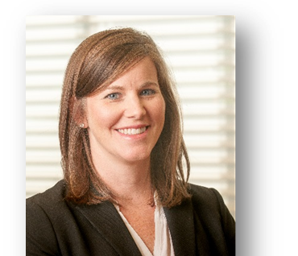
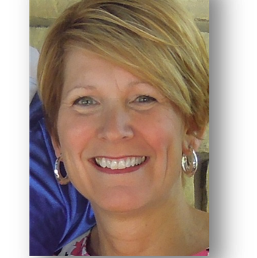

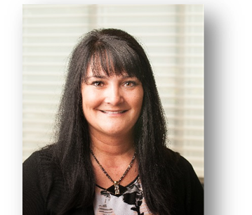
Contact Us
For more information, visit our website @
www.smi-inc.com
Joe Stone Joe.Stone@smimail.net
Karen Middlebrooks Karen.Middlebrooks@smimail.net
Lisa Skenandore Lisa.Skenandore@smimail.net
Jackie Scharping Jackie.Scharping@smimail.net

