Slide 1
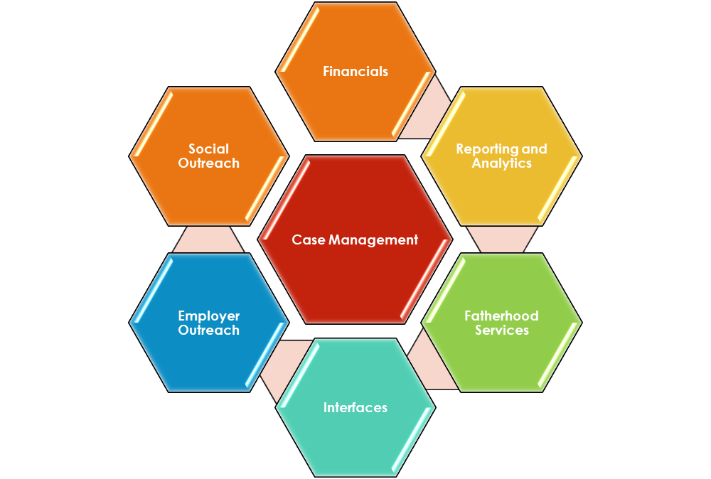
A fresh perspective for Child Support:
Incremental, Modular Modernization
Your Priorities | Quick Wins | Controlled Risk

