Slide 1
Courtland Consulting
Preferred System Implementation
Vendor Since 1990

Slide 2
Child Support Services
Plan Develop Implement Support
Stakeholder Communication & Change Management Strategies
Collaborative Partnerships with Cohesive & Dynamic Teams
System Implementation, Training & Customer Support
System User Community to Project Team
IV-D Directors to Chief Information Officers
IV-D Program to
Interface Partners
Partner Collaboration
Managers to Front Line Workers
Vendor to Vendor
State to Local Government
to Courts & Stakeholders
Project Management
Office to Developer
Trainers to Site Support

Slide 3
Our Commitment
Help leaders and end users embrace change and utilize new technology to improve job satisfaction, retention and provide outstanding service to the public
Leverage and sustain a strong communication strategy that is constant during the entire project lifecycle resulting in higher productivity and continuous movement forward with project goals
Practice a proven implementation method that is focused on the users to motivate, inspire and engage
PROJECT
SUCCESS
Job
Satisfaction
Higher
Productivity
Engagement
of Users

Slide 4
User-Focused Implementation
Communication Strategy
INITIATION & PLANNING Organizational Assessment Change Management Organizational Buy-in Data Preparation Implementation Plan Training Plan | PRE DEPLOYMENT Application Impact Analysis Training Materials User Training Go-Live Readiness Assessment Data Conversion/ Go Live Help Desk Prep & Setup | POST DEPLOYMENT On-site Support Help Desk/Triage Training Material Updates Ongoing Training Support eLearning Webcasts & Webinars Training & Support Website | SUPPORT / TRANSITIONAL Help Desk/Triage Training Material Updates Ongoing Training Support eLearning Webcasts & Webinars Training & Support Website

Slide 5
State of Michigan
MiCSES Statewide Child Support Project
Status: Active
1990 – 2003: Implementation of new system, Courtland provided Conversion, Application Development, Business Analysts, Subject Matter Experts, Testing, Training, Site Support and Helpdesk services.
2004 - Present the MICSES project has transitioned to maintenance mode, Courtland continues to provide Business Analysts, Subject Matter Experts, Testing and Training staff.
Partner: Accenture

Slide 6
State of New Jersey
NJKids Statewide Child Support Project
Duration: 2006 -2017
During initial implementation Courtland was responsible for Conversion, Implementation, Site Support, Training and Help Desk services.
After project completion in 2011, Courtland provided Staff Augmentation support for the 2500 users in Finance, Probation, CWA and Family Offices throughout the State until the end of 2017.
Partner: Protech Solutions

Slide 7
State of Delaware
Delaware Statewide Child Support Project
Status: Complete
Duration: 2010 – 2014
Scope: Statewide Child Support Implementation, Training, Help Desk and Business Analysts for 800 users
Partner: Conduent

Slide 8
State of South Carolina
South Carolina Statewide Child Support Project
Duration: 2015 to present
Statewide Child Support Project Management, Implementation, Site Support, Deployment, Training and Helpdesk for 46 counties and 800 users
Partner: Conduent

Slide 9
State of Nevada
Nevada Statewide Child Support Project
Duration: 2019 to present
Statewide Child Support Implementation, Training, User
Support & Help Desk Services for 500 users.
Partner: Protech Solutions

Slide 10
Michigan Supreme Courts/Circuit Courts
Impact Evaluations
Duration: 2001 – 2018
Conducted evaluations of grant funded court improvement projects aimed at improving the child support program.
Focused on alternative methods of dispute resolution, unique partnerships, and non-adversarial approaches

Slide 11
Federal Office of Child Support Enforcement
Demographic Survey & Analysis of 10 States w/the Largest CSE caseloads
Partner: Urban Institute
Impact evaluations of 1115 Child Support Demonstration Grants & SIP Grants
Focus: Fatherhood programs, marketing of child support, asset building and holistic practices
Projects: Dads From Day One, Fatherhood/Healthy Marriage Grant, Kent County Cooperative Parenting Grant, Kent County REACH Asset Building Grant

Slide 12
National & Regional Non-Profit Organizations
Courtland provides web design & development for the following organizations:
ERICSA: Eastern Regional Interstate Child Support Association
MIFSC: Michigan Family Support Council
NTCSA: National Tribal Child Support Association
NATCSD: National Association of Tribal Child Support Directors
WICSEC: Western Intergovernmental Child Support Engagement Council

Slide 13
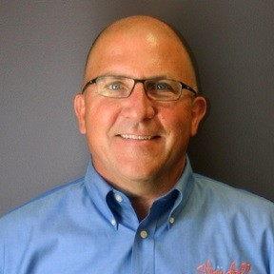
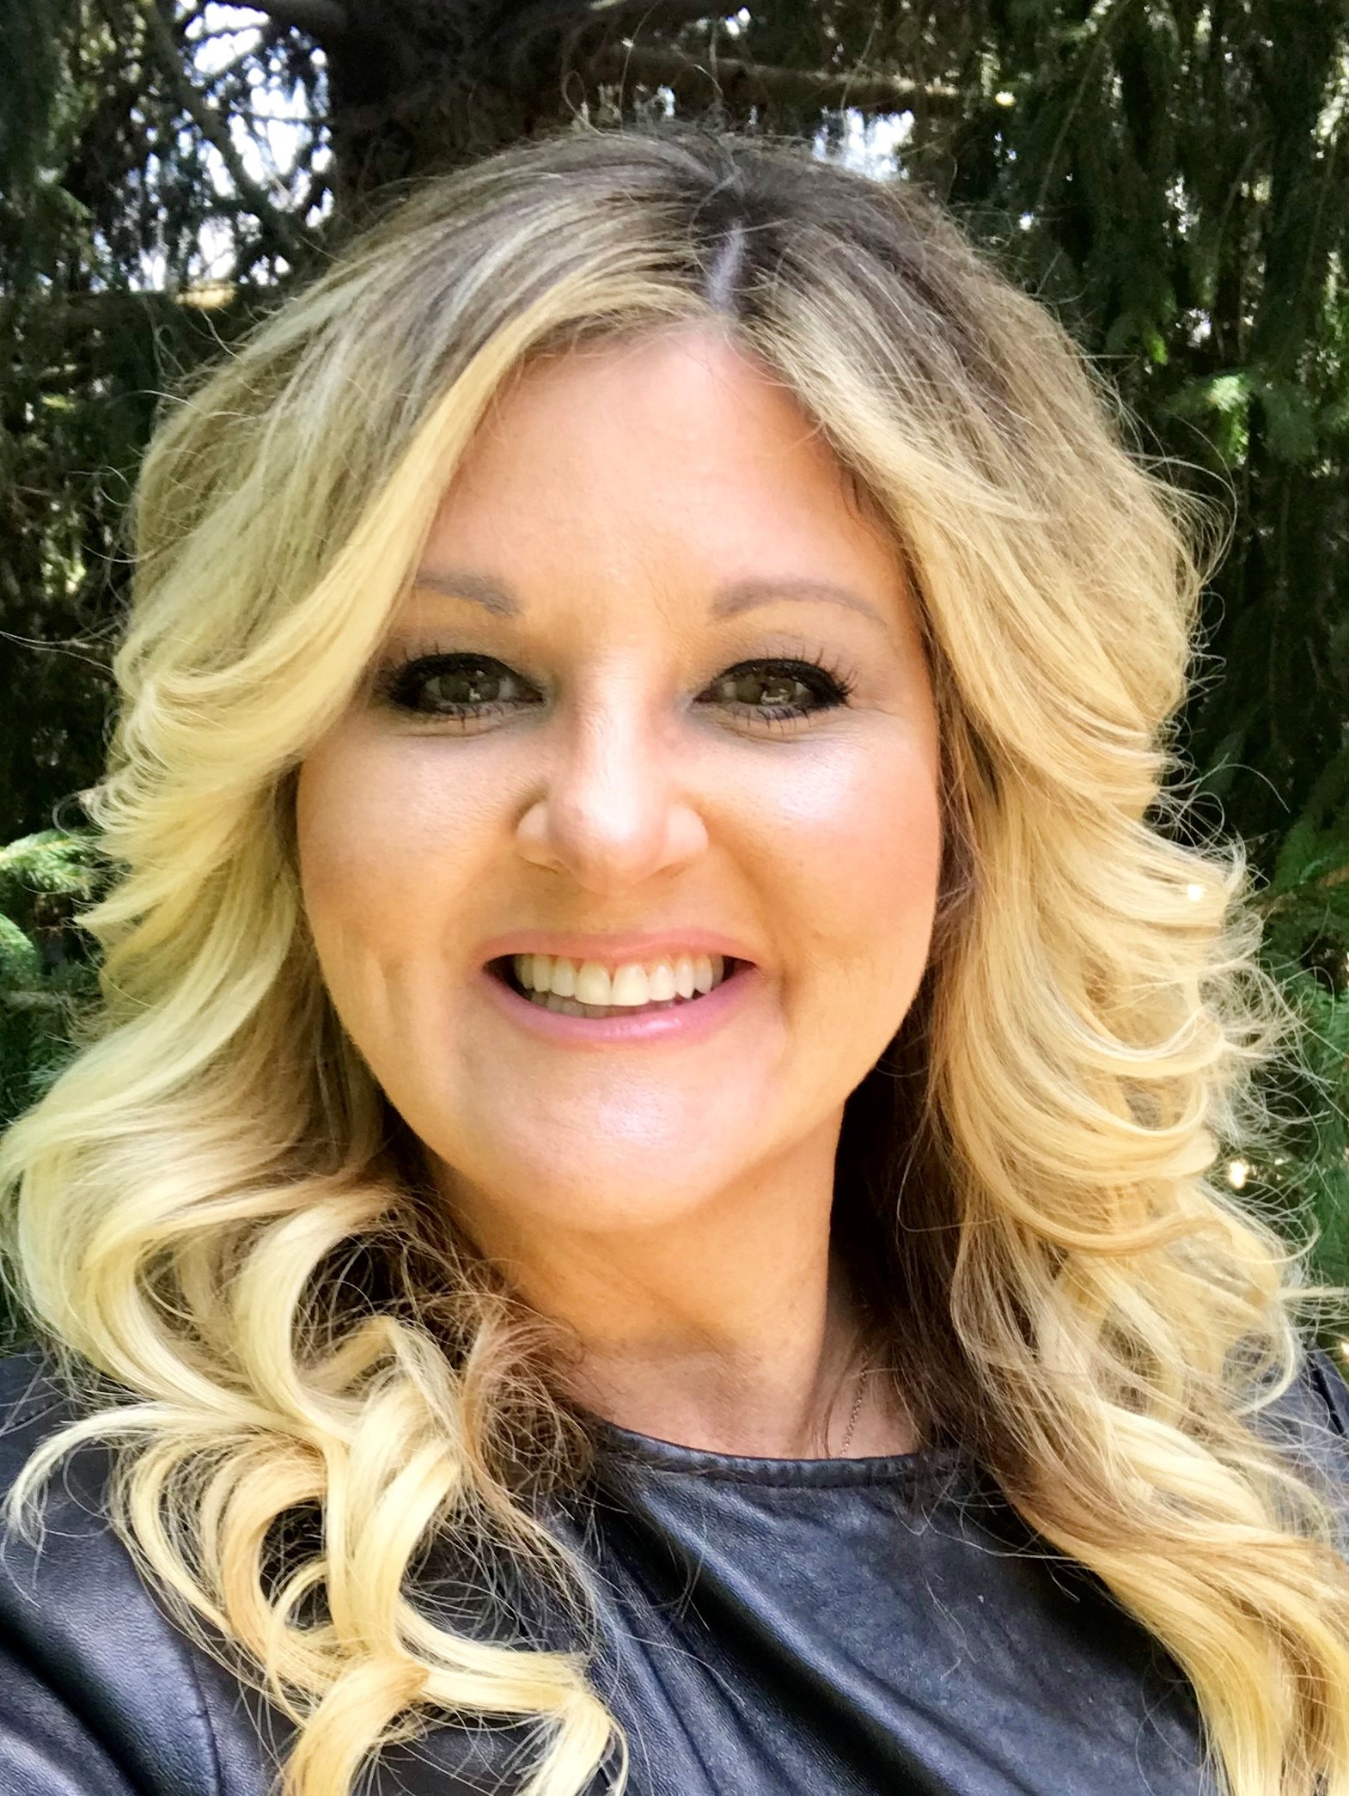
Let’s Connect!
Steven Trudell, Owner & President
trudells@courtlandconsulting.com
(517) 908-3941
Sharon Pizzuti, Executive Director
pizzutis@courtlandconsulting.com
(517) 908-3943
CourtlandConsulting.com
Facebook.com/CourtlandConsulting
Twitter.com/CourtlandCares
Linkedin.com/company/courtland-consulting

