Slide 1
New Mexico Child Support Services (oops, we are still the Child Support Enforcement Division)
Step Up Program

Slide 2
Why should we change what we are doing?

Slide 3
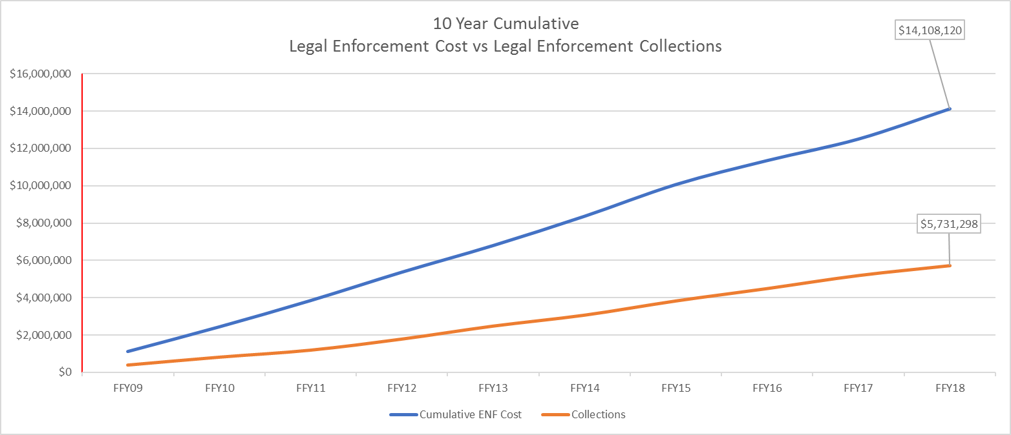
Debt driven Legal Enforcement

Slide 4
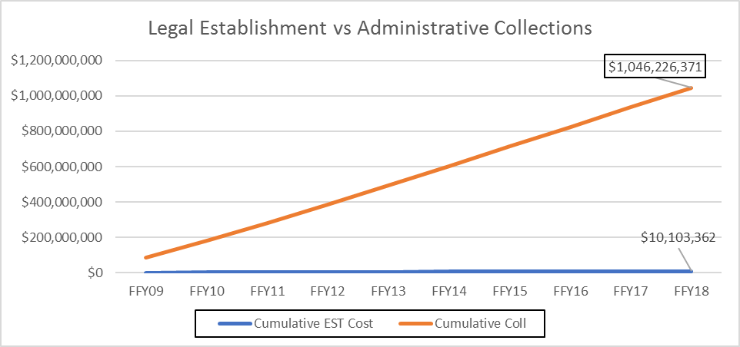
Administrative Enforcement Collections

Slide 5
CSED
Mission and Vision
The New Mexico Child Support Enforcement Division will put children first by encouraging both parents to assume responsibility for improving the economic and social well-being, health, and stability of their children

Slide 6
How will we change?
We need to get back to our Mission

Slide 7
NM CSED 4 year Strategic Plan:
Improve Front Line Staff Retention (
  4yr 35% avg. attrition down to 19%
Fill Vacancies
  8yr 26% avg. vacancy rate down to 0% (7/19)
Develop and Implement Data-Driven Business Model
  New performance metrics already in use in 2 Pilot offices
Develop and Implement Process Improvement Methodology
  Created Performance Management Office developing a lean Six-Sigma model
Align Policy (7 Statute revisions needed) to Federal Modernization Rules and National Best Practices
  All regulatory revisions that could be made have been
Implement Child Support Technology Plan (integrate into Modular MMIS)

Slide 8
STEPup Project:
Supporting, Training, and Employing Parents
Phase II of Data Driven Business Model Pilot
Partnered with New Mexico Dept. of Workforce Solutions (DWS)
2 DWS Employment Specialists in Pilot office 1 day a week
DWS staff sit with customer for an hour to:
  Create a profile in the DWS system
  Create a Skills based Resume in the DWS system
  Train them on using the DWS system
  Identify Independent Employment Plan (includes identifying employability roadblock, I.e. education, substance abuse, incarceration history, or behavioral health needs)
  In 3 weeks 11 customers have been scheduled and 9 have showed and completed the process.

Slide 9
STEPup Project: (yes we stole this name from Maryland)
Supporting, Training, and Employing Parents
Who is eligible?
  Every CSED Customer (New Mexico Statute requires work participation for non-paying NCPs)
How is the project funded?
  DWS provides their staff and CSED provides the DWS staff an interview room
  For the next FY, CSED has requested state funding for ½ of 21 DWS positions
    CSED is working on the OCSE Waiver as we speak!
    These positions will put one staff in 11 of our offices full time, 2 in one office full time, and 3 full time staff in our 3 large offices

Slide 10
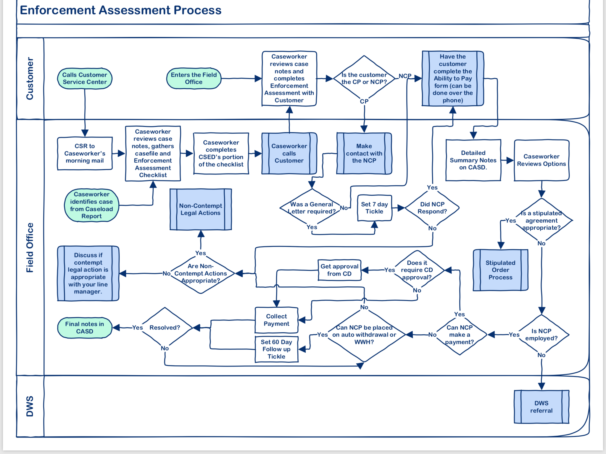
STEPup Project: Starts with Ability to Pay Assessment

