Slide 1
Innovative Solutions to Improving Customer Service

Slide 2
Tanguler Gray Georgia IV-D Director

Slide 3
Division of Child Support Services
Our Mission is to Enhance the Well- Being of Children by:
Locating Non-Custodial Parents
Establishing paternity
Establishing, enforcing and modifying support obligations (financial and medical)
Collecting and distributing support payments
Georgia’s Vision is to be:
Ranked in the top 10 states nationally
Recognized nationally as a trendsetter for best practices
Best managed division in the state of Georgia
Program of choice for employment and outreach partnerships
DCSS is Governed by these Values:
Put Children First
Children need both parents
Customer Interaction is an opportunity
Employees are valuable resources

Slide 4
Program Data
DCSS is responsible for the statewide administration of the child support enforcement program under the provisions of Title IV‑D of the Social Security Act (42 U.S.C. 651 - 669).
Program Legislative Authority
State Authority / Reference
Official Code of Georgia, Annotated, Titles 9 and 19 and Departmental Rules, DHS Rules at 290-7-1
Federal Authority / Reference
Code of Federal Regulations, Title 45, Parts 300-399
Budget
Total budget SFY2019
$109,195,624
% State funds
27%=$29,672,610
% Federal funds
70%=$76,285,754
% Other Funds
3%=2,841,500
Program Information
Performance indicators | Performance Measures: Paternity establishment Order establishment Current support paid
Arrears support paid
Undistributed collections
Locate
Collections
Cost Effectiveness
Total offices
58 local offices excluding state, region and specialty/hub offices
Total number of positions
1,122
Total caseload as of 9/30/18
390,096

Slide 5
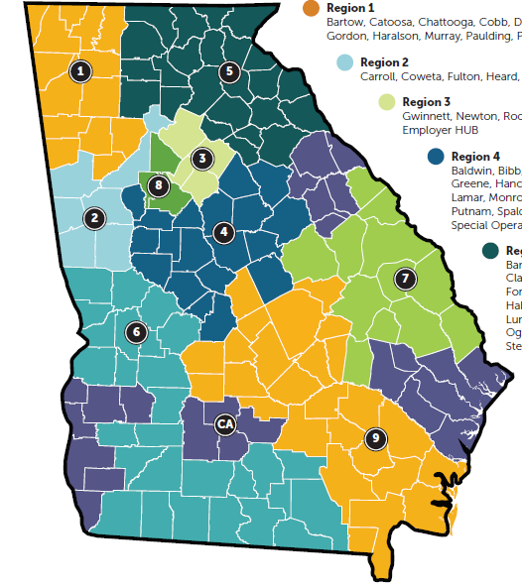
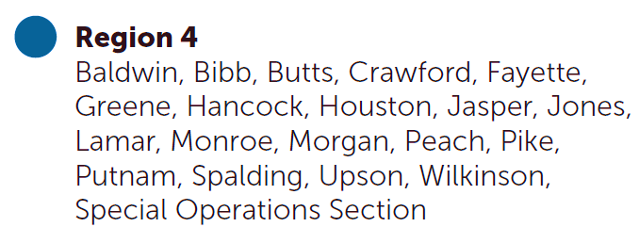
DCSS Region Map

Slide 6
Child Support Services
Intake
Walk-ins
Mail
Portal
Referrals
Locate
Automated interfaces and manual searches
Paternity Establishment
Paternity testing
Financial
Centralized payment processing by the Family Support Registry (FSR)
Outreach Programs
DCSS has partnered with other government and community agencies to develop a comprehensive network of services – Fatherhood and Parental Accountability Court Programs.
Court Order Establishment
Financial Support
Medical Support
Process service (Sheriff or private process server)
Enforcement
Administrative and judicial actions to collect delinquent payments
Review & Modification
Administrative and/or judicial review of orders 36 months old or older for
possible modification of support amount

Slide 7
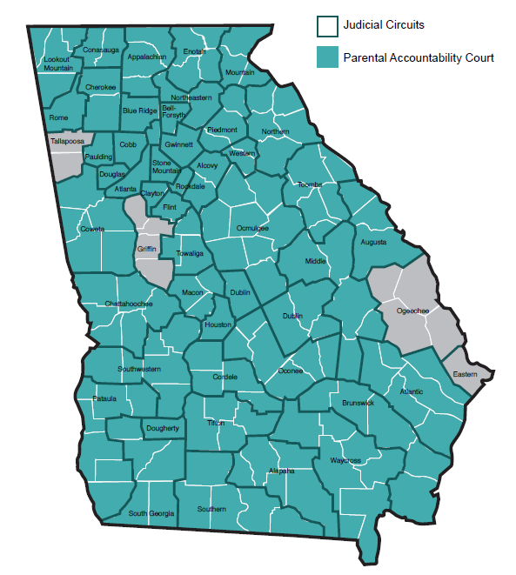
Community
Outreach
Aids unemployed or
underemployed parents.
Connecting participants with
resources that lead to jobs, greater
self-sufficiency, and more emotional, parental,
and financial involvement.
Collaborates with Superior
Court Judges and Community
Service Boards to offer alternatives
to incarceration to chronic nonpayers.
Barriers that keep parents from meeting their support obligations are addressed under Judicial oversight .
Services
Community awareness
GED classes
Short-term training
Resume writing
Federal bonding
Access & visitation
Referrals for legitimization
Job placement, coaching & mentoring
Services
Substance abuse treatment
Job assistance/ placement
Literacy training
Mental health services
Clinical assessments
Education Services
Enrollment into Georgia Work Ready Program
Goal: PACs in all 49 judicial circuits in SFY19.
6,511
parents enrolled in the
Fatherhood program
9,173
children supported
1,340
NCPs enrolled in GED classes through the Fatherhood program.
1,174
participants enrolled in short-term training programs
3,163
NCPs at risk of
incarceration who avoided jail
time & provided support to
6,835
of Georgia’s children. Program participants
paid an estimated
$9 million +
to support families
Fatherhood Celebrations
Fatherhood Conversations
Fatherhood participants who have had their driver’s licenses suspended nonpayment can regain driving privileges.
Parental Accountability Courts are in
45 out of 49
judicial circuits across
the state.

Slide 8
Self Service Options FFY19
Customer Contact Center
Customer Online Services Portal
Mobile App
Calls
offered
iPhone-
114,783
Calls
answered
Android-150,938
NCP’s registered during FFY
Chats
offered
Dual- 8,811
NCP’s accessed portal during FFY
Custodian- 66,391
Chats
fulfilled
Non Custodial- 43,868

Slide 9
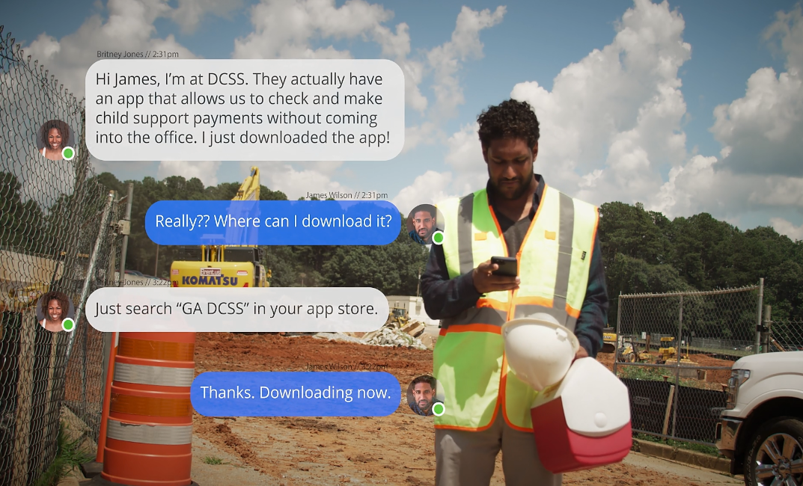
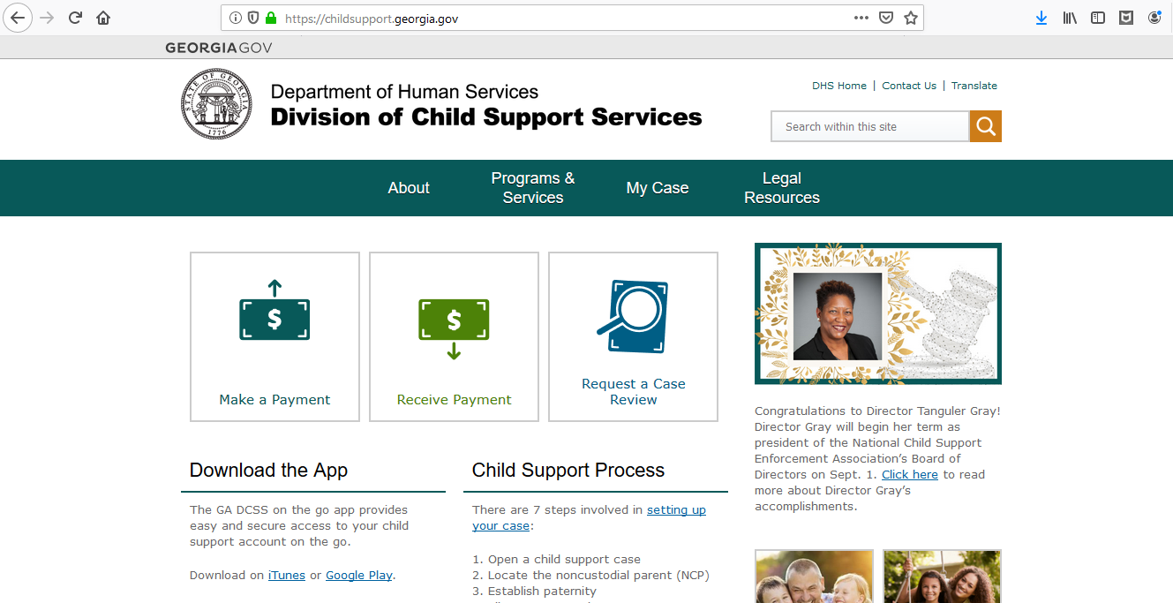
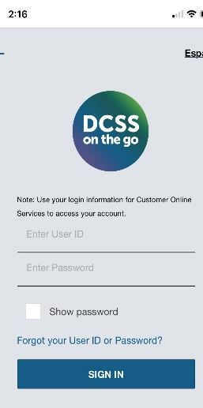
Local Office Videos
Marketing Strategies
Child Support Commercial
Mobile App
288,291+
Number of downloads since rollout
Everything Georgians need to manage their child support case in the palm of their hands.
125,440+
Number of active users

Slide 10
Hybrid Mobile Application
The latest IOS and Android operating systems enable app to act as websites while still having to access device features like camera.
GPS
Geospatial capability
Benefits of
Mobile App
Advanced Features
Document upload, signature, and integrations with Document Imaging System (DIS) & $TARS
Accessibility
No browser needed.
Offline Access
FAQ's, Driver’s license release process, Fatherhood and Parental Accountability Court access
Brand Presence
The app icon acts as an advertisement for the brand.
Cost-Effective and Easy Maintenance
Inexpensive cross performing
Hybrid App
Push Notifications
Payment Reminders, Case Updates, etc.
Performance
High speed network access, quality, and speed

Slide 11
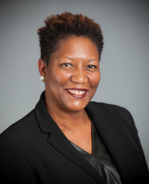
Thank you!
Questions
Tanguler Gray
Director
Georgia Department of Human Services
Division of Child Support Services
Office phone: 404-463-0992
Email: tanguler.gray@dhs.ga.gov

Slide 12
Jim Fleming North Dakota IV-D Director

Slide 13
Transforming the Child Support Customer Experience in North Dakota
This Photo by Unknown Author is licensed under CC BY-SA

Slide 14
State Demographics
70,761 Square Miles
217 Miles North to South
353 Miles East to West
760,077 residents
34,303 open IV-D cases
163.2 Full-time Equivalent Positions (all in-house)
53 counties, 8 Field Offices, including Dickinson (6 FTE), Williston (7 FTE), and Jamestown (8.2 FTE)
74% of collections received electronically
98% of collections disbursed electronically
Until 2007, ND was county-administered

Slide 15
Catalysts for Change
Performance no longer improving
Need for greater consistency of service between offices, especially for parents with multiple obligations
Retiring workforce and difficulty in recruiting for smaller communities
Declining number of in-person contacts with customers
5% staff reduction due to state revenue lower than forecasted
Lack of funding for travel expense for statewide training
Lost opportunities for efficiency through specialization
Statewide voluntary separation program

Slide 16
Where to Begin?
Count number of in-person customer contacts, by category
Assess IV-D services that must be provided locally or can be provided remotely
Strengthen website functionality and usability
Still mailing an authorization code? Welcome to the new Millenia
Paperless offices – immediate scanning of all incoming documents
Embrace remote supervision and telework
Theories of Constraint: What is Job #1?
Protect, defend, and guard the workload for caseworkers
Automated System - what can we improve?

Slide 17
Becoming the AmazonTM of Child Support
Remove field office location information from website and public materials
Business cards on how to pay and communicate electronically
Forward all field office calls to the State Disbursement Unit
Increase use of IVR and SDU to screen calls and reduce interruptions to assigned caseworkers
Selectively reallocate vacant field office positions to SDU
Encourage walk-in payers to use website or pay SDU
Brief the legislature during budget hearing

Slide 18
Becoming the AmazonTM of Child Support
Soft closing – one field office in November 2018 after moving to new location
Batten down the hatches – May 28, 2019
Field offices are closed to public
Staff are available for in-person conversations by appointment only
Signs posted 6 weeks in advance that office will no longer be open
Liberal appointment policy – call from the vestibule, if staff are available

Slide 19
Improving the Customer Experience
Locking customers out and making it harder to reach staff IMPROVES customer service?
Scheduled appointments are more productive because caseworker is able to familiarize with latest case activity
Reduction in interruptions for caseworkers increases time for casework
By reducing incoming calls, caseworkers can be more prompt in responding to calls that they need to return
Customers quickly adapted and realized website, e-mail, and IVR met their needs on their own schedule

Slide 20
Customer Backlash
(imagine sound of crickets chirping)

Slide 21
What Happened?
Collections in June and July 2019 INCREASED compared to 2018
Confirmation that customers don’t need or want in-person contact for many case activities – can be nudged to electronic
5% reduction in staff with very little negative impact on collections or customer service
Flexibility to approve alternate work schedules and telework
Statewide (and worldwide) recruiting for vacant positions
Reduced costs for office space
Centralization of staff for training purposes
Adapts easily to inclement weather

Slide 22
Rough Spots
Private attorneys wanting to by-pass IVR to talk to opposing counsel
SDU being asked to respond to a wider array of phone calls
Caseworkers still need to pick up the phone
SDU workers having access to schedule caseworker appointments
Voice mail
Brief absences – leave message
Longer absences – how to know to refer to back-up?
Maintaining comparable caseloads
Response times for phone calls

Slide 23
What’s Next?
Centralized incoming mail center
New organizational structure based on function rather than location
Further specialization
Charters for each new specialized unit
Change case assignment rules for enforcement cases
Poised for increase in caseload from resumption of referrals from Medicaid program

Slide 24
Takeaways
Customers can be moved toward electronic communication
It is not necessary for much of casework to be provided face-to-face
Payment patterns can change

Slide 25
Lyndsy Irwin Mississippi IV-D Director

Slide 26
Mississippi IV-D Program
Caseload: 268,283
State Administered: with Statewide Privatization of Offices
FTEs: State ~25; Privatization Vendor ~431
24 District Offices: 2 Case Processing Centers, Customer Service Center
Budget: Total-$38-44M
IVR: July 2019: ~369,000 calls, ~302,000 resolved in the IVR with ~61,780 transferred to CSRs.
Customer Service Center: July 2019: ~61,085 calls received but only ~39,700 calls answered. More than 15% abandoned at greater than 5 minutes, and the average wait time was 7:46.

Slide 27
What is GenBot?
Child Support
FAQ
Support Requests
Find Gen
CUI currently supporting participants and stakeholders of the Child Support program.
Answers FAQ's, Provides geo-located office information, Payment Calculators: Customers and Employers, Support Requests.
Contempt, Review and Modification, Change of Information, Change of Employment, Case Closure, Report Information, Receive Payment History, Add Authorized User, General Inquires
https://www.mdhs.ms.gov/

Slide 28
Why GenBot?
1
2
3
Tools
Workflow
Metrics
Need more self-help options for families. Prior to Gen, the IVRS was the only option.
High-call volumes, wait times and transfers to customer service representatives.
Lack of data into needs of customers and how to make continued improvements to best meet their needs.
4
5
6
Transparency
Services
Policy
Lack of transparency into how requests are being handled and difficulty tracking contract SLAs.
24 / 7 access, FAQs, Calculators, Support Requests, Office Locations.
Improve transparency by connecting to CASEYBot.

Slide 29
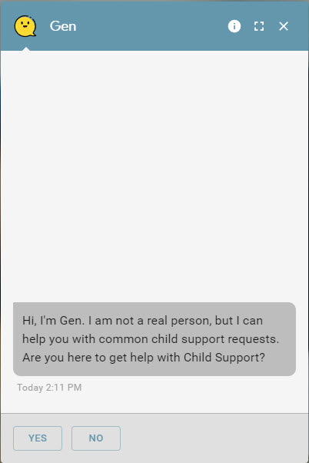
Expected Outcomes
Modernize
Provide a modern self-help tool that program participants will use.
Call Volumes
Reduce call volumes and number of inquiries and complaints for commonly requested information and action requests.
Analytics
Use data analytics to improve interactions with participants in the future.
Monitor
Monitor performance of legal services/case management vendor (Jira).

Slide 30
Outputs/Outcomes
21,301
19.6
TOTAL USERS
MINUTES
4,933
231
AVERAGE CONVERSATION DURATION
ENGAGED USERS
SUPPORT REQUESTS
* Hard Launch 8/5 (Data last 30 days from 8/26)

Slide 31
Contract Management/SLAs
GenBot tickets are submitted via Jira Service Desk.
Case Management vendor has access to Jira to handle tickets, but the plan is to communicate directly with vendor’s workflow management system.
Jira tracks service level agreement (SLA) timeframes to allow the state to quickly identify when tickets are not handled timely.
Along with GenBot tickets, all complaints received at State Office will be submitted through Jira for better tracking of SLAs, and plan is to submit all case reviews and self-assessment findings through Jira as well.

Slide 32
Lessons Learned & Future Plans
Lessons Learned
AGILE!
KNOW YOU CLIENTS
PLAN
TESTING
Build incrementally with regular iterations.
Understand the lingo.
Plan for gaps and provide positive responses.
Test, test, test!
Future Plans
PRIORITES
PORTAL
EXPAND
Use data to determine priorities in developing a child support client portal.
Interface with the child support portal once developed.
Expand to other programmatic areas.

Slide 33
Data Analytics

Slide 34
Data Analytics

Slide 35
Data Analytics

Slide 36
Questions?
Thank you!

