Slide 1
Exemptions and Waivers for Activities that Improve the Child Support Program
2019 NCCSD Conference
Great Lakes, Great Future

Slide 2
Authority and Guidance
Incentive Exemption
Section 458(f)
IM-18-02 Use of IV-D Incentive Funds for NCP Work Activities
AT-01-04 Reinvestment of Child Support Incentive Payments
Waiver Project
Section 1115
IM-19-04 Availability of Section 1115 Waivers to Fund NCP Work Activities
Memo 88-1 Social Security Act Waivers

Slide 3
Incentive Exemption Quick Facts
Not eligible to receive Federal Financial Participation
State can determine amount to invest in exemption activity
Apply to OCSE before the funds are actually used for the activity
Follow the guidance provided in AT-01-04 when applying for OCSE approval
Renew with an annual request for approval, including the amount to be expended in the upcoming year and the amount expended in the preceding year

Slide 4
Waiver Project Quick Facts
State funding share is 34%, as with normal child support program operations
Federal funding share is 66%, up to a maximum of $2 million for the duration of the project
Funding typically for 2-5 years, depending on costs
Can be public-private partnership, if a foundation or other private funder contributes the state’s share
Private funding of state share requires a waiver from the requirement to fund the state share with public dollars

Slide 5
Letter Requesting to use Incentive Exemption
give specific, detailed information on the activity the incentive payment will fund
state what portion of the payment will be spent on this activity
explain how this activity will improve the effectiveness or efficiency of the state's CSE program
show a clear connection to and collaboration with the state CSE program
give the time period for this activity (is this a one-year or ongoing request)

Slide 6
Application for Waiver Project
goals and objectives
program requirements to be waived, or services that are not funded under current regulations
project description
implementation plan
evaluation plan
budget
population to be served

Slide 7
Technical Assistance
OCSE Division of Policy
OCSE Division of Program Innovation
OCSE Regional Offices
Knowledge Works! Resource and Toolkit

Slide 8
Questions and Information
Barbara Lacina barbara.lacina@acf.hhs.gov

Slide 9
National Council of Child Support Directors
2019 Annual Meeting and Conference
Great Lakes, Great Future
State of North Carolina
Incentive Exemption Process
Carla West
Director
State of North Carolina
Division of Social Service
Child Support Services
September 9, 2019

Slide 10
Guidance Received from OCSE
IM-18-02
Clarifies that HHS approves exemption requests to use incentive funds for employment programs for non-custodial parents
TANF-ACF-IM-2018-01
Reminds states that they may use TANF funds to serve noncustodial parents in employment programs

Slide 11
Guidance Received from OCSE
Other non-IV-D activities that may qualify for funding with incentive payments include, but are not limited to:
  Programs targeting incarcerated or putative fathers
  Teen pregnancy programs
  Mediation or couples counseling
  Visitation issue resolution when linked to nonpayment of support
The requested activity must show a clear connection to and collaboration with the state CSE program

Slide 12

It starts with a vision…
Notes:
North Carolina is a State Supervised – County Administered state.
- Talk about the steps that counties have to take to use their incentives, the process the state follows with OCSE, and the oversight that the state provides.

Slide 13
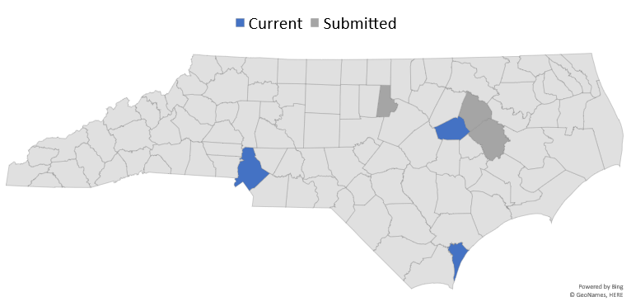
North Carolina Incentive Exemptions
Current:
New Hanover County
Mecklenburg County
Wilson County
Submitted:
Pitt County
Durham County
Edgecombe County
Completed:
Edgecombe County
Durham County

Slide 14

Plans vary…
Women’s Empowerment Conference
Job Readiness & Placement Programs
Fatherhood Initiative - 24/7 Dad Curriculum
Parenting skills
Strengthening economic mobility and stability
Life Skills
Conflict Resolution
Family Mediation
Education and Job training
Notes:
COMPLETED Durham County – VIP Corporate Sponsor at Women’s Empowerment
Opportunity for customer engagement approach.
Provide greater community awareness of the Child Support program and its benefits.
PENDING Durham County - Job Readiness & Placement Program for NCPs
Increase employability of participants by connecting NCPs with community resources that provide:
Guidance for completing employment applications
Resume writing
Appropriate attire for interviews and work
Interviewing skills
Communication skills
Identify barriers to employment and connect NCPs with appropriate resources
PENDING (and COMPLETED) Edgecombe – Fatherhood Initiative Program
24/7 Dad program to increase employment
CURRENT Wilson County – Fatherhood Initiative using the Mom as a Gateway Booster Session
Education and job training, mental health assessments, 24/7 Dad curriculum and referrals to county resources.
CURRENT Mecklenburg County – Empowering Fathers Fatherhood Program
Strengthening families through parenting skills, economic mobility, economic stability, life skills, conflict resolution, homelessness and substance use.
PENDING Pitt County – Employment of Social Worker to work with NCPs
Seeking to enhance total collections by having a social worker to work directly with NCPs who are unemployed/underemployed to promote dual self-sufficiency (that of the NCP and client) by improving the NCPs ability to pay.
CURRENT (and COMPLETED) New Hanover – Family Support Program
OPERATING SINCE 2013
Help eliminate barriers and promote self-sufficiency for NCP’s by education and job training, family mediation, cooperative parenting classes and referrals to other community resources.

Slide 15
Exemption Application
A letter detailing specific information on the activity the incentive payment will fund
A detailed budget
An explanation on how the activity will improve the effectiveness or efficiency of the state's CSE program
Show a clear connection to and collaboration with the state CSE program
Give the time period for this activity

Slide 16
Exemption Budget
For staffing – include salary and benefits
For contracting – include entire cost of the contract
For participants – include detailed explanation of all costs
  Supplies and training materials
  Education expenses
  Events
  Advertising and Marketing

Slide 17

How we track…

Slide 18
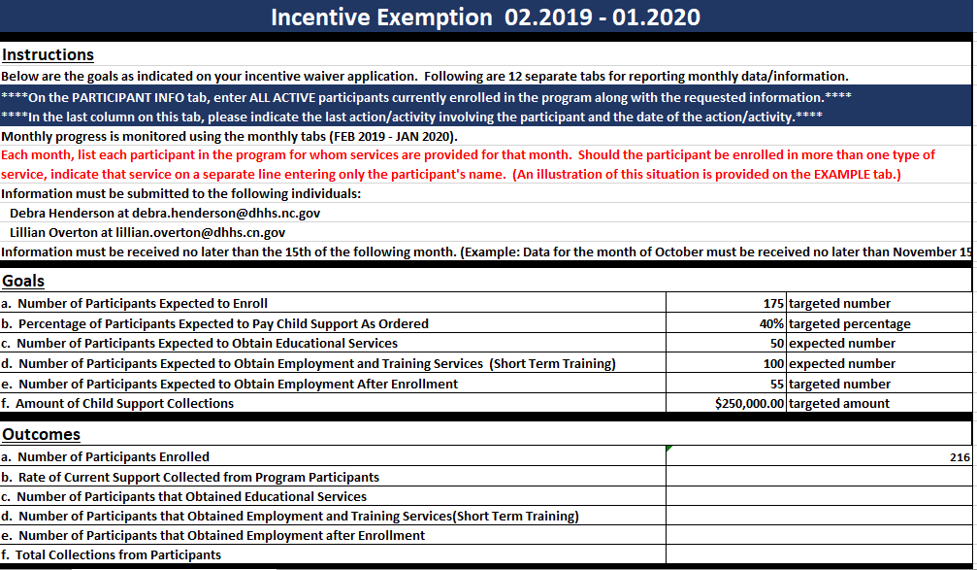

Slide 19
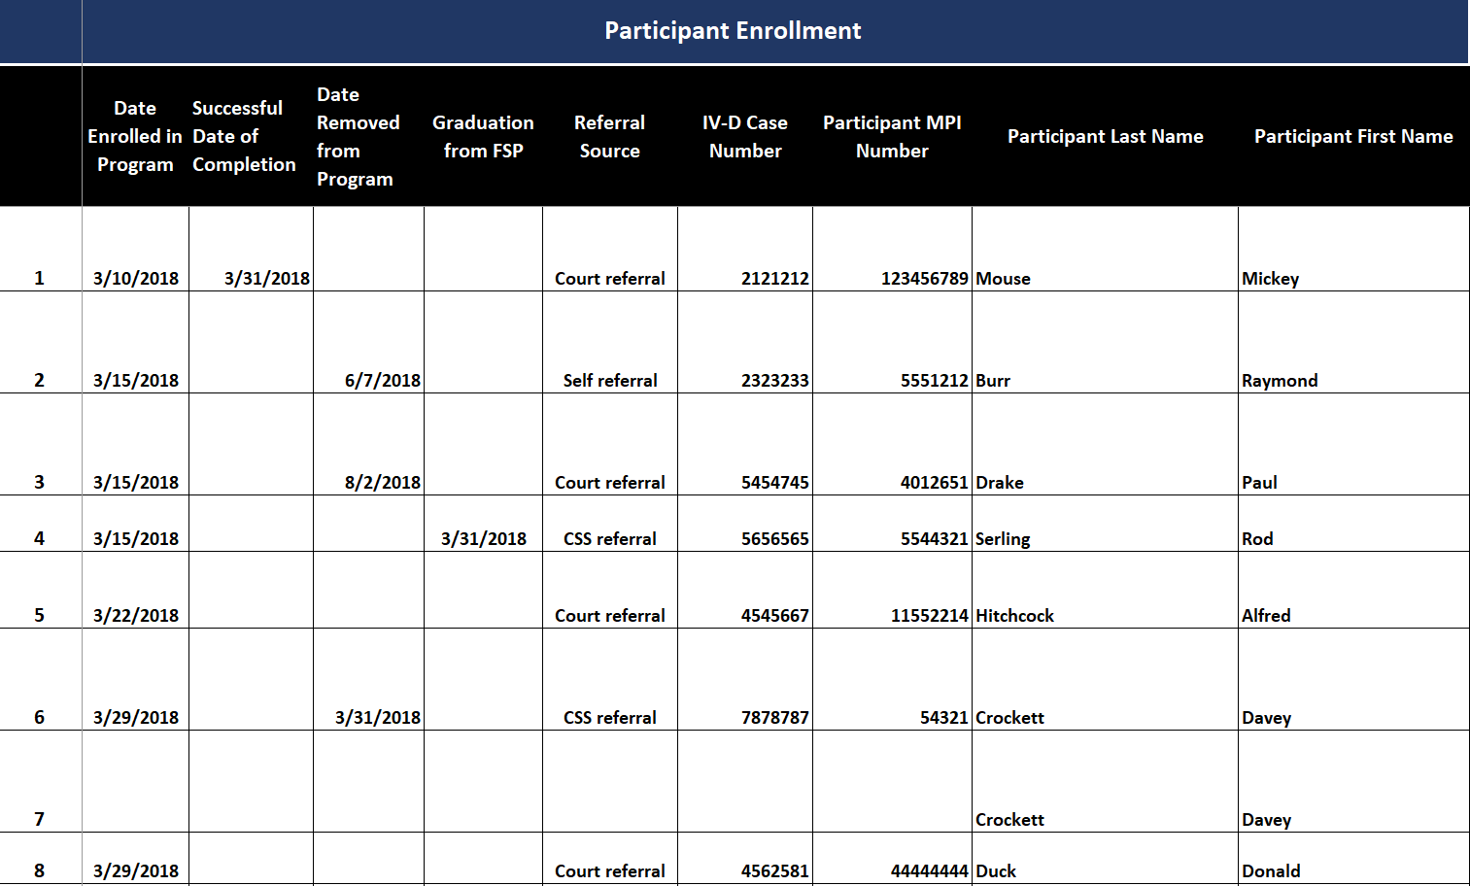

Slide 20
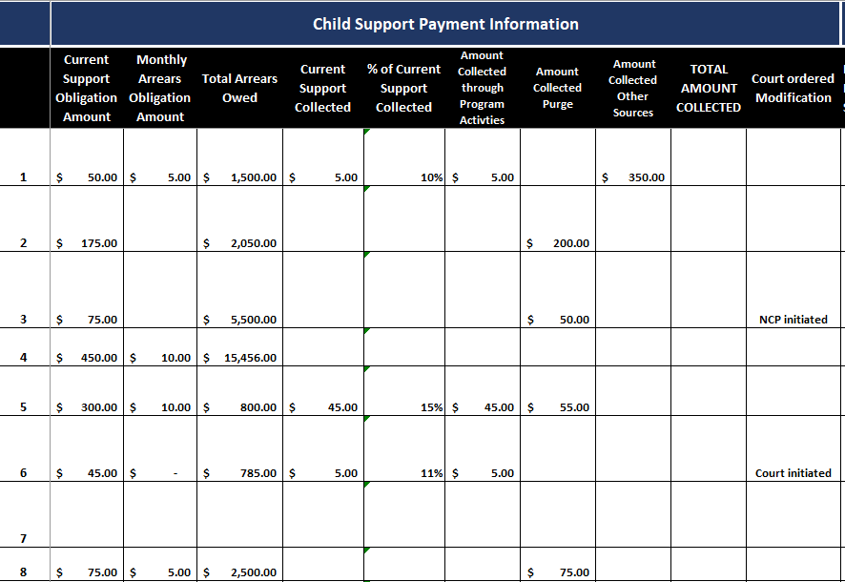

Slide 21
We track collections that were made specifically due to the activities conducted specified in their plan separately from other forms of payment

Slide 22
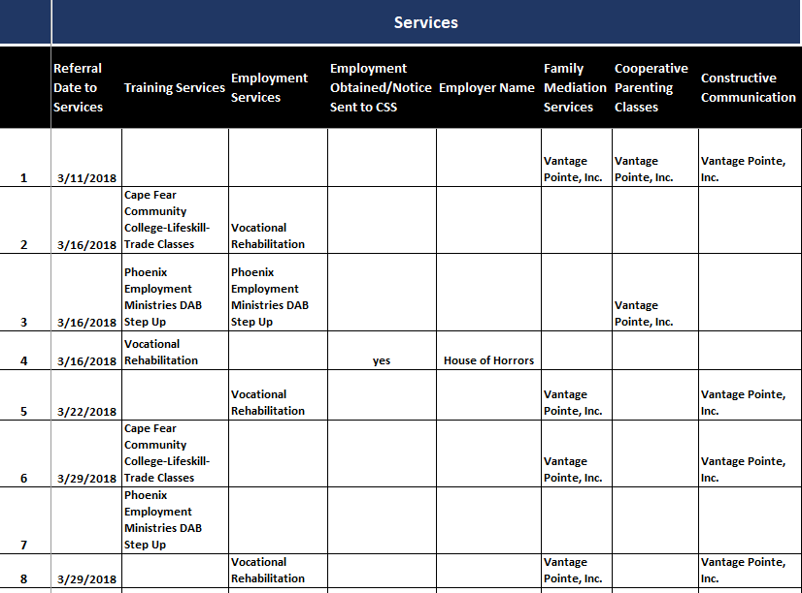

Slide 23
Drop down boxes are added for each program that they have specified that they are working with to make it easier to track the success rate.

Slide 24
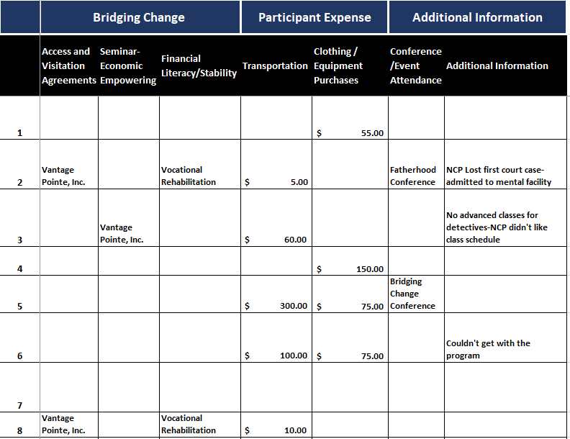

Slide 25
They have a place to easily track their expenses for their budget.

Slide 26
And a place to keep notes each month to track each individual’s journey through the program.

Slide 27
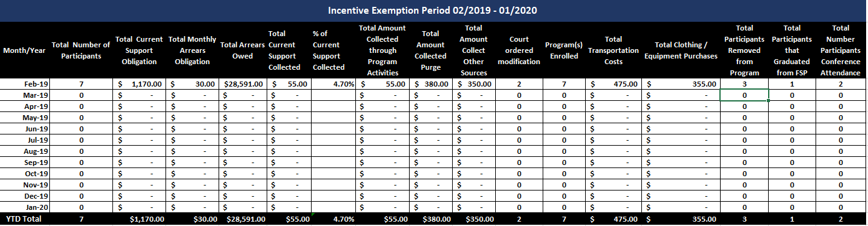
The summary page makes it easier to complete the end of the year report and renewal request as well as determine if the program was successful

Slide 28
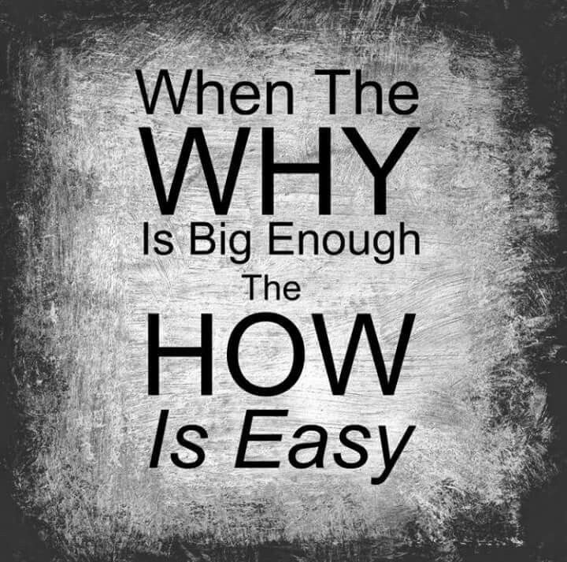
R
E
S
U
L
T
S
In the most recent exemption year:
Assisted over 350 Non-Custodial Parents
Collected over $50,000.00
Future Plans
Increased participation
Increased ability to pay
Increased Collections
Increased involvement
Strengthen the family
Strengthen the program
Notes:
COMPLETED Durham County – VIP Corporate Sponsor at Women’s Empowerment
Opportunity for customer engagement approach.
Provide greater community awareness of the Child Support program and its benefits.
Expected outcome – increase in the number of applications for the program. (this is still being monitored)
PENDING Durham County - Job Readiness & Placement Program for NCPs
Increase employability of participants by connecting NCPs with community resources that provide:
Guidance for completing employment applications
Resume writing
Appropriate attire for interviews and work
Interviewing skills
Communication skills
Identify barriers to employment and connect NCPs with appropriate resources
Expected outcome – NCP increased employment and increase in over total collections
PENDING (and COMPLETED) Edgecombe – Fatherhood Initiative Program
24/7 Dad program to increase employment
In the previous exemption, the county served 167 participants and collected almost $11,000
CURRENT Wilson County – Fatherhood Initiative using the Mom as a Gateway Booster Session
Education and job training, mental health assessments, 24/7 Dad curriculum and referrals to county resources.
Expected outcome – Increase NCPs involvement in the lives of their children, stable employment, increasing child support payments and establishing successful co-parenting
CURRENT Mecklenburg County – Empowering Fathers Fatherhood Program
Strengthening families through parenting skills, economic mobility, economic stability, life skills, conflict resolution, homelessness and substance use.
Expected outcome – Strengthen the child support program by addressing concerns that are most often identified by NCPs and implementing strategies for mitigating those concerns.
PENDING Pitt County – Employment of Social Worker to work with NCPs
Seeking to enhance total collections by having a social worker to work directly with NCPs who are unemployed/underemployed to promote dual self-sufficiency (that of the NCP and client) by improving the NCPs ability to pay.
CURRENT (and COMPLETED) New Hanover – Family Support Program
Help eliminate barriers and promote self-sufficiency for NCP’s by education and job training, family mediation, cooperative parenting classes and referrals to other community resources.
In the previous exemption year the Family Support Program serviced 187 NCPs and collected in excess of $35,000 in child support payments. Several gained employment through the Program. The Family Support Program also assisted in hosting the 12th Annual New Hanover County Fatherhood Conference.

Slide 29
Carla West
carla.west@dhhs.nc.gov
919-855-4405

Slide 30

An Overview of Funding Alternatives
Sharon Redmond, Director
Washington State Division of Child Support

Slide 31


INFORMATION MEMORANDUM
IM-19-04
DATE: July 23, 2019
TO: State and Tribal IV-D Agencies
SUBJECT: Availability of Section 1115 Waivers to Fund NCP Work Activities
States must invest new funds to pay their share of the cost of the pilot activities and cannot re-direct funds that would have been spent on the child support program.
Agency share or private funds are eligible for federal financial participation

Slide 32
Returns on Investments of Incentive Funds
AT-01-04: Reinvestment of Child Support Incentive Payments
Contribute to improving the effectiveness and efficiency of the IV-D program
Show a clear connection to and collaboration with the child support program
Expenditures not eligible fore federal financial participation
Washington has requested use of incentive funds for paternity program every year since 2008 to fund no-cost genetic testing for parents outside the IV-D caseload
Notes:
AT-01-04 is the prevailing guidance on when to request approval for and what needs to be included the request to use incentive funds for expenses that cannot be paid with IV-D funds
We must be able to show the connection to the program. Those pilots and ideas that are on the perimeter; we know that the subject of the waiver request helps families in the holistic approach that is consistent with our evolving mission and strategic plan. But, we are limited in how we can pay for those programs. Lots of great ideas, but not always enough $.
Champion of idea plays a large role in the request process. Not particularly onerous to make a request: must provide details of exactly what you are going to use the dollars for and be prepared to show an accounting of exactly how they are used.
Not eligible for FFP.
In mid-2005, OCSE awarded Washington State an 1115 demonstration grant to implement and rigorously evaluate enhancements to its pioneering work in voluntary paternity establishment. Specifically, the demonstration, called the Bright Start Program,
seeks to mitigate the existing barriers to voluntary establishment through two major
strategies.
WA Voluntary Paternity Testing Program
Most of the people who utilize the program do not have a IV-D case. No income considerations for parents. Serves a small but important population.
Many parents who utilize the program are in a relationship at the time of the request for genetic testing or just transitioning out of a relationship; parents may be receiving pressure from other family members or external sources to undergo genetic testing.
Program is voluntary, so these are parents who are generally welcoming and responsive.
Paternity program costs have varied. AT-01-04 requires a request to be submitted annually.
While we have had periods where we have used incentive funding for other programs that have come and gone, such as PREP bootcamp classes, use of incentive funds for paternity program has been consistent for over 11 years
PREP bootcamp classes a specific example of a request for one fiscal year because we stopped the bootcamp program. Sometimes we consider requests, but needs of programs change or other funding opportunities present

Slide 33
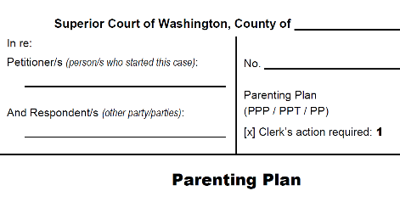
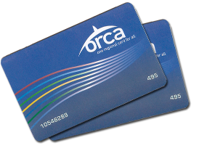
Pending Requests
  Pierce County Parenting Plan Pilot
  Transit Assistance

Slide 34
Wavering about a Waiver?
States may utilize other strategies when Section 1115 demonstration waivers or requests to use incentive funding is not feasible
Clear language in contracts in the statement of work and around funding sources can be used to ensure IV-D funds only used for allowable activities
PIQ-12-02 provides some clarification around allowable child support expenditures if the activities are “incidental and related to establishing paternity, or establishing, modifying, enforcing, and obtaining support.”

Slide 35
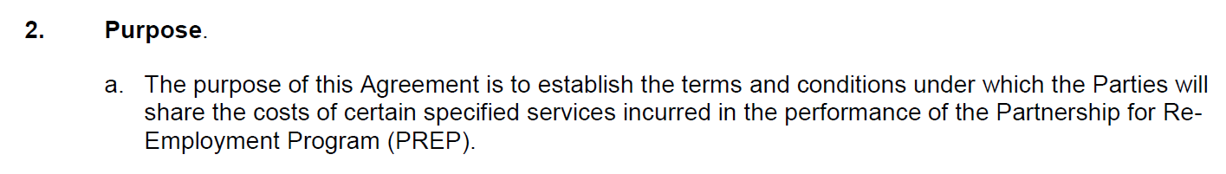
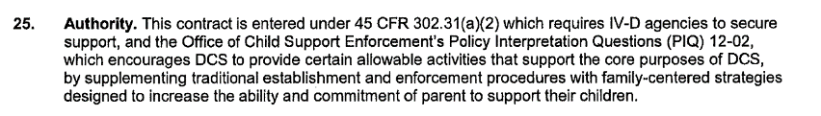
Partnership with Employment Security Department in different offices, funded different ways and captured in contract
Partnership with South Seattle College for formerly incarcerated NCPS and funds limited to allowable activities

