Slide 1
MD THINK Child Support System
Kevin Guistwite (Executive Director, CSA)
Subramanian Muniasamy (CTO, MD THINK)
Vallimanalan Thirugnanam (Applications Director, MD THINK)
Sujatha Meenakshisundaram (Director, MD THINK)

Slide 2
Agenda
1
MD THINK Overview
2
System Overview and Architecture
3
Data and Security Architecture
4
Child Support System (CSS) Demo
5
Questions & Suggestions

Slide 3





MD THINK Vision
MD THINK is a transformational, groundbreaking technology program that will modernize service delivery to Marylanders
Platform Features
MD THINK Platform
  Enterprise Security
    Sophisticated platform meeting all Federal & State Requirements
    Uniform security policies and governance for all Apps
  Cloud Infrastructure
    Highly scalable, yet affordable infrastructure
    Enables rapid setup with flexible configuration
  Application Platform
    Full-featured application architecture providing all components required for developing sophisticated applications
    Ready to use, fully configured application frameworks
  Shared Data Repository & Analytics
    Highly scalable, flexible and searchable shared data platform
    Provides, secure, role based access to cross-agency data
  Integration Platform
    Ready-built interfaces with FDSH and State data systems
    Supports rapidly implementing additional interfaces
Enterprise Security
Agency App
Agency App
Agency App
Application Platform
Shared Data Repository
Integration Platform
Cloud Infrastructure
Agency Application(s)
Shared Platform Services

Slide 4







Streamline HHS Technology Systems
Initial phase of this program is focused on modernizing and streamlining the application systems for Maryland’s Health & Human Services agencies
Siloed Systems with Disjointed User Experience
Streamlined User Experience
DHS-CSA
DHS-SSA
DHS-FIA
MDH
CSES
CHESSIE
CARES
Agency Applications
Cottage Apps
Future State
Shared Services
MHBE
DJS
Shared Data Repository & Analytics
MHC
ASSIST
Access Control & Governance
Point to Point Access Control and Governance for Workers
Centralized Access Control and Governance for All Workers

Slide 5
Program Timeline
CJAMS R2 Review
Aug 2019
E&E, R2 Review
June 2020
Platform ready
for Other Agency
Integration
Base MDM &
Data Governance, Platform R2 Review
Sept 2018
LTC, platform
R3 Review
Dec 2018
CJAMS Statewide
Oct 2019
Child Support
(CS) Pilot
Jul 2020
Child Support
Statewide
Dec 2020
Oct 2017
4/17 – 9/17
Cloud Infrastructure
Continued Support for System
9/17 – 9/21
4/17 – 9/17
Cloud Security
Continued Support for Security
9/17 – 9/21
4/17 – 9/17
Cloud DevOps
Continued Support for DevOps
9/17 – 9/21
4/17 – 9/18
MDM & Data Governance
Continued MDM & Data Governance updates
10/18 – 9/21
4/17 – 5/20
Shared Data Repository, Data Lake, Analytics & Reporting
Post production
6/20 – 9/21
10/17 – 12/20
Pre-Development activity
Child Support Worker Portal & Mobile Apps
Post production
12/20 – 9/21
12/17 – 5/20
Eligibility Determination Business Rules (All Program)
Post production
6/20 – 9/21
12/17 – 5/20
ESB, Data Integration, BPM, Batch Interfaces, ETL
Post production
6/20 – 9/21
12/17 – 5/20
Document Generation & Notices, Document Management
Post production
6/20 – 9/21
12/17 – 5/20
Eligibility & Exchange (Consumer & IE Worker Portals & Mobile Apps) - Cares Replacement
Post production
6/20 – 9/21
02/18 – 4/19
Continued Support for CJAMS post production
5/19 – 9/21
CJAMS - CW, DJS, Adult Services Workers Portal (CHESSIE/DJS, Assist Replacement)
12/18 – 9/19
HBX
Post Production
10/19 – 9/21
LTC Soft Launch
CJAMS
Pilot
May 2019
CJAMS Statewide
Oct 2019
DEPLOYED
DEPLOYED
Bureau of LTC Launch
HBX Integration Complete
Sept 2019
E&E Pilot (MA, SNAP, Cash) Dec 2019
Child Support Statewide
Dec 2020
Pilot Go-Live
Base Infrastructure
Sep 2017
DEPLOYED
DEPLOYED
HBX Onboard Complete
May 2019
E&E (MA, SNAP, Cash)
Statewide
June 2020
DEPLOYED
MD THINK Complete
Sep 2021
Base Data Platform
Dec 2017
LTC State-wide Launch
Aug 13, 2018
Child Support Pilot Jul 2020
Calendar year
2017
Calendar year
2021
2017
Q2
Q3
Q4
Q1
2018
Q2
Q3
Q4
Q1
2019
Q2
Q3
Q4
Q1
2020
Q2
Q3
Q4
Q1
2021
Q2
Q3
Dec 2020
MDM/Shared Platform Complete

Slide 6


Application Architecture
The MD THINK Application Architecture will provide a groundbreaking shared platform supporting multiple Mission Specific Applications
Mobile Apps
FDSH Interfaces
Highlights
MD Benefits
MD IE Worker
MD CW Worker
MD CS Worker
Other Agencies APP.
Cloud
Infrastructure
RIDP
SSA
Flexible, auto-scaling “pay as you go” Cloud infrastructure
Integrated web & mobile platform for consumers and workers to provide user friendly and efficient access
APIs for all client and worker functions, and for all business and technical areas to support plug and play architecture
Well defined Shared Platform for supporting all Agency Apps, architected for additional agencies across the State
Shared Data Repository provides a 360 degree view and advanced analytics across all programs and various product databases
Web Access
Access Management
Identity Management
API Gateway
VAHI
VLP
Applications
Max APTC
DHS
Consumer Portal
Agencies
Consumer Portal
Agencies
Worker portal
Eligibility
Worker portal
CJAMS Worker Portal
Child Support Worker Portal
MEC
Consumer API (s)
Worker API(s)
Other Federal Interfaces
Eligibility Determination Business Rules
(SNAP, TANF, MORA, LTC, OHEP, Medicaid, …)
Analytics & Reporting
IRS
Deployment Management (DevOps)
ESB
Data Integration
Batch Interfaces & ETL
(Federal, State Agencies)
API Management
SSA
DRS
Business Process Management
Document Generation
& Notices
Enterprise Search
MDM(Client
& Provider Index)
ACF
Document Management
Big Data Analytics
System Monitoring
Audit Logging
& Analysis
State Interfaces
Data
MMIS/DHMH
Shared Data/Document Repository
Legend:
LDSS
Agencies DB
CW COTS DB
CS COTS DB
Agency Applications
EBT/EFT
E&E COTS DB
ECM DB
MDM COTS DB
Shared Platform
Bureau of Empl. Prog.
In use or ready for use
State Treasury

Slide 7
Accomplishments
Completed procurement of key software components
Amazon Web Services (AWS) environment established
Kicked off LTC program in E&E
Completed Platform ATO
Agile Team RFP Released
Base Content Management (ECMS) Platform deployed in Production to support Long Term Care and other future Applications
CJAMS Kickoff
LTC Statewide Go Live in E&E system (08/06), 300+ users
Kicked off projects for additional programs in E&E: non-MAGI MA, SNAP, Cash
Onboarding of Agile Team
APD Approved
CTO Hired
Finalized Architecture and Execution Approach
DEPLOYED
DEPLOYED
DEPLOYED
DEPLOYED
Pilot Go-Live
Base Infrastructure
Sep 2017
Deployed Base Data Platform
Dec 2017
Base Content management Platform
March 2018
Master Data Management deployed
April 2018
LTC Statewide
Aug 2018
2017 Q1
2017 Q2
2017 Q3
2017 Q4
2018 Q1
2018 Q2
2018 Q3
2018 Q4
Calendar year
Hired Key Team Members
Steering Committee Established
Established PMO
Awarded CJAMS Vendor
Completed Data Platform ATO and deployed SDR
Enterprise Master Data Management (EMDM) Deployment
Application ATO Signed Off for LTC production launch
Awarded Agile Vendors
Completed CJAMS core development and Rollout Strategy
Initiated HBX migration
Submitted APDu

Slide 8
CSS Overview and Architecture

Slide 9

What is Child Support System (CSS)?
Definition: The Child Support System is an application being developed as part of MD THINK that supports the Child Support Administration (CSA) business functions such as enforcement of child support, locating parents, establishment of paternity and support orders and collection of support payments. This system is being developed with adherence to the ACF 2017 guidelines.
Benefits of CSS Replaces legacy Child Support Enforcement System (CSES) and four other silo systems Supported on tablet and mobile devices Allows workers to enter real time information Shares information across programs Minimizes redundant data entry | Key Statistics (2018) Caseload: 198,241 Annual Collection : $552 Million Cases with support order: 165,766 71.5% collection by employee paycheck withholding $ 4.64 collected for every $1.00 spent

Slide 10
Implementation Timeline
Statewide rollout
Dec 2020
Pilot Report
Oct 2020
ATO, ATC
May 2020
Agile team onboarding
July - Aug 2018
Phase 1
Begin UAT Testing
Pilot deployment
June 2020
Project Kick-off
October 2017
Agile team onboarding
Dec 2018 Phase 2
Oct 2017 – Mar 2018
Apr 2018 - Sep 2018
Oct 2018 - Mar 2019
Apr 2019 - Sep 2019
Oct 2019 – Mar 2020
Apr 2020 – Sep 2020
Oct 2020 – Mar 2021
Pre-development Documentation and Requirements
Application development, System integration,
Platform integration, Data migration, OCM, Stakeholder Engagement
Pre-certification documentation,
Data migration
Statewide Rollout,
Federal Certification
Initiation of Federal Certification Process
Pilot deployment in 3 counties - Phase 1 & 2
Review by Federal Team

Slide 11
Project Execution Approach
As-Is Documentation
Gap Analysis
To-Be Requirements
Development
Maintenance and Operation
Documentation of current system from CSA Team (assisted by MD THINK Team).
Analysis of current system by MD THINK team.
Recommendations from MD THINK team for system enhancement.
Project Execution Approach
Functional requirement submission from CSA Team (assisted by MD THINK team).
Technical (Platform, Security, Application, Data) requirements from MD THINK Team
Architecture: Spring Framework: Spring Boot, Spring Data, Spring Container, JPA Hibernate, Hibernate Envers, RESTful Web service/JSON, Angular JS etc.
Identity and Access Management: Single Sign-on using Forgerock Open AM and Sailpoint Open DJ
Corticon Rules Engine Integration
System/Interface Integration
Data Mapping, Conversion and Migration
Document Management
Shared Data Repository and Master Data Management
Analytics - Reports
AWS Cloud Deployment, Secure Access Gateway, WSO2 API Manager, Network and log Management, Host based protection
Stakeholder testing
UAT Testing
OCM – Stakeholder Engagement/Training
Authorize To Operate review and Approval
Federal Certification
Post production support and Enhancements.
Owner: CSA Team
Owner: MD THINK Team
Owner: CSA Team/ MD THINK Team
Owner: MD THINK Team
Owner: M&O Team
PI – 07, 08
PI - 09
PI – 09 - 14
PI – 11 to PI - 23
Post PI -23
Methodology:
Cutting Edge Technology for the Application and Shared services and platform - AWS
Test Driven Continuous Development
Built using SAFe Methodology
Independent Verification & Validation :
Quality Management for product and system requirements / specifications
All Development according to Federal, State and DHS requirements, MD THINK Platform and Security standards

Slide 12


Child Support System (CSS) Overview
User Groups
Consumer Portal
Worker Portal
Federal Interfaces
Application submission
Payment processing
Appeals
Consumer Dashboard
Document upload
Notices
Online payment
Employer portal – Report employee termination, Request NMSN, IWO notice
E-FPLS
NFIDM
Case Registration
Workload Management
Locate
Establishment
FCR
Federal Tax Offset
NDNH
SSA
IV-D, IV-A, IV-E, Intergovt. Case Registration
Dashboard
Workload prioritization
NCP/CU Locate
Paternity Establishment
Support order establishment
Inter-State Interfaces
CSENet
QUICK
Consumer,
Employer
State Interfaces
DVR
MD OAG
Enforcement
Case Management
Intergovt.
Financial Management
Document Generation
MVA
MD DNR
MDH-PLS
SDNH
Comptroller’s Office
MDEC
Caseworker,
Supervisor, Director,
SDU worker, Sherriff
Attorney, Call Center, Help Desk
Enforcement actions
Case Management
Case modification
CSENet
Transmittal 1, 2, 3
Financial accounts
Notices, letters Generation
DPSCS
DRAFS
MLGCA
SDU
State Treasurer Office
MDH Boards and Commissions
DLLR
MD Insurance Administration
MD PSC
Conversion
Enterprise Functions
Private Interfaces
Application, Case Financial, Documents
Enterprise Search
BI Reports & Analytics
Master Data Management
Shared Data Repository
Login, Security, Account, and Role Management
Enterprise Content Management
BofA
Credit Bureaus
NiC
Casinos

Slide 13


CSS Reference Architecture
Client/Consumer Portal
Interface/Integration
Interfaces
Federal Interfaces
CSA
E-FPLS
NFIDM
Application & Case Registration
FCR
Federal Tax Offset
Master Data Search,
Create & Update
NDNH
SSA
Identity Access Management- Consumer and Employer
Application Intake, Employer Services, Online Payment @ myMDTHINK.gov
Workload and Case Management
MDM
Locate, Establishment and Enforcement
Inter-State Interfaces
CSENet
QUICK
Financial Management
State Interfaces
Case Workers Portal
Enterprise Search
Shared Data Repository
Interfaces, Notices and Batch Framework
Shared Data Platform
DVR
MD OAG
MVA
MD DNR
Document Generation
Reporting
MDH-PLS
SDNH
Mail Processing
Affidavits
Comptroller’s Office
MDEC
Process Applications,
Manage Case Lifecycle
Data Lake
DPSCS
DRAFS
Reports and Analytics
MLGCA
SDU
Change Data
Capture (CDC)
State Treasurer Office
MDH Boards and Commissions
Mobile Application
Application Database
DLLR
MD Insurance Administration
Enterprise Content Management
MD PSC
Document Upload,
Search & Retrieval
Private Interfaces
Future
BofA
Credit Bureaus
MD THINK Shared Services:
Identity Access Management, Shared Data Repository (SDR), Master Data Management (MDM), Enterprise Content Management (ECM), Rules Engine, Integration Services (Notification framework and batch framework)
NiC
Casinos

Slide 14
CSS Interfaces
Office of the Attorney General
MD Insurance Administration
DLLR
MD Department of Environment
MDH Board of Nursing
MDH Board of Pharmacy
Md. State Dept. of Education
MDH Board of Physicians
OCSE-New Hires
Federal
Monthly
Monthly
Monthly
Monthly
Monthly
Monthly
Monthly
Monthly
Monthly
State
Department of Vital Records (DVR)
DHMH Dental Board
MD Dept. of Transportation
MD Dept. of Agriculture
DLLR - UIC
MDH Boards & Commissions
MD Secretary of State
MD Public Service Commissions
Md Public Service Commission
Private
Daily
Monthly
Monthly
Monthly
Daily
Monthly
Monthly
Monthly
Monthly
Completed
TCA (TANF) - IV A
Daily/Monthly
Monthly
Daily
Maryland Department of Health (MDH) (Super Board)
In progress
Bank of America
Monthly
Bank of America-EPIC
Monthly
MDH Board of Occupational
Therapy Practice
OCSE- QUICK
Monthly
Weekly
Dept. of Public Safety & Correctional Services (DPSCS)
DLLR
Daily/Monthly
CSS
Daily
ACH Clearinghouse via State Treasurer’s Office
TOP(FMS)
Weekly/Monthly/Quarterly
Daily/weekly/Monthly
FIDM – In State (outside vendor – Informatix Inc.)
CJAMS - IVE
Daily
On Request
FCR ICR (Interstate Case Reconciliation)
OCSE – CSENet
Daily
Daily/Monthly
Maryland Lottery & Gaming Control Agency (MLGCA)
OCSE- e - IWO
Daily
Daily/Weekly/Annual
Comptroller of MD (State Comptroller’s Office)
Motor Vehicle Administration
Daily/Monthly
Daily
Workers Compensation Commission
FCR (Federal Case Registry)
Daily
Maryland Electronic Court System (MDEC)
myMDTHINK
Daily
MDH (Title XIX)
Daily
Monthly
Daily
Daily
Daily
Daily
Daily
NiC_Payment Processing Module
Horseshoe Casino
Court of Appeals
Rocky Gap
SDNH-Maximus
Ocean Downs
Maryland Live
Hollywood Casino
Monthly
Daily
Daily
Monthly
Lyft
Uber
Innovis
State Disbursement Unit-SMI Inc
Equifax
MGM National Harbor
Division of Recoveries and Financial Services (DRAFS)

Slide 15
Data Platform Reference Architecture

Slide 16
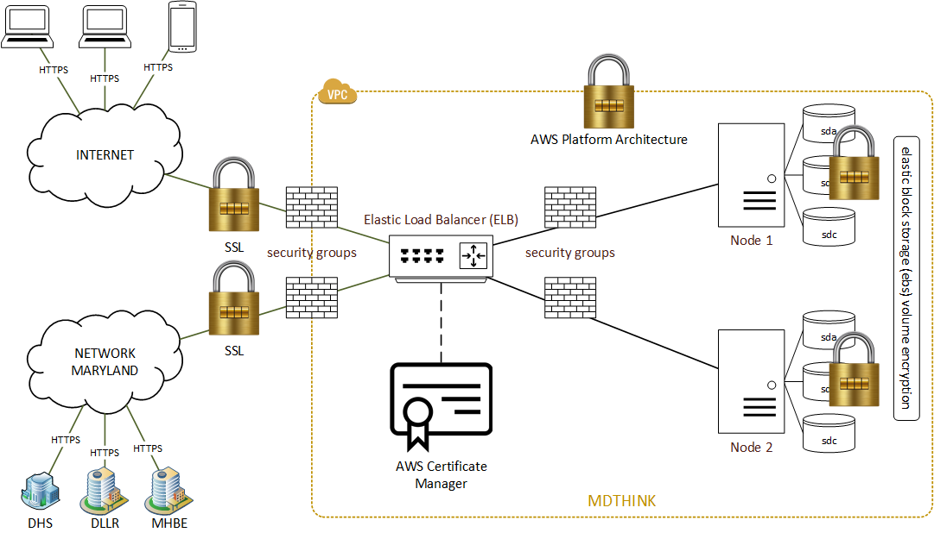
Cloud Security
Notes:
The plan is for initial production release in late June. Single slide view of functional pieces.
Focus for this initial launch is core functionality including, especially current CARES and MyDHR functionality as those systems will not be used for LTC as of launch
Items highlighted in bold are net new functionality to the business, including

Slide 17














Application Technology Stack
Technical Architecture Stack View
Runtime
Business Service
Programming
Language
Middleware/Data Integration
Identity Access/Log
Management

Slide 18






















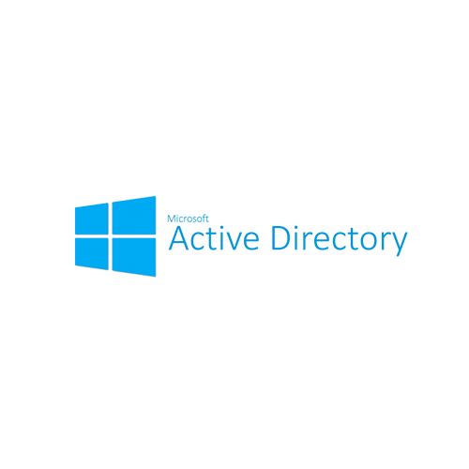









Cloud Platform Technologies
Technical Architecture Stack View
Foundational Infrastructure
IBM Connect Direct
Connectivity, High Availability and Fault Tolerance
Statewide Government Intranet (SwGI)
S3
Direct Connect
System Security
Enterprise Security
Data and Security
BeyondTrust PAM
User Access
State Domain Services
Monitoring, Incident Response and Change Management

Slide 19

















SDP Tech Stack
Technical Architecture Stack View
Presentation
Dashboards, Analytics, Self-Service BI
and Geo-Spatial Visualization
Semantic Layer
Mapping complex data into familiar business terms
Intelligent Data Lake
Enterprise Information Catalog
Analytics
Building Blocks for modeling & processing Analytics Applications
Storage
Cloud Architecture and
other Validated Storage
Data Ingestion
Data Integration, Data Quality and Data Preparation
Big Data Manager
Data Quality
Platform
Scalable and Flexible Cloud Platform

Slide 20
Child Support System Demo

Slide 21




Demo Use Case
Scenario: Emily C Bartholme and Richard Mutter have a son John Mutter. Richard and Emily do not live together and their son John lives with her mother, Emily. Emily applies for child support from Richard using the Maryland Department of Human Services Benefit portal.
Emily Bartholme
Custodial Parent and applicant for Child Support
Richard Mutter
Noncustodial Parent
John Mutter
Son of Emily and Richard
Mary Smith
Case intake worker with the Maryland Child Support Administration
Demo Step | Description
1 | Emily Bartholme logs into the MD THINK Consumer Portal to apply for Child Support.
2 | Emily completes screening questions. She is found eligible. Emily then completes and submits a IV-D child support application.
3 | Case intake worker Mary Smith logs into Worker Portal. Emily’s IV-D application is in her work item list in the dashboard.
4 | Mary starts processing Emily’s application by doing a member clearance using Shared Data Repository. After that Mary registers Emily’s child support case.

Slide 22







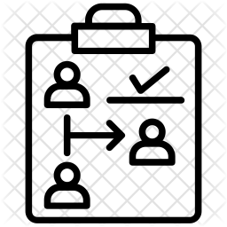






CSS Case Intake Flow
START
Legend
Account creation in Consumer Portal
First time log-in
Review customer dashboard
Review existing applications and cases
Start new application
Federal Certification adherence
1
Custodial Parent
2
Custodial Parent
3
Custodial Parent
4
Custodial Parent
5
Custodial Parent
MD THINK Shared services feature
Consumer Portal
Worker Portal
Review Worker Portal dashboard widgets
Review Worker Portal dashboard work item
Caseworker logs in into Worker Portal
E-signature, application fee payment and application submission
Document Upload (Enterprise Content Management)
10
9
8
7
6
Caseworker
Caseworker
Caseworker
7
Custodial Parent
Custodial Parent
STOP
Enterprise search and member clearance of IV-D application
Review of application details and case registration
Automatic entry into Case Action Log
System submits the case members information to FCR overnight
Log-off from Worker Portal
11
Caseworker
12
Caseworker
13
Caseworker
14
System
15
Caseworker
Notes:
A-1: The system must accept, maintain, and process information for non-IV-A services.
State System Requirements:
A1 A. Upon receipt of an application for child support services, the system must maintain:
1. The date the application was requested,
2. The date the application and program information describing services and fees, rights and responsibilities, and cost recovery and distribution policies were sent to the applicant, and
3. The date the signed application and fee were received.
A1 B. Within 20 calendar days of receipt of a signed application for non-IV-A services, the system must:
1. Establish a case record,
2. Refer the case to the appropriate processing unit (e.g., locate or paternity/parentage establishment),
3. Notify the caseworker of the case and
4. Submit the case to the Federal Case Registry (FCR).
------------------------
Identity Access Management
Shared Data Repository (SDR)
Master Data Management (MDM)
Enterprise Content Management
Rules Engine
Integration Services (Notification framework and batch framework)

Slide 23

Questions and Suggestions

