Slide 1
Cloud Computing

Slide 2
Considerations For Moving To The Cloud
Identifying the benefits of moving to the cloud
Understanding your current architecture and how it will adapt in the cloud environment
Understanding your security needs and requirements
Identifying software licensing and support
Identifying the environment and applications to move first (Start small)
Determining which Cloud Service Provider (CSP) to select
Training staff for the cloud
Analyzing risk and exit strategy

Slide 3
Service Models
Software as a Service (SaaS)
A service provider delivers software and applications through the internet. Users subscribe to the software and access it via the web or vendor APIs. (e.g., Google Apps, Cisco WebEx, Office 365, GitHub)
Platform as a Service (PaaS)
A service provider offers access to a cloud-based environment in which users can build and deliver applications. The provider supplies underlying infrastructure. (e.g., AWS Elastic Beanstalk, Windows Azure PaaS)
Infrastructure as a Service (IaaS)
A vendor provides clients pay-as-you-go access to storage, networking, servers and other computing resources in the cloud. (e.g., Amazon Web Services (AWS), Windows Azure)

Slide 4
Deployment Models
Organizations have several choices for deploying a cloud computing model, as defined by NIST in SP 800-145:
Private cloud
The cloud infrastructure is operated solely for a single organization. It may be managed by the organization or a third party and may exist on premise or off premise.
Community cloud
Several organizations share a dedicated cloud. They can freely exchange data among themselves while keeping it secure from the outside world
Public cloud
The cloud infrastructure is made available to the general public or a large industry group and is owned by an organization selling cloud services.
Hybrid cloud
A cloud infrastructure composed of two or more clouds (private, community, or public) that remain unique entities but are bound together by standardized or proprietary technology that enables data and application portability.

Slide 5
Requirements for Federal Tax Information (FTI) in a Cloud Environment
Agency must be in compliance with all Publication 1075 requirements. The following mandatory requirements are in effect for introducing FTI to a cloud environment:
FedRAMP Authorization
Onshore Access
Physical Description
45-Day Notification
Data Isolation
Service Level Agreements (SLA)

Slide 6
Requirements for Federal Tax Information (FTI) in a Cloud Environment
Data Encryption in Transit
Data Encryption at Rest
Persistence of Data in Relived Assets
Risk Assessments
Multi-Factor Authentication
Security Control Implementation

Slide 7
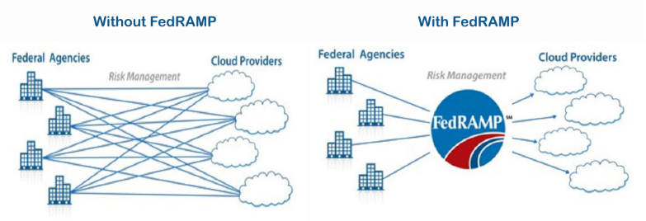
Federal Risk and Authorization Management Program (FedRAMP)
Rather than forcing agencies to hire multiple companies to conduct different, mandatory security assessments, FedRAMP was created to provide a standardized process to determine if cloud service providers meet federal security guidelines.

