Slide 1
national council of child support directors
Child support modernization

Slide 2
Modernization Terminology
What does it mean?
Code Conversion
Re-factor
Re-platform

Slide 3
Modernization Terminology
What does it mean?
Commercial off the Shelf (COTS)
“Low Code”
Platform as a Service (PaaS)

Slide 4
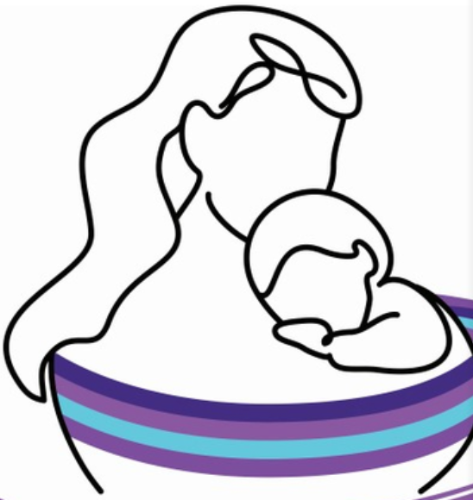
Demonstration
Child Support in a PaaS

Slide 5
Code Conversion
Incremental Modernization
“All In” Platform
Modernization Approaches
A Modernization ‘Journey’
Platform Integration

Slide 6
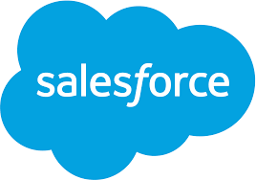


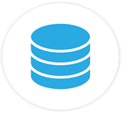
Platform Integration
Salesforce integrated with CSE Solution
Considerations:
Duplicated databases
Requires large scale, complex data synchronization
  Prone to data integrity challenges
Core business logic duplicated across Salesforce and CSE Engine
Reduced maintainability
Performance impacts
Costs associated with two application models
Web Services
CSE User Interface
Integration
CSE
Business Logic
Data Replication
CSE Business Data
JDBC
CSE Engine
Business Logic + Batch
CSE Business Data

Slide 7
“All in” Platform
Salesforce as the CSE Solution
Considerations:
Single database, no data synchronization
Eliminates business logic duplication
Improves maintainability
Reduces Web Service calls
Improves Performance
Enables full Salesforce feature set and maximizes use of native capabilities
Single application model, lowers costs
CSE User Interface
Web Services
Integration
CSE Batch Jobs
CSE Business Data
CSE Engine
Business Logic

Slide 8
Modernization Approaches
A Modernization ‘Journey’
“All In” Platform

Slide 9
Questions?
Thank you for your time!
Feel free to reach out with questions/clarifications:
Jamie Walker, Managing Director North America Child Support
Jamie.D.Walker@Accenture.com; (517) 862-0192
Slade Gauntt, Managing Director Child Support Architect
S.Slade.Gauntt@Accenture.com; (916) 337-9065

