Slide 1
Child Support
February 9, 2019

Slide 2
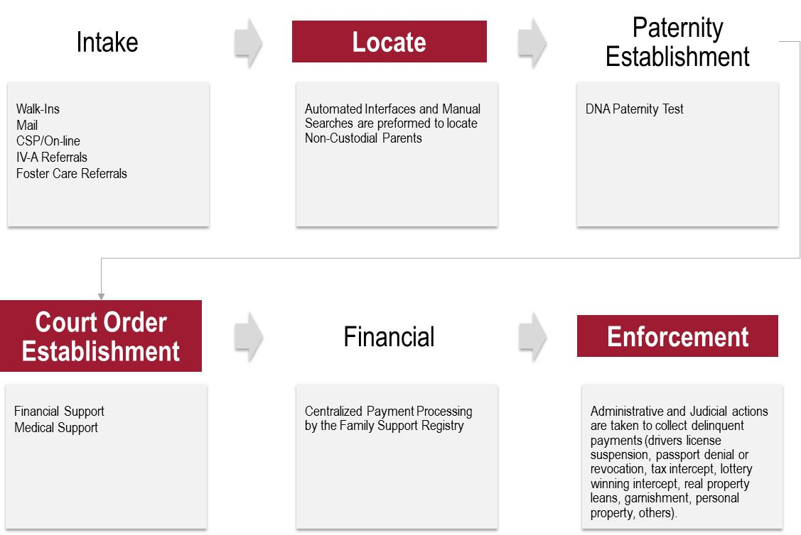
Equifax CSE Solution
Equifax is working on a robust Child Support Enforcement (CSE) solution
Partnering to deliver data driven insights to support Locate, Establishment and Enforcement activities
State/Federal Partners
Commercial Partners
Equifax Partners

Slide 3









Multi-Phase Development:
Phase 1 Current Data Sets
Input
Output
Data Sources
Phases Supported
Locate
Establish
Enforce
Address
Phone
Email
Utility (NC+)
n
Employment
Employment
Last Payment Date
Credit (ACRO)
n
n
n
SSN
FN
LN
Address
State
Zip
Trade Lines
Loans to Lien
Potential Assets
The Work Number
n
n
n
Incarcerated (Y/N)
If Yes Where
Incarceration Data (Appriss)
n
n
Requested Benefits in past 5 Years
If Yes Where
Inquiry Data
n
Fin Asset Report
Financial Assets
n
Real Property Report
Real Property
n
Personal Property Report
Personal Property
n

Slide 4
Locate
Client Tracking ID:
Name: Bob Smith
SSN: XXX-XXX-XXXX
DOB: XX/XX/XXXX
Phone: XXX-XXX-XXXX
Address: XXXXXXXXX
XXXX, XX, YYYYY-YYYY
Identity Check
Locate Results
l Most Recent Address 12/01/18
l Most Recent Phone 12/01/18
l Most Recent Employment 01/11/19
l Currently Incarcerated No
l Social Services Inquiry Yes
View Reason Codes
Programs:
Employment
Incarceration
Contact Data
SS Inquiry
Employer Name Status Last Pay Period
Company X Active 2019-01-11
Company Y Inactive 2018-08-21
Company Z Inactive 2018-08-21
Company A Inactive 2018-08-21

Slide 5

Establish
Client Tracking ID:
Name: Bob Smith
SSN: XXX-XXX-XXXX
DOB: XX/XX/XXXX
Phone: XXX-XXX-XXXX
Address: XXXXXXXXX
XXXX, XX, YYYYY-YYYY
Identity Check
Estimated Income
View Reason Codes
Programs:
Employment
Incarceration
Contact Data
Employer Name Status Last Pay Period
Company X Active 2019-01-11
Company Y Inactive 2018-08-21
Company Z Inactive 2018-08-21
Company A Inactive 2018-08-21

Slide 6
Enforce
Client Tracking ID:
Name: Bob Smith
SSN: XXX-XXX-XXXX
DOB: XX/XX/XXXX
Phone: XXX-XXX-XXXX
Address: XXXXXXXXX
XXXX, XX, YYYYY-YYYY
Identity Check
Estimated Income
View Reason Codes
Programs:
Employment
Incarceration
Contact Data
Asset
Property
Employer Name Status Last Pay Period
Company X Active 2019-01-11
Company Y Inactive 2018-08-21
Company Z Inactive 2018-08-21
Company A Inactive 2018-08-21

