Slide 1
Application Programming Interface (API)

Slide 2
Application Program Interface (API) definition
Dictionary.com
  A set of functions and procedures allowing the creation of applications that access the features or data of an operating system, application, or other service.
Redhat.com
  A set of tools, definitions, and protocols for building and integrating application software. It lets your product or service communicate with other products and services without having to know how they’re implemented.
Wikipedia.com
  A set of subroutine definitions, communication protocols, and tools for building software. In general terms, it is a set of clearly defined methods of communication among various components.

Slide 3
Scenario: Let’s think of an API as a waiter in a restaurant, the critical link to communicate your order to the kitchen and deliver your food back to your table.

Slide 4
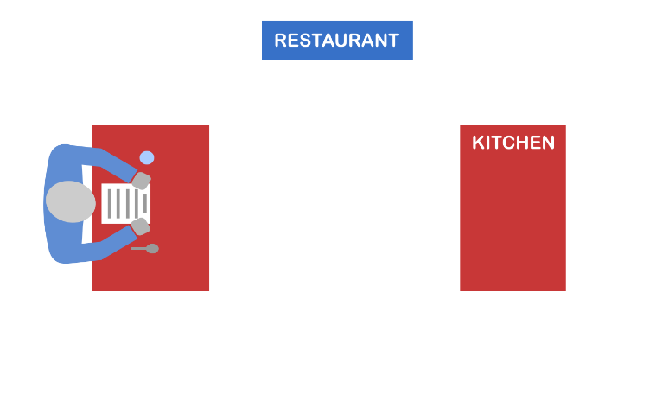
Imagine sitting at a table with a menu of choices to order from

Slide 5
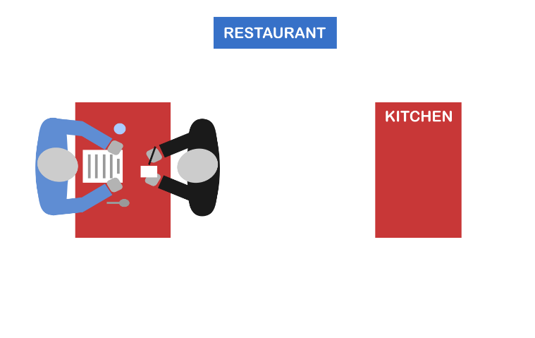
The waiter (API) takes your request or order

Slide 6
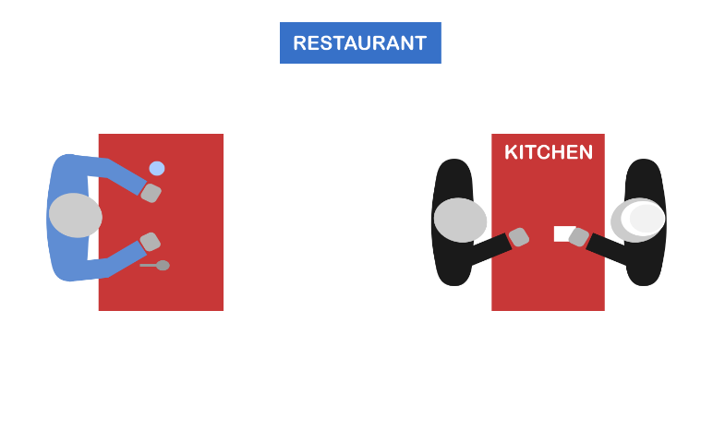
The waiter (API) tells the kitchen (system) what to do based on your order

Slide 7
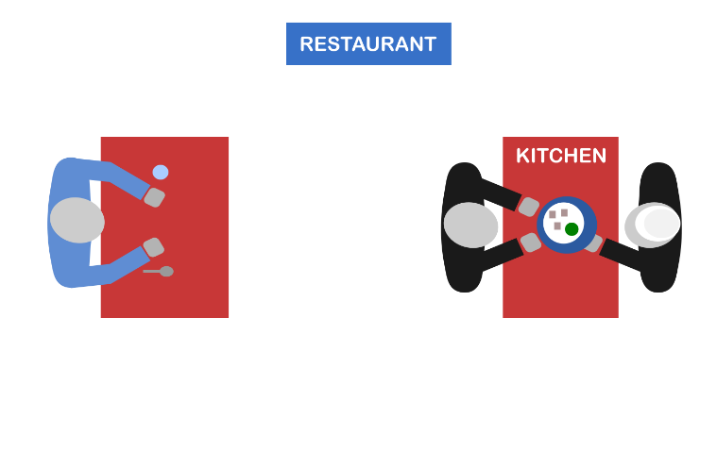
Kitchen (system) prepares the food (response) and hands it to the waiter (API)

Slide 8
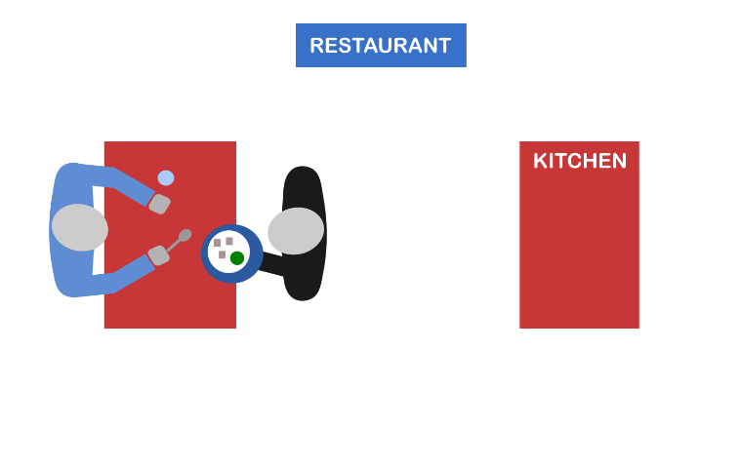
The waiter (API) delivers the food (response) back to your table

Slide 9
Scenario: Let’s look at how a state system can benefit from using API when modernizing

Slide 10
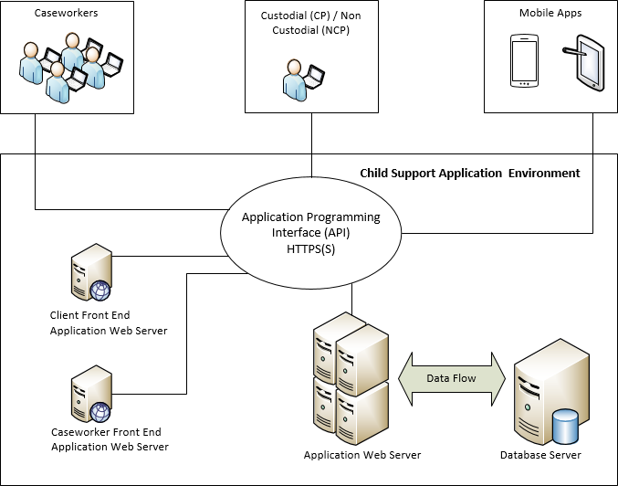
How a state system benefits from using API

Slide 11
Some Benefits From Using API
Unification of your development processes
More efficient collaboration
More consistent feature development
Reduction of the time to production
Easier and cost effective application integration with an enterprise wide system
Integrable during the refactoring of legacy code base, which makes it easy to extend, replace, or enhance

